Slide 1
“May the King Answer”
Notes:
.

Slide 2
“May the King answer”
“Ask and it will be given to you, seek and you will find, knock and it will be opened to you. For everyone who asks receives…” Mt. 7:7
“Now this is the confidence that we have in Him, that if we ask anything according to His will, He hears us. And if we know that He hears us, whatever we ask, we know that we have the petitions that we have asked of Him.” I Jn. 5:14-15

Slide 3
He will answer!
“The Lord is near to all who call upon Him, to all who call upon Him in truth. He will fulfill the desire of those who fear Him; He will also hear their cry and save them” Ps. 145:18-19
“If you abide in Me and My words abide in you, you will ask what you desire, and it shall be done for you” Jn. 15:7
“For the eyes of the Lord are on the righteous, and His ears are open to their prayers; but the face of the Lord is against those who do evil.” 1 Pt. 3:12

Slide 4
He will answer!
This Psalm is about trusting in the Lord, especially when there is trouble brewing! (:1) Who is there who does not encounter a day of trouble? (Ps. 50:15; Nahum 1:7)

Slide 5
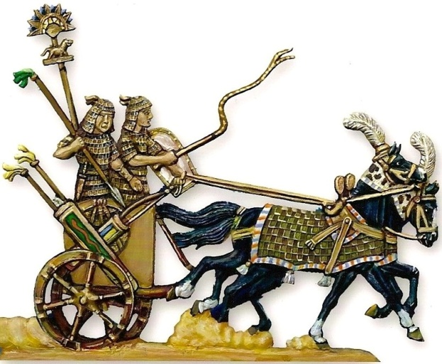
Some trust in chariots and some in horses
The Children of Israel struggled with trust issues (:7) (Judges 1:19; I Sam. 13:5; Is. 31:1-3)
People often have a false sense of security (Pr. 21:31; Ps. 33:16-17)

Slide 6
Some trust in chariots and some in horses
It is ok to employ the use of physical things but remember that victory belongs to the Lord (Deut. 8:11-14, 17-18)
Where is our place of refuge? Prov. 18:10

Slide 7
But we will remember the Name of the Lord
He will defend (:1)
Lit. “set you on high” above all this world’s inequity and iniquity
He will help (:2)
Ps. 121:1-2 “From whence comes my help?”
He will strengthen (:2)
Ps. 55:22 Cast your burden on the Lord He shall sustain you
He will remember (:3)
This is worth pausing for reflection (selah)
He will save (:6)
That is something to rejoice in (:5) and get excited about! (:9)

Slide 8
But we will remember the Name of the Lord
We will rejoice (:5)
We will set up our banners! (:5)
Strongs: “to flaunt” to raise a flag; fig. “to be conspicuous”
Let there be no doubt whose side we fight on! (Mk. 8:38; 2 Cor. 6:17)
We will have confidence and faith (:6)
The Lord saves His anointed! What blessed assurance!
We will notice a contrast (:8)
God is not impressed with chariots and horses but with the righteousness of man (Ps. 147:7-11)

Slide 9
Trusting God to Help
Requesting God’s help (:1-4)
Rejoicing in God’s help (:5)
Relying on God’s help (:6-9)
May the Lord answer…
…He will answer.

