Slide 1
Has life turned out differently than you thought it would at age 18?

Slide 2
Abel
Enoch
Noah
Abraham
Sarah
Isaac
Jacob
Joseph
Moses
Rahab
Gideon
Samson
Jephthah
David
Samuel
The Prophets

Slide 3
Don’t make “concrete” plans
The reality is you cannot live out every dream
Just ask the author of Ecclesiastes
Then I hated all my labor in which I had toiled under the sun, because I must leave it to the man who will come after me. (2:18)

Slide 4
Don’t make “concrete” plans
The reality is you cannot live out every dream
Have dreams but don’t set them in stone
Life doesn’t always go as planned
I returned and saw under the sun that—The race is not to the swift, Nor the battle to the strong, Nor bread to the wise, Nor riches to men of understanding, Nor favor to men of skill; But time and chance happen to them all (Eccl. 9:11)

Slide 5
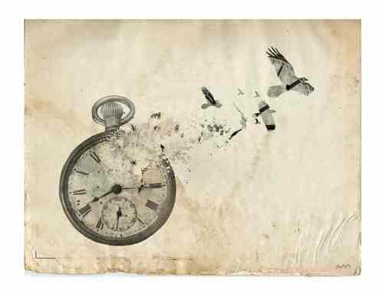
Come now, you who say, “Today or tomorrow ^{[a]}we will go to such and such a city, spend a year there, buy and sell, and make a profit”; whereas you do not know what will happen tomorrow. For what is your life? It is even a vapor that appears for a little time and then vanishes away. Instead you ought to say, “If the Lord wills, we shall live and do this or that.” But now you boast in your arrogance. All such boasting is evil.
James 4:13-16

Slide 6
Don’t make “concrete” plans
The reality is you cannot live out every dream
Have dreams but don’t set them in stone
Life doesn’t always go as planned
“Concrete” plans are made without God in mind

Slide 7
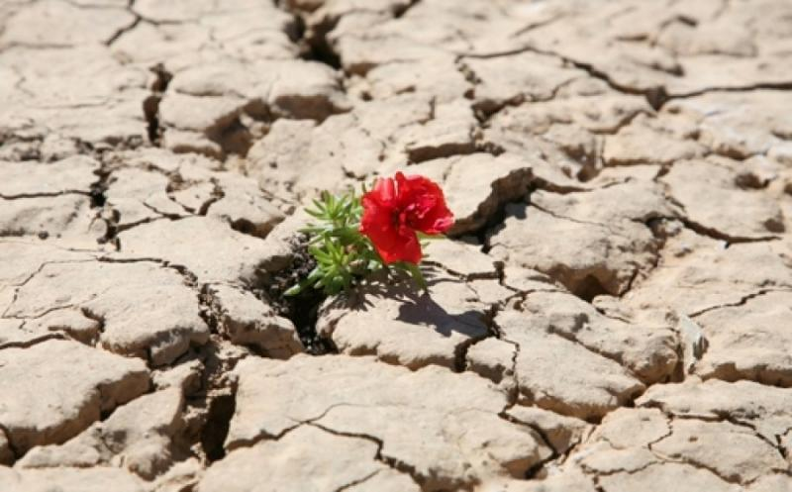
Bloom where you are planted
.

Slide 8
Consider Moses:
And when he went out the second day, behold, two Hebrew men were fighting, and he said to the one who did the wrong, “Why are you striking your companion?” Then he said, “Who made you a prince and a judge over us? Do you intend to kill me as you killed the Egyptian?” So Moses feared and said, “Surely this thing is known!” –Exodus 2:13-14
When Pharaoh heard of this matter, he sought to kill Moses. But Moses fled from
the face of Pharaoh and dwelt in the land of Midian. -Exodus 2:15

Slide 9
Consider Jeremiah:
Then the word of the Lord came to me, saying:
⁵ “Before I formed you in the womb I knew you; Before you were born I sanctified you; I ordained you a prophet to the nations.”
⁶ Then said I: “Ah, Lord God! Behold, I cannot speak, for I am a youth.”
⁷ But the Lord said to me: “Do not say, ‘I am a youth,’ For you shall go to all to whom I send you, And whatever I command you, you shall speak. ⁸ Do not be afraid of their faces, For I am with you to deliver you,” says the Lord. –Jer. 1:4-8

Slide 10
Consider Ruth:
She did not allow the “ought to” to take precedence over reality
No one knows where planting will occur-Use Your Opportunity!
No one knows with/without whom planting will occur-Use Your Opportunity!
Remove focus on self; place it on God and others
And may he be to you a restorer of life and a nourisher of your old age;
for your daughter-in-law, who loves you, who is better to you than seven sons,
has borne him.” –Ruth 4:15

Slide 11
Abel
Enoch
Noah
Abraham
Sarah
Isaac
Jacob
Joseph
Moses
Rahab
Gideon
Samson
Jephthah
David
Samuel
The Prophets

Slide 12
By Faith Abel
By Faith Enoch
By Faith Noah
By Faith Abraham
By Faith Sarah
By Faith Isaac
By Faith Jacob
By Faith Joseph
By Faith Moses
By Faith Rahab
By Faith Gideon
By Faith Samson
By Faith Jephthah
By Faith David
By Faith Samuel
By Faith The Prophets

Slide 13
Faith: Whenever, Wherever, However
A solid life begins and ends with solid faith
Now faith is the substance (assurance) of things hoped for, the evidence of things not seen. –Hebrews 11:1
Substance/Assurance: “To Hold the Title of a Possession”

Slide 14
.
For God!

