Slide 1
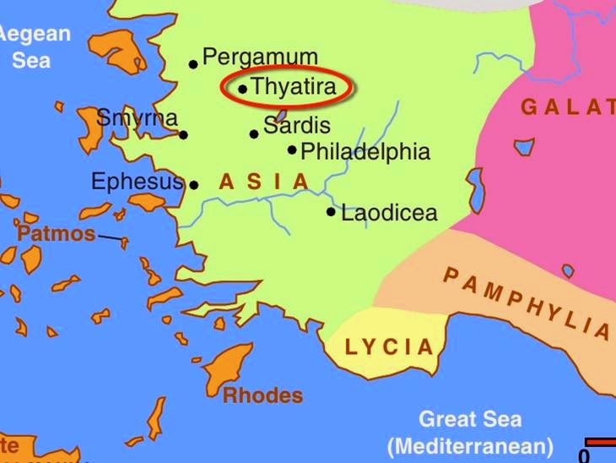
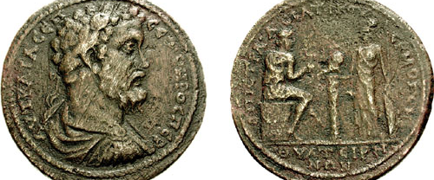
Thyatira

Slide 2
Thyatira:
The congregation had done some things very well:
“I know your works, love, service, faith, and your patience; and as for your works, the last are more than the first.”

Slide 3
Thyatira:
A problem with permissiveness
Tolerance has it’s rightful place
One of the Christian women had an extremely negative influence
“Jezebel”: manipulative, controlling, lying
Opportunity for repentence: rejected
Severe consequences (2 Chron. 7:14; Acts 3:19; Is. 55:17)
That said, however, there were some serious failures:
“Nevertheless…I have a few things against you..”

Slide 4
Thyatira:
Hold fast (krataioo) “seize, grasp”
Hold on tight! (Rev. 3:11, I Cor. 15:1-2)
Blessings of overcoming:
1) Power over the nations
2) The morning star (c.f. Rev. 22:16)
There were those who had not become involved in departing:
“to the rest in Thyatira, as many as do not have this doctrine, who have not known the depths of Satan”

