Slide 1
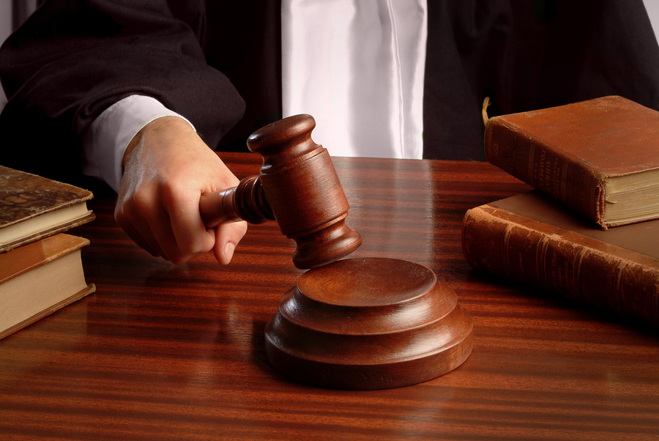
What about your conscience?

Slide 2
Conscience: “it is that Inner witness that testifies to the rightness or wrongness of our actions and on the basis of them pronounces a judgment about us as a person. An awareness inside of us that judges whether what we are doing is in harmony with what we believe to be right.”
The conscience bears important testimony
Rom. 9:1 “my conscience bearing me witness”
Acts 24:16 “strive to have a conscience…”
I Tim. 1:5 “a good conscience”

Slide 3
Listen to your alarm!
Rom. 14:23 Paul encourages faith prompted action…
However, (:3 etc.) Paul did not relegate or discount the role of conscience.
Paul did not encourage us to hit the snooze or turn down the volume!

Slide 4
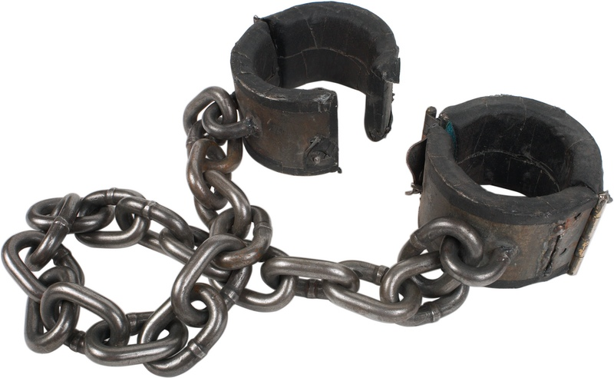
Who is leading who captive?
2 Corinthians 10:5
“…bringing every thought into captivity to the obedience of Christ”
Colossal failures in scripture often occurred because of feelings: i.e. Lot, Samson, Esau, David

Slide 5
Who is leading who captive?
When the feeling’s gone…
Do it anyway! (Luke 5:1-5) He said to Simon, “Launch out into the deep and let down your nets for a catch.”⁵ But Simon answered and said to Him, “Master, we have toiled all night and caught nothing; nevertheless at Your word I will let down the net.”

