Slide 2
Anthony Bourdain…he coped by self-medicating and behaving “in a completely irresponsible and suicide way.” He told Daily Life in a 2012 interview, “I didn’t value my own life and acted accordingly. I had put myself in a very dark place and behaved recklessly in the not-too-subconscious hope that something terrible would happen. I was doing everything possible—smoking pot incessantly, drinking and-driving etc—to invite that.”
“Do yourself no harm, for we are all here.” (Acts 16:28)

Slide 3
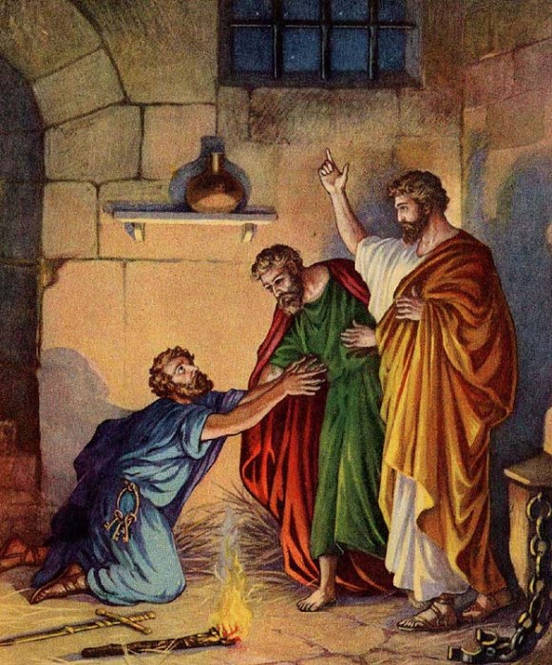
The Philippian Jailer
The jailer’s suppositions, assumptions, perceptions were wrong (Acts 16:27)
What brought about those suppositions was a chain of events that he was unaware of and was out of his control (Acts 16:6ff)
He listened to the right “voices” (Acts 16:28)
God often works through people
God used these circumstances for His glory (c.f. Ps. 147:3-5)

Slide 4
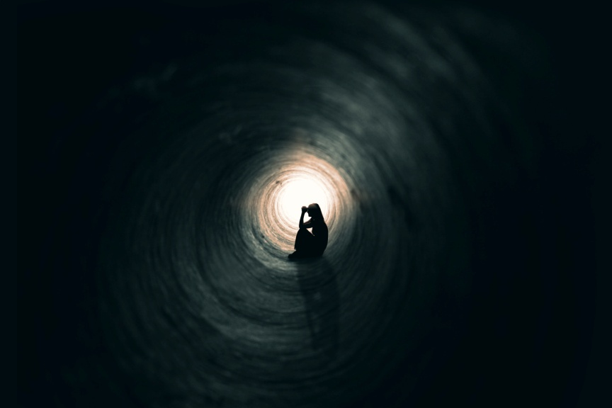
“Do yourself no harm”
When there is darkness and you can’t see (Acts 16:25,29)
When suddenly your world gets shaken up (:26)
When the very foundations are shaken (:26)
When it seems everyone has fled and you are alone (:27)
When all the signs seem to point the wrong direction (:27)

Slide 5
“Do yourself no harm”
Look for the right people (Acts 16:29-30)
Ask the right questions (:30)
Decide on the right course of action (:31-34)

