Slide 1
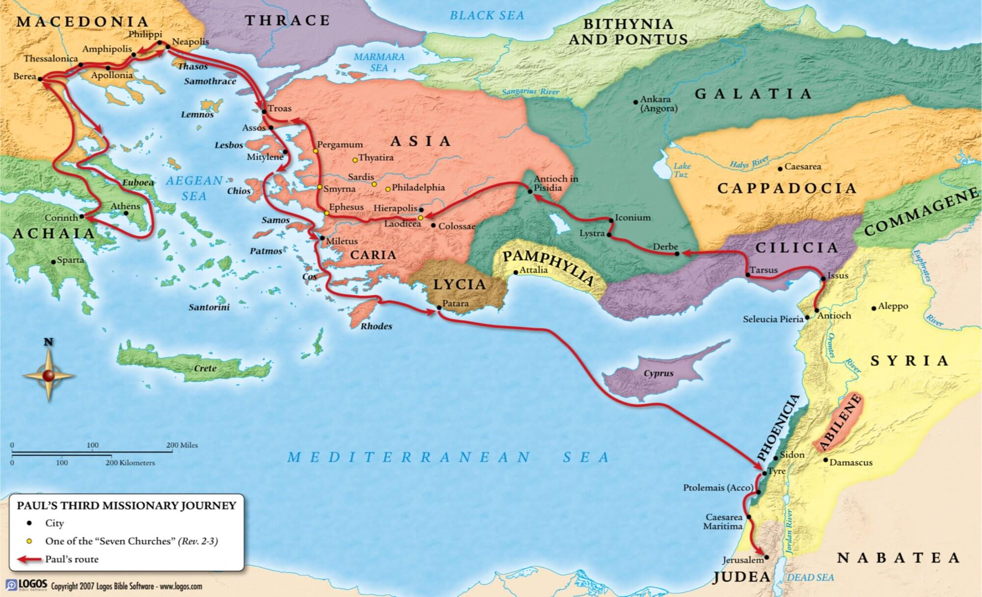
Paul’s 3rd Missionary Journey
Caesarea
Jerusalem

Slide 2
Acts 24:1-4
Now after five days Ananias the high priest came down with the elders and a certain orator named Tertullus. These gave evidence to the governor against Paul. ² And when he was called upon, Tertullus began his accusation, saying: “Seeing that through you we enjoy great peace, and prosperity is being brought to this nation by your foresight, ³ we accept it always and in all places, most noble Felix, with all thankfulness. ⁴ Nevertheless, not to be tedious to you any further, I beg you to hear, by your courtesy, a few words from us.

Slide 3
Acts 24:5-9
⁵ For we have found this man a plague, a creator of dissension among all the Jews throughout the world, and a ringleader of the sect of the Nazarenes. ⁶ He even tried to profane the temple, and we seized him, and wanted to judge him according to our law. ⁷ But the commander Lysias came by and with great violence took him out of our hands, ⁸ commanding his accusers to come to you. By examining him yourself you may ascertain all these things of which we accuse him.” ⁹ And the Jews also assented, maintaining that these things were so.

Slide 4
Acts 24:10-13
¹⁰ Then Paul, after the governor had nodded to him to speak, answered: “Inasmuch as I know that you have been for many years a judge of this nation, I do the more cheerfully answer for myself, ¹¹ because you may ascertain that it is no more than twelve days since I went up to Jerusalem to worship. ¹² And they neither found me in the temple disputing with anyone nor inciting the crowd, either in the synagogues or in the city. ¹³ Nor can they prove the things of which they now accuse me.

Slide 5
Acts 24:14-16
¹⁴ But this I confess to you, that according to the Way which they call a sect, so I worship the God of my fathers, believing all things which are written in the Law and in the Prophets. ¹⁵ I have hope in God, which they themselves also accept, that there will be a resurrection of the dead, both of the just and the unjust. ¹⁶ This being so, I myself always strive to have a conscience without offense toward God and men.

Slide 6
Paul’s Christian Defense
(Acts 24:14-16)
“I worship God” (vs 14)

Slide 7
Acts 24:14-16
¹⁴ But this I confess to you, that according to the Way which they call a sect, so I worship the God of my fathers, believing all things which are written in the Law and in the Prophets. ¹⁵ I have hope in God, which they themselves also accept, that there will be a resurrection of the dead, both of the just and the unjust. ¹⁶ This being so, I myself always strive to have a conscience without offense toward God and men.

Slide 8
Paul’s Christian Defense
(Acts 24:14-16)
“I worship God” (vs 14)
“I have hope in God” (vs 15)

Slide 9
Acts 24:14-16
¹⁴ But this I confess to you, that according to the Way which they call a sect, so I worship the God of my fathers, believing all things which are written in the Law and in the Prophets. ¹⁵ I have hope in God, which they themselves also accept, that there will be a resurrection of the dead, both of the just and the unjust. ¹⁶ This being so, I myself always strive to have a conscience without offense toward God and men.

Slide 10
1 Thessalonians 4:16-18
¹⁶ For the Lord Himself will descend from heaven with a shout, with the voice of an archangel, and with the trumpet of God. And the dead in Christ will rise first. ¹⁷ Then we who are alive and remain shall be caught up together with them in the clouds to meet the Lord in the air. And thus we shall always be with the Lord. ¹⁸ Therefore comfort one another with these words.

Slide 11
1 Corinthians 15:50-54
⁵⁰ Now this I say, brethren, that flesh and blood cannot inherit the kingdom of God; nor does corruption inherit incorruption. ⁵¹ Behold, I tell you a mystery: We shall not all sleep, but we shall all be changed— ⁵² in a moment, in the twinkling of an eye, at the last trumpet. For the trumpet will sound, and the dead will be raised incorruptible, and we shall be changed. ⁵³ For this corruptible must put on incorruption, and this mortal must put on immortality. ⁵⁴ So when this corruptible has put on incorruption, and this mortal has put on immortality, then shall be brought to pass the saying that is written: “Death is swallowed up in victory.”

Slide 12
2 Thessalonians 1:8-10
⁸ in flaming fire taking vengeance on those who do not know God, and on those who do not obey the gospel of our Lord Jesus Christ. ⁹ These shall be punished with everlasting destruction from the presence of the Lord and from the glory of His power, ¹⁰ when He comes, in that Day, to be glorified in His saints and to be admired among all those who believe, because our testimony among you was believed.

Slide 13
Paul’s Christian Defense
(Acts 24:14-16)
“I worship God” (vs 14)
“I have hope in God” (vs 15)
“I have a good conscience
toward God and man” (vs 16)

Slide 14
Acts 24:14-16
¹⁴ But this I confess to you, that according to the Way which they call a sect, so I worship the God of my fathers, believing all things which are written in the Law and in the Prophets. ¹⁵ I have hope in God, which they themselves also accept, that there will be a resurrection of the dead, both of the just and the unjust. ¹⁶ This being so, I myself always strive to have a conscience without offense toward God and men.

Slide 15
Acts 24:14-16
¹⁴ But this I confess to you, that according to the Way which they call a sect, so I worship the God of my fathers, believing all things which are written in the Law and in the Prophets. ¹⁵ I have hope in God, which they themselves also accept, that there will be a resurrection of the dead, both of the just and the unjust. ¹⁶ This being so, I myself always strive to have a conscience without offense toward God and men.

Slide 16
Paul’s Christian Defense
(Acts 24:14-16)
“I worship God” (vs 14)
“I have hope in God” (vs 15)
“I have a good conscience
toward God and man” (vs 16)

Slide 17
“My” Christian Defense
“Who am I?”
“I worship God according to
scripture”
“I have hope in God and
believe all of His promises”
“I strive to be blameless and
holy in everything I do”

