Slide 1
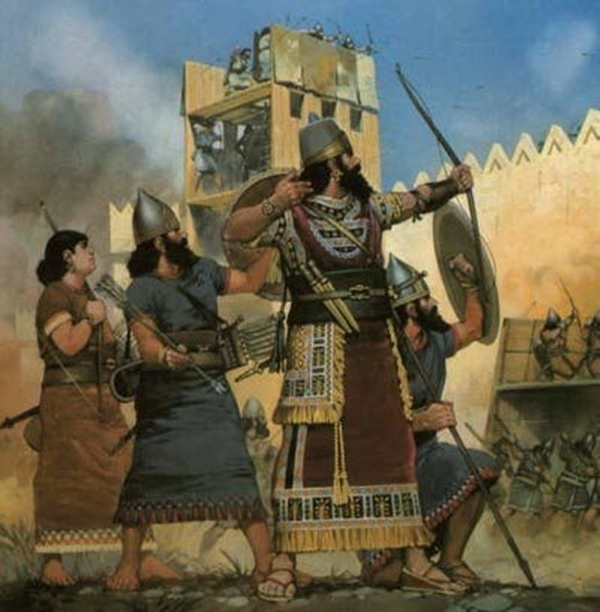
Remaining silent
2 Kings 7:1-15

Slide 2
A recognition of new circumstances!
“Why are we sitting here until we die?” (:3)
They go from famine to feasting
There is abundance on the “other side”
Do you remember your “day of good news”?
Then they said to one another, “We are not doing right. This day is a day of good news, and we remain silent. If we wait until morning light, some punishment will come upon us. Now therefore, come, let us go and tell the king’s household.” 2 Kings 7:9

Slide 3
A recognition of the need to communicate the blessings!
Think of the consequences if nothing is done:
People may perish
Failure to fulfill one’s responsibility
God is not pleased
Then they said to one another, “We are not doing right. This day is a day of good news, and we remain silent. If we wait until morning light, some punishment will come upon us. Now therefore, come, let us go and tell the king’s household.” 2 Kings 7:9

Slide 4
A recognition of the need to communicate the blessings!
Why do we often fail to?
Neglect? (2 Pt. 1:8-9)
A fear of the unknown? (2 Tim. 1:7-8; Acts 7:29)
By over complicating things? (I Cor. 15:1-4)
Failure to overcome worldly tendencies?
Then they said to one another, “We are not doing right. This day is a day of good news, and we remain silent. If we wait until morning light, some punishment will come upon us. Now therefore, come, let us go and tell the king’s household.” 2 Kings 7:9

Slide 5
Recognition of a need to act differently!
There is a conclusion to be reached:
“therefore”
There is action to be taken:
“therefore, come, let us go”
There is an urgency to be felt:
“therefore, come, let us go and tell”
Then they said to one another, “We are not doing right. This day is a day of good news, and we remain silent. If we wait until morning light, some punishment will come upon us. Now therefore, come, let us go and tell the king’s household.” 2 Kings 7:9

