Slide 1
Watching for Morning
Psalm 130:6

Slide 2
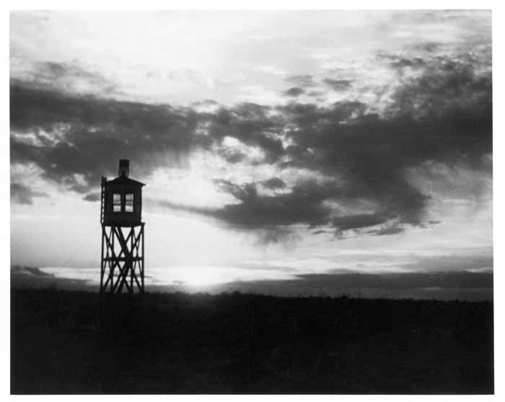
Psalm 130
¹ Out of the depths I have cried
to You, O Lord;
² Lord, hear my voice!
Let Your ears be attentive
To the voice of my supplications.
³ If You, Lord, should mark iniquities,
O Lord, who could stand?
⁴ But there is forgiveness with You,
That You may be feared.
⁵ I wait for the Lord, my soul waits, And in His word I do hope.
⁶ My soul waits for the Lord more than those who watch for the morning—
Yes, more than those who watch for the morning.
⁷ O Israel, hope in the Lord; For with the Lord there is mercy,
And with Him is abundant redemption.
⁸ And He shall redeem Israel from all his iniquities.

Slide 3
Psalm 130:6
NKJV: My soul waits for the Lord more than those who watch for the morning—
Yes, more than those who watch for the morning.
NASB: My soul waits for the Lord
More than the watchmen for the morning;
Indeed, more than the watchmen for the morning.
NLT: I long for the Lord
more than sentries long for the dawn,
yes, more than sentries long for the dawn.

Slide 4
“More than sentries long for the dawn”
The job is easier when in the light.
The enemy attacks more frequently in darkness.
The shift is over in the morning!
Notes:
It is easier to do the job when in the light. A watchman longs for light so that he might see, I can just imagine the feeling of the sentry as he sun begins to peek over the horizon and the world comes into view. To hear the sound of the birds chirping in the trees and the rooster crowing and seeing the dew on the ground. But he is not so much excited for that because of nostalgia but b/c it means that the enemy has not come. His job is to advise of danger (like the watchman of Ezekiel 33). At night the senses are on full alert and one of the senses is greatly incapacitated. As morning comes the environment changes, the change of circumstance makes life easier on him. Longing for the Lord is somewhat like that because when you are in the light life is easier, when the light of the world is directing your steps and aiding your vision life has so much more clarity. When the light of His revelation has come into your life and His will is known and Jesus is directing the course-the way is easier. When the light of the world has come over the horizon of your life and you can see-all fear is gone. The way of the transgressor is hard ( ). But when decisions of life are made in the light, life is easier. Job, marriage, recreation, money matters, friends-all of those matters are easier. You can see your way in life, the direction of life, how to best care for your family
Enemy attacks are more frequent at nighttime. In that culture and I suppose in most any culture the enemy is more apt to attack at low visibility. The thief steals at night, the wicked come out at night.
The shift is over in the morning. When morning comes you go off duty. I used to work the night shift at a cabinet mfg. co. and worked in the back near some big bay doors, ran a scmi saw all night long-pretty tough work. Remember in summer time having those big doors open at night and knowing my shift was over when the light came through. How I longed for that light, to go home, to see my family, to rest. My work had ended. For the sentry how sweet would be the morning. The danger had ended, the possibility for harm ceased. For many it may seem like there is no better time than right now. Small kids without a care in the world, newly married couple yet to even have a fight. Things going your way-relationships, job, etc. But there comes difficulty, pains, repairs, losses. We experience pain and difficulty in this life but with a view to morning. A time when we can clock out. Life may be good in the here and now, but it doesn’t compare with that to come. Heb. 4:1 “therefore since a promise remains of entering His rest, let us fear lest any of you seem to have come short of it.” Do not check out early-don’t come short of the reward.

