Slide 2
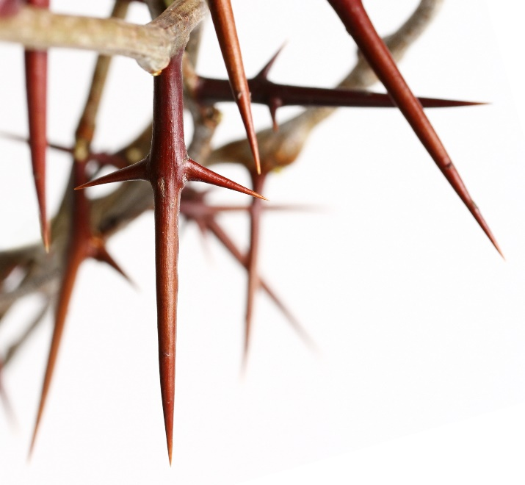
Thorns
Thorns of Creation (Gen. 3:17-19)
Thorns of Canaan (Josh. 23:13)
Thorns of Christianity (2 Cor. 12:7-10)
Thorns of Christ (Mt. 27:29-30)

Slide 3
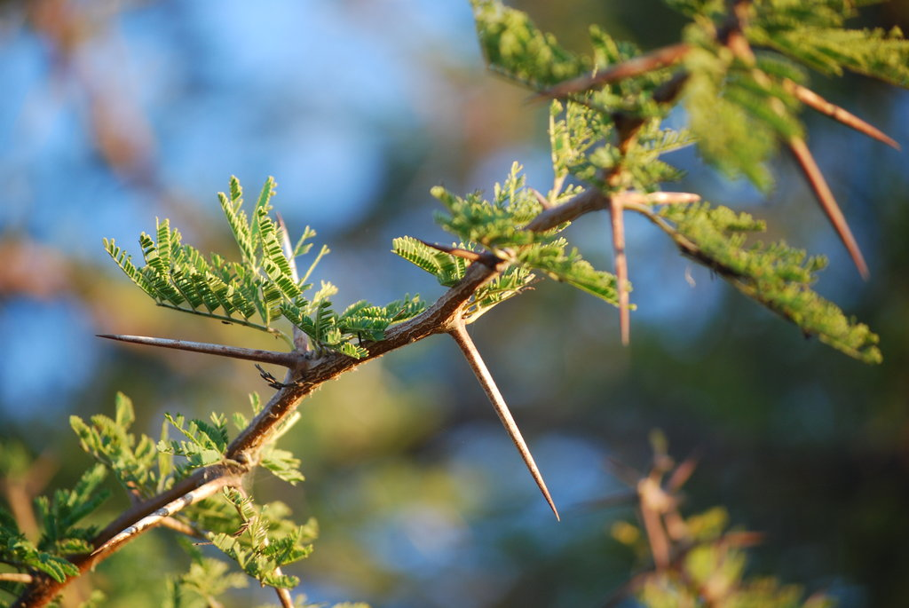
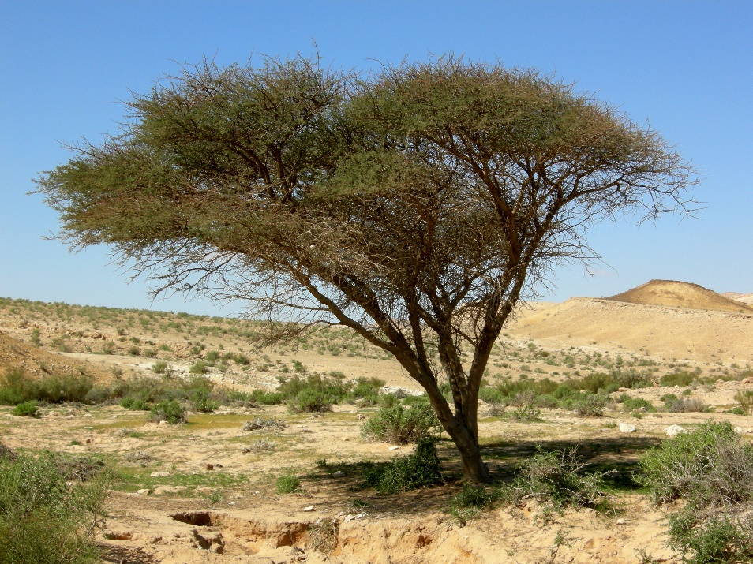
Acacia (“thorny”) Wood
Ark of the Covenant (Exodus 25:10)
Tabernacle Courtyard (Exodus 26:15)
Bronze Altar (Exodus 27:1)
Altar of Incense (Exodus 30:1)

Slide 4
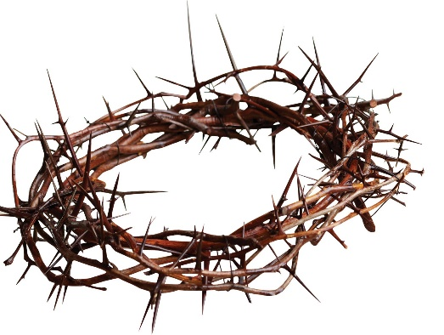
John 19:1-5
So then Pilate took Jesus and scourged Him. ² And the soldiers twisted a crown of thorns and put it on His head, and they put on Him a purple robe. ³ Then they said, “Hail, King of the Jews!” And they struck Him with their hands.
⁴ Pilate then went out again, and said to them, “Behold, I am bringing Him out to you, that you may know that I find no fault in Him.”
⁵ Then Jesus came out, wearing the crown of thorns and the purple robe. And Pilate said to them, “Behold the Man!”

Slide 5
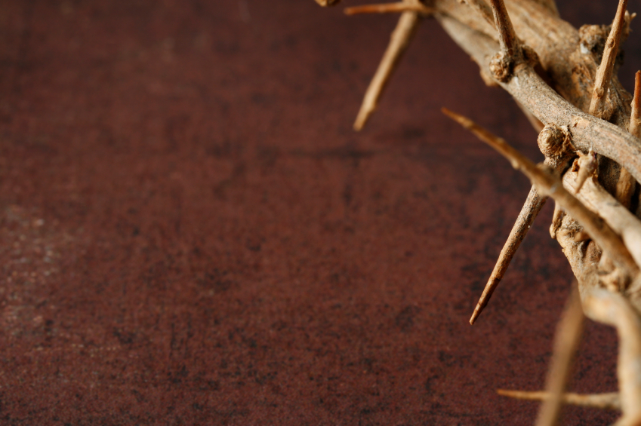
^{Hebrews 6:4-8}
⁴ For it is impossible for those who were once enlightened, and have tasted the heavenly gift, and have become partakers of the Holy Spirit, ⁵ and have tasted the good word of God and the powers of the age to come, ⁶ if they fall away, to renew them again to repentance, since they crucify again for themselves the Son of God, and put Him to an open shame…

Slide 6
^{Hebrews 6:4-8}
⁷ For the earth which drinks in the rain that often comes upon it, and bears herbs useful for those by whom it is cultivated, receives blessing from God; ⁸ but if it bears thorns and briers, it is rejected and near to being cursed, whose end is to be burned.

Slide 7
Revelation 22:1-3
And he showed me a pure river of water of life, clear as crystal, proceeding from the throne of God and of the Lamb. ² In the middle of its street, and on either side of the river, was the tree of life, which bore twelve fruits, each tree yielding its fruit every month. The leaves of the tree were for the healing of the nations. ³ And there shall be no more curse, but the throne of God and of the Lamb shall be in it, and His servants shall serve Him

