Slide 1
^{Acts 8:4-13}
⁴ Therefore those who were scattered went everywhere preaching the word. ⁵ Then Philip went down to the city of Samaria and preached Christ to them. ⁶ And the multitudes with one accord heeded the things spoken by Philip, hearing and seeing the miracles which he did. ⁷ For unclean spirits, crying with a loud voice, came out of many who were possessed; and many who were paralyzed and lame were healed. ⁸ And there was great joy in that city.

Slide 2
^{Acts 8:4-13}
⁹ But there was a certain man called Simon, who previously practiced sorcery in the city and astonished the people of Samaria, claiming that he was someone great, ¹⁰ to whom they all gave heed, from the least to the greatest, saying, “This man is the great power of God.” ¹¹ And they heeded him because he had astonished them with his sorceries for a long time. ¹² But when they believed Philip as he preached the things concerning the kingdom of God and the name of Jesus Christ, both men and women were baptized. ¹³ Then Simon himself also believed; and when he was baptized he continued with Philip, and was amazed, seeing the miracles and signs which were done.

Slide 3
The Samaritans
Mixed origin (II Kings 17:24-29)
Limited contact (John 4:9-10)
Samaria

Slide 4
How can we determine truth?
Claims of Preachers? (Acts 8:9)
Simon was claiming that he was “someone great”
Some make great claims and create a following by presumption of authority
An Old Testament example: (I Kings 13:4-10; 15-18)

Slide 5
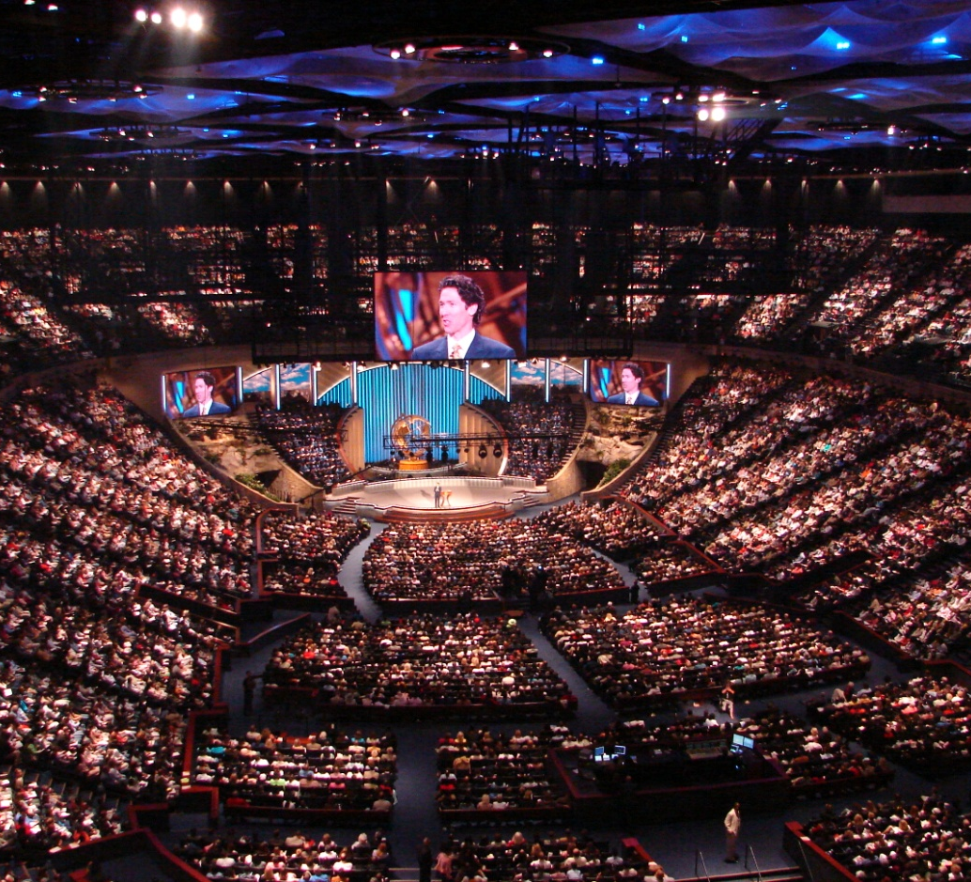
How can we determine truth?
Quantity of Believers? (Acts 8:10)
Here “they ALL gave heed”
Consider the time of Noah (ratio of 8:1,000,000 ?)
Do not “follow a crowd” (Ex. 23:2)
Majority rules? Mt. 7:13-14

Slide 6
How can we determine truth?
Social status of followers? (Acts 8:10)
They all gave heed from the “least to the greatest”
Does “might make right” in religious matters? (I Cor. 1:26-29)
A “Pharisaical” attitude (Jn. 7:45-48)

Slide 7
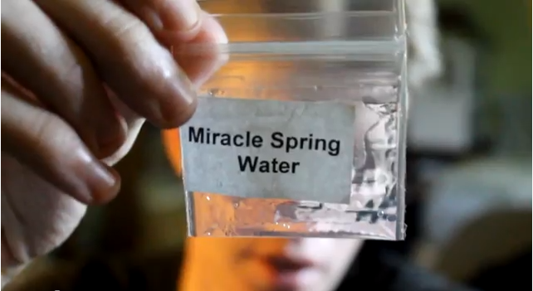
How can we determine truth?
The “signs” pointing to “success”? (Acts 8:9)
This man had done some amazing things
Belief must not be merely based on the “signs” (Deut. 13:1-4)
Careful what we base faith on (Rev. 13:11)
Caution lest we be deceived (2 Th. 2:9)

Slide 8
How can we determine truth?
Amount of time practicing (Acts 8:11)?
They had heeded him “a long time”
“If it was good enough for them it is good enough for me” (c.f. Mt. 15:2-3)

Slide 9
How can we determine truth?
Sincerity of the adherents? (Acts 8:9-11)
Were these Samarians just a bunch of hypocrites?
Paul was sincerely wrong (Acts 23:1; 26:9-10)
Cornelius was a sincerely religious person (Acts 10:2)

Slide 10
How can we determine truth?
Claims of Preachers? (Acts 8:9)
Quantity of Believers? (Acts 8:10)
Social status of followers? (Acts 8:10)
The “signs” pointing to “success”? (Acts 8:9)
Amount of time practicing? (Acts 8:11)
The sincerity of the adherents? (Acts 8:9-11)

Slide 11
How can we determine truth?
That Christ is preached
That the kingdom of God is preached
That the name of Christ is preached
That obedience to His word is preached

