Slide 1
The Kingdom of God belongs to such as these…
These are little children
Paidion – “an infant or half-grown boy or girl”
Little or no rights in Jewish society
Father’s had little to do with children until 12
Jesus attitude much different than Disciples’
Disciples were rebuking the parents
Jesus was indignant (extreme displeasure)
There is value in bringing children to Jesus

Slide 2
The Kingdom of God belongs to such as these…
The kingdom of God belongs to such as these
Not a command to baptize infants!
The children are the model for attitude and behavior
“Whoever does not receive the kingdom of God like a child will not enter it at all.”
Not child-ish
I Cor. 14:20 – “Do not be children in your thinking…”
Eph. 4:14 – “No longer children…carried about by every wind of doctrine…”
But child-like!

Slide 3
The Kingdom of God belongs to such as these…
At that time the disciples came to Jesus and said, “Who then is greatest in the kingdom of heaven?” ² And He called a child to Himself and set him before them, ³ and said, “Truly I say to you, unless you are converted and become like children, you will not enter the kingdom of heaven. ⁴ Whoever then humbles himself as this child, he is the greatest in the kingdom of heaven. ⁵ And whoever receives one such child in My name receives Me.
- Matthew 18:1-5

Slide 4
The Kingdom of God belongs to such as these…
Humility is the primary characteristic of a child that God requires of us!
Humility
The proper estimation of one’s self
Not thinking too highly of self
Not thinking too lowly of self
How is humility manifest in little children?

Slide 5
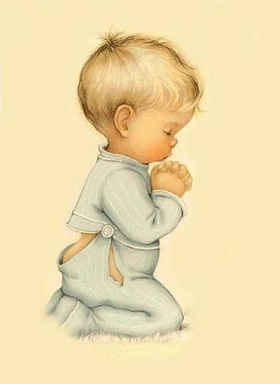
Dear GOD,
Maybe Cain and Abel would not kill each so much if they had their own rooms. It works with my brother
- Larry
Dear GOD,
I want to be just like my
Daddy when I get big but not with so much hair all over.
- Sam
Dear GOD,
If you watch in church on Sunday I will show you my new shoes.
- Mickey D.

Slide 6
The Kingdom of God belongs to such as these…
Children come to relationships with nothing to offer but themselves.
Dear GOD,
I think about you sometimes even when I’m not praying
- Elliott
Children are absolutely and completely dependent upon others
What do I have to bring to my relationship to God but a broken spirit? – Matt. 5:3
“Here,” says He, “is the one excellence on which My kingdom is founded, and by which alone it can be extended – the excellence of not knowing you have any excellence at all.”
(Marcus Dods – 19th Century theologian)

Slide 7
The Kingdom of God belongs to such as these…
Children have absolute and complete trust
Dear GOD,
I keep waiting for Spring but it never come yet. Don’t forget.
- Mark
Phil. 4:13 “I can do ALL things through Christ who strengthens me.”
Romans 8:35-37 – “But in all these things we overwhelmingly conquer through Him who loved us.”

Slide 8
The Kingdom of God belongs to such as these…
Children are completely teachable/moldable
Dear GOD,
Did you mean for the
giraffe to look like that
or was it an accident?
- Norma
Marcus Dods
“The child hears of the world and its wonders with a reverential awe. As we grow older we clothe ourselves in skepticism, and guard ourselves against deception, till, as the climax of wisdom and safety, we believe nothing, and are like the heavy-mailed knights of old, stifled in our own armor. We train our spirits to believe in nothing but the most obvious commonplace physical things, which by their own nature are destined to decay. And the end is, we cannot, if we would, believe in the most tremendous realities.”
Hebrews 11:6

Slide 9
The Kingdom of God belongs to such as these…
Children abound in innocence and honesty
Dear GOD,
I do not think anybody could be a better God. Well I just want you to know but I am not just saying that because you are God.
- Charles
Children are perpetually happy!
Children bring nothing but themselves, and are completely cared for and loved
Children can live without fear because they trust totally and completely
Children believe what they are taught and are happy to share it with others.

