Slide 1
The Compassion of Jesus
Isaiah 42:1-4
“Behold, My Servant, whom I uphold; My chosen one in whom My soul delights. I have put My Spirit upon Him; He will bring forth justice to the nations. ² “He will not cry out or raise His voice, Nor make His voice heard in the street. ³ “A bruised reed He will not break And a dimly burning wick He will not extinguish; He will faithfully bring forth justice. ⁴ “He will not be disheartened or crushed Until He has established justice in the earth; And the coastlands will wait expectantly for His law.”

Slide 2
The Compassion of Jesus
Isaiah 42:1-4

Slide 3
The Compassion of Jesus
Isaiah 42:1-4
“Behold, My Servant, whom I uphold; My chosen one in whom My soul delights. I have put My Spirit upon Him; He will bring forth justice to the nations. ² “He will not cry out or raise His voice, Nor make His voice heard in the street. ³ “A bruised reed He will not break And a dimly burning wick He will not extinguish; He will faithfully bring forth justice. ⁴ “He will not be disheartened or crushed Until He has established justice in the earth; And the coastlands will wait expectantly for His law.”

Slide 4
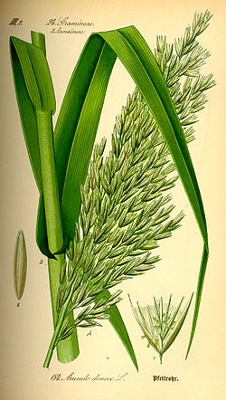
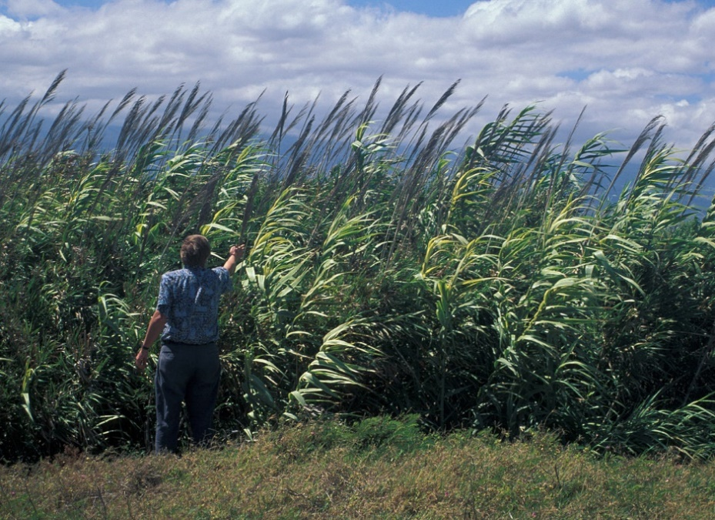
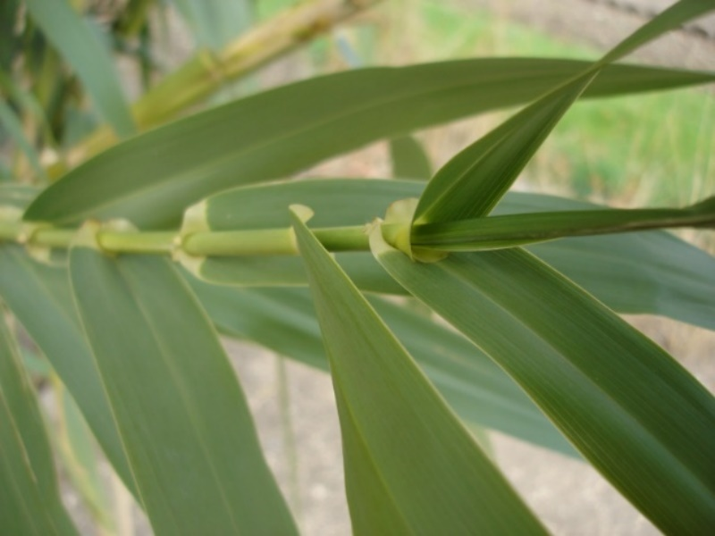
The Compassion of Jesus
Isaiah 42:1-4
“A bruised reed He will not break…”
Strength That is Lost
Can No Longer Support Itself
No apparent way to be healed

Slide 5
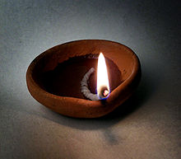
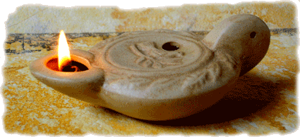
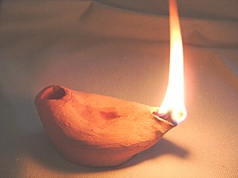
The Compassion of Jesus
Isaiah 42:1-4
“A dimly burning wick He will not extinguish…”
Strength of light lost
Fuel is running low or is gone
Only remedy is to replace the wick

Slide 6
The Compassion of Jesus
Isaiah 42:1-4
¹⁵ But Jesus, aware of this, withdrew from there. Many followed Him, and He healed them all, ¹⁶ and warned them not to tell who He was. ¹⁷ This was to fulfill what was spoken through Isaiah the prophet:
¹⁸ “Behold, My Servant whom I have chosen; My Beloved in whom My soul is well-pleased; I will put My Spirit upon Him, And He shall proclaim justice to the Gentiles. ¹⁹ “He will not quarrel, nor cry out; Nor will anyone hear His voice in the streets. ²⁰ “A battered reed He will not break off, And a smoldering wick He will not put out, Until He leads justice to victory. ²¹ “And in His name the Gentiles will hope.”

Slide 7
The Compassion of Jesus
Isaiah 42:1-4
Matthew 9:35-38
³⁵ Jesus was going through all the cities and villages, teaching in their synagogues and proclaiming the gospel of the kingdom, and healing every kind of disease and every kind of sickness.
³⁶ Seeing the people, He felt compassion for them, because they were distressed and dispirited like sheep without a shepherd. ³⁷ Then He said to His disciples, “The harvest is plentiful, but the workers are few. ³⁸ Therefore beseech the Lord of the harvest to send out workers into His harvest.”
Distressed – idea is “to faint”
Dispirited – “thrown about, scattered”
Sheep without a shepherd
10:1 – Jesus gave them the tools to be workers!!

Slide 8
The Compassion of Jesus
Isaiah 42:1-4
Luke 19:41-44
⁴¹ When He approached Jerusalem, He saw the city and wept over it, ⁴² saying, “If you had known in this day, even you, the things which make for peace! But now they have been hidden from your eyes. ⁴³ For the days will come upon you when your enemies will throw up a barricade against you, and surround you and hem you in on every side, ⁴⁴ and they will level you to the ground and your children within you, and they will not leave in you one stone upon another, because you did not recognize the time of your visitation.”

Slide 9
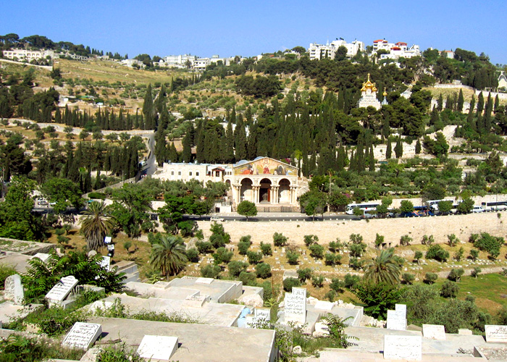
The Compassion of Jesus
Isaiah 42:1-4

Slide 10
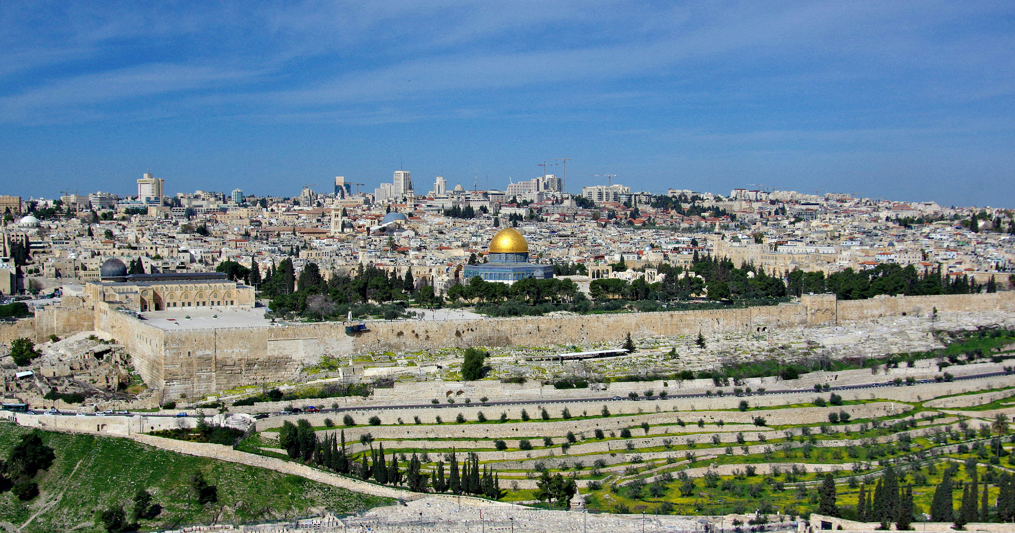
The Compassion of Jesus
Isaiah 42:1-4
Jesus wept when He saw this!!

Slide 11
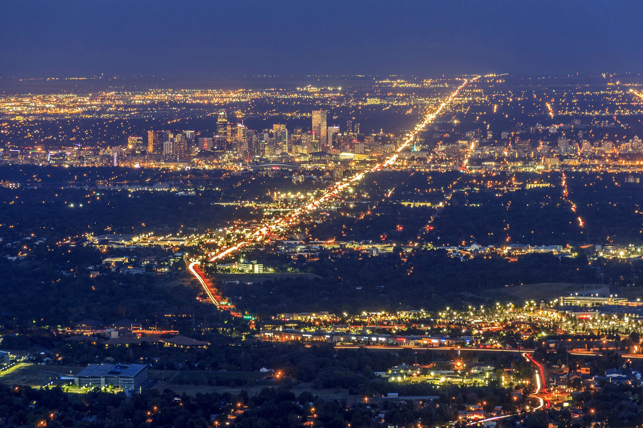
The Compassion of Jesus
Isaiah 42:1-4
Does this cause us to weep too??

Slide 12
The Compassion of Jesus
Isaiah 42:1-4
Out of His compassion came action - Luke 19:45-46
⁴⁵ Jesus entered the temple and began to drive out those who were selling, ⁴⁶ saying to them, “It is written, ‘And My house shall be a house of prayer,’ but you have made it a robbers’ den.”
Second time He has done this (John 2 was the first)
His compassion drove Him to righteous anger
His compassion drove Him to action

Slide 13
The Compassion of Jesus
Isaiah 42:1-4
A bruised reed and a dimly burning wick
People without God or who have lost God are hurting and are in danger!
Sometimes we cannot see the solution
We cannot fix a bruised reed
We cannot always stoke a dimly burning wick
Jesus is the one who heals
Jesus is the Shepherd
Demonstrate an attitude of compassion…
…and point them to Jesus!

