Slide 1
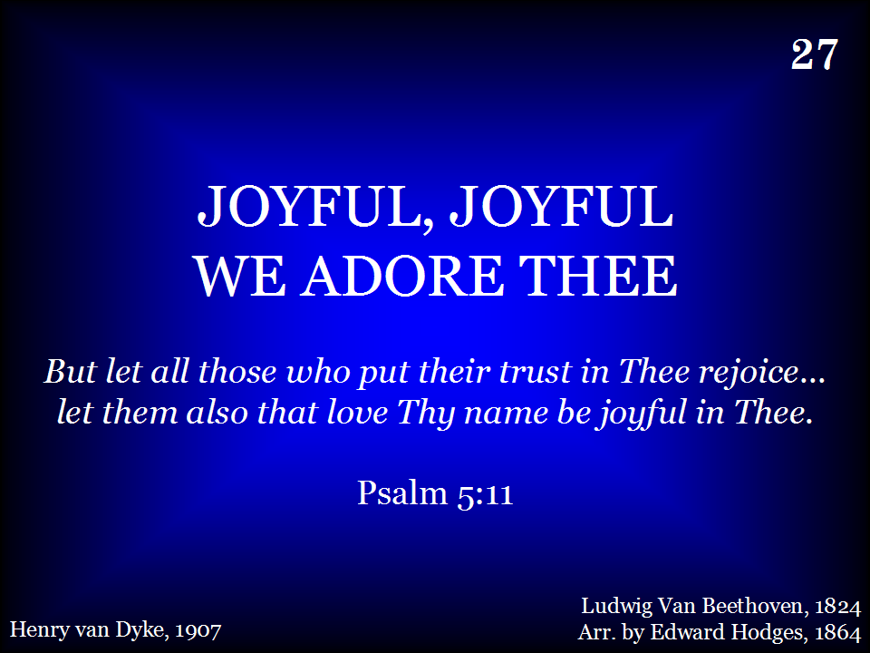
027 - Joyful, Joyful We Adore Thee - Title

Slide 2
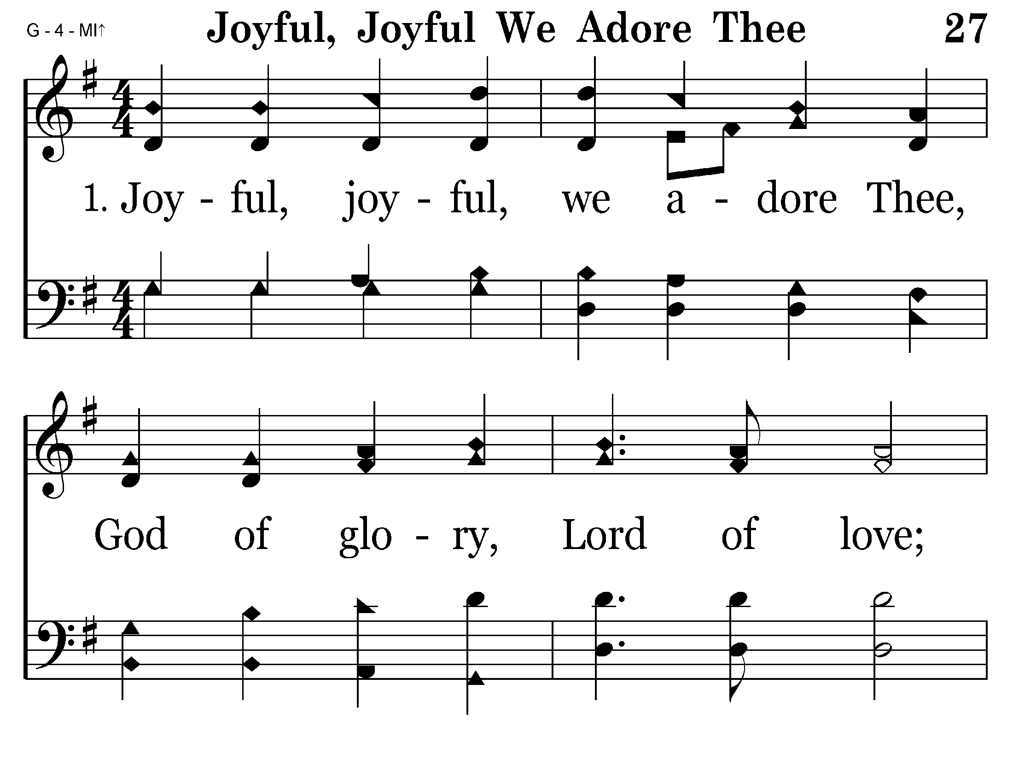
027 - Joyful, Joyful We Adore Thee - 1.1

Slide 3
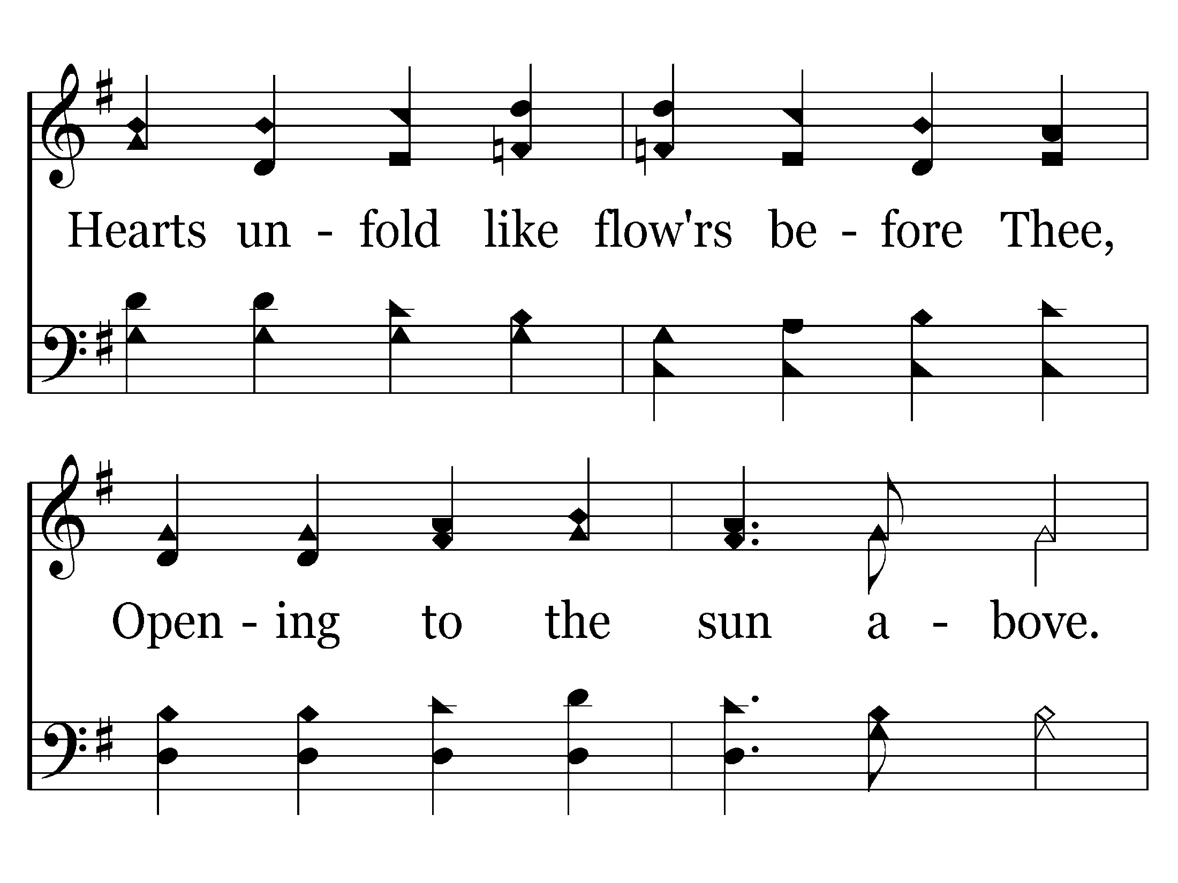
027 - Joyful, Joyful We Adore Thee - 1.2

Slide 4
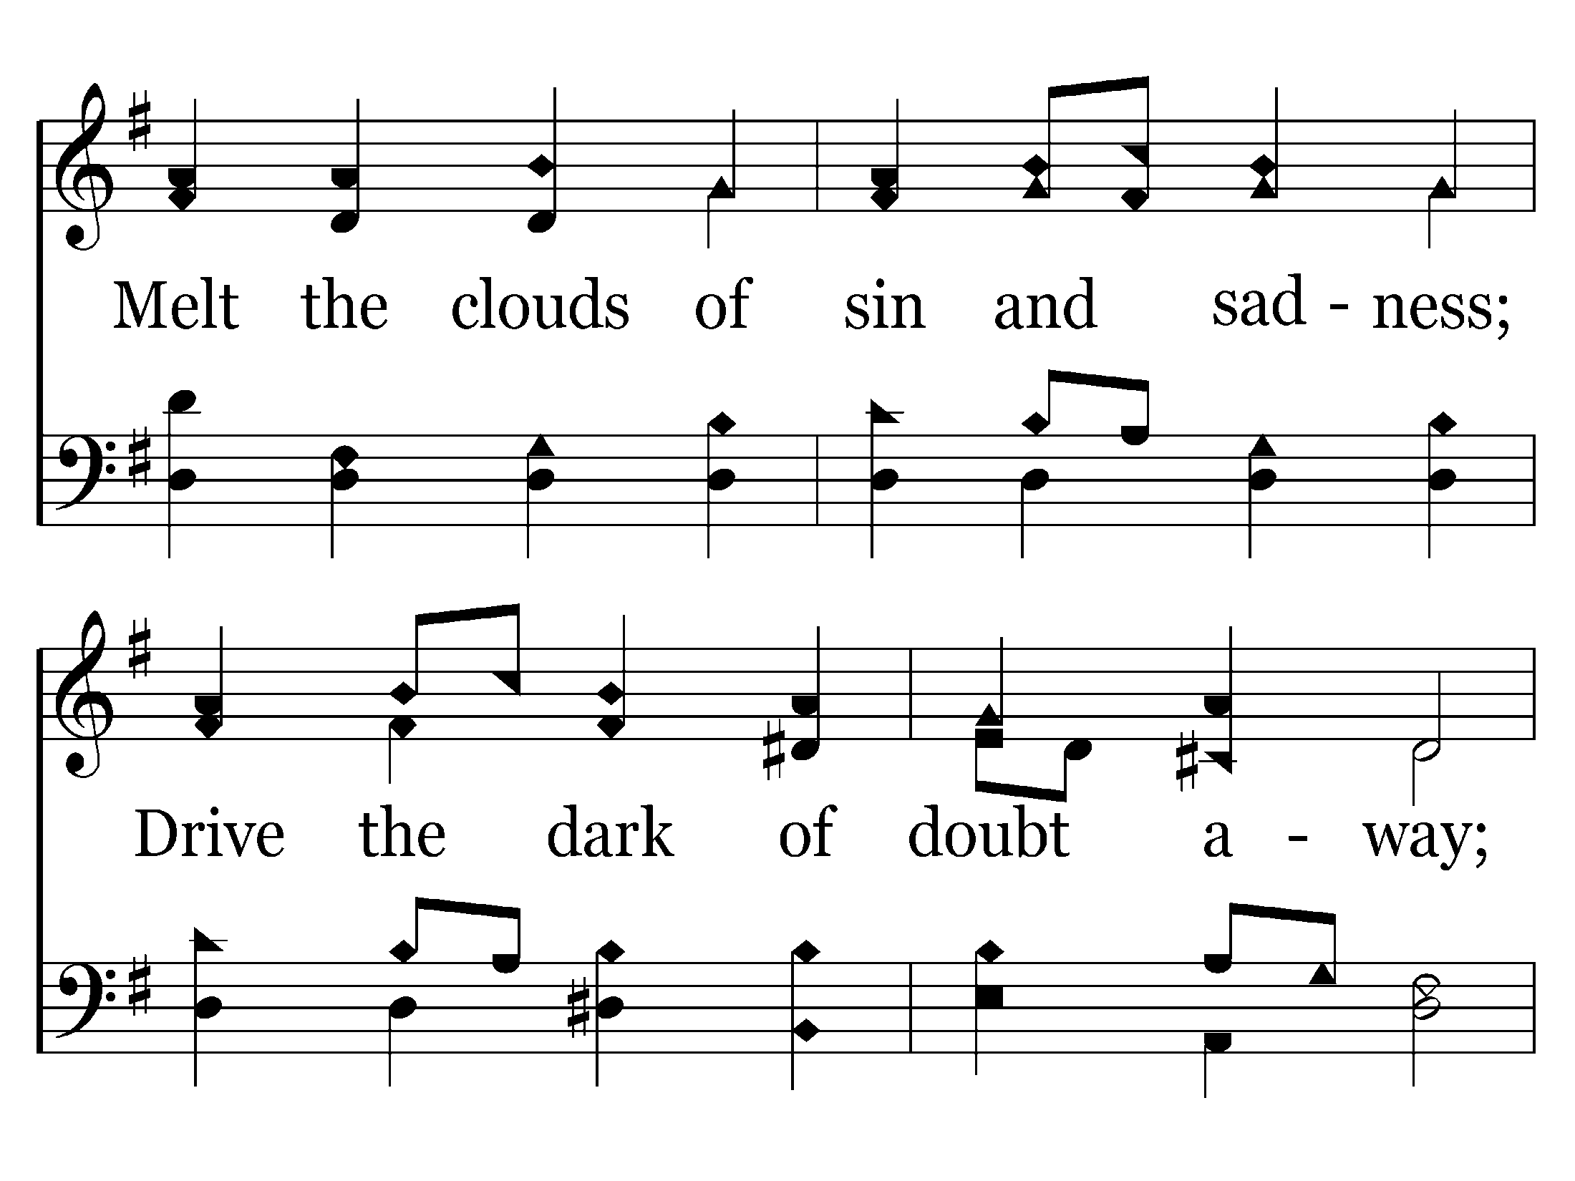
027 - Joyful, Joyful We Adore Thee - 1.3

Slide 5
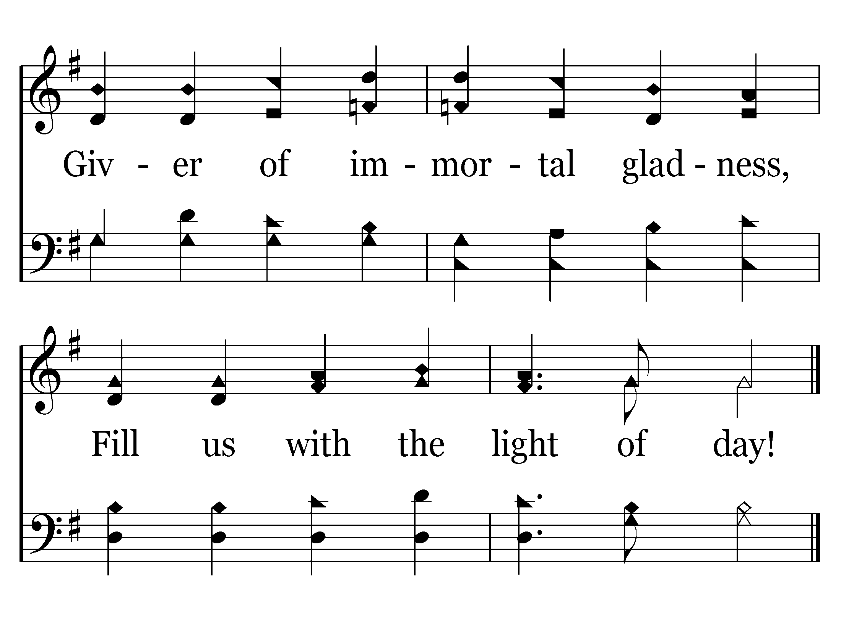
027 - Joyful, Joyful We Adore Thee - 1.4
End of Verse 1

Slide 6
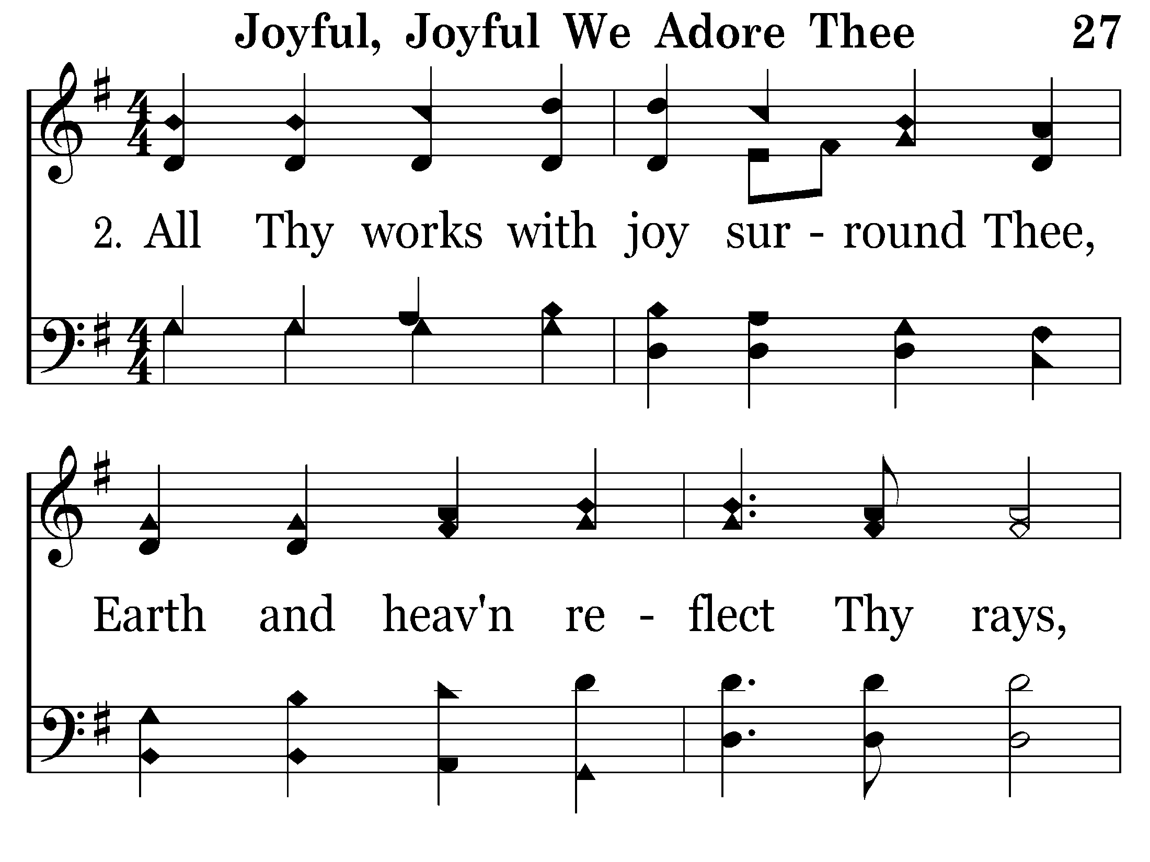
027 - Joyful, Joyful We Adore Thee - 2.1

Slide 7
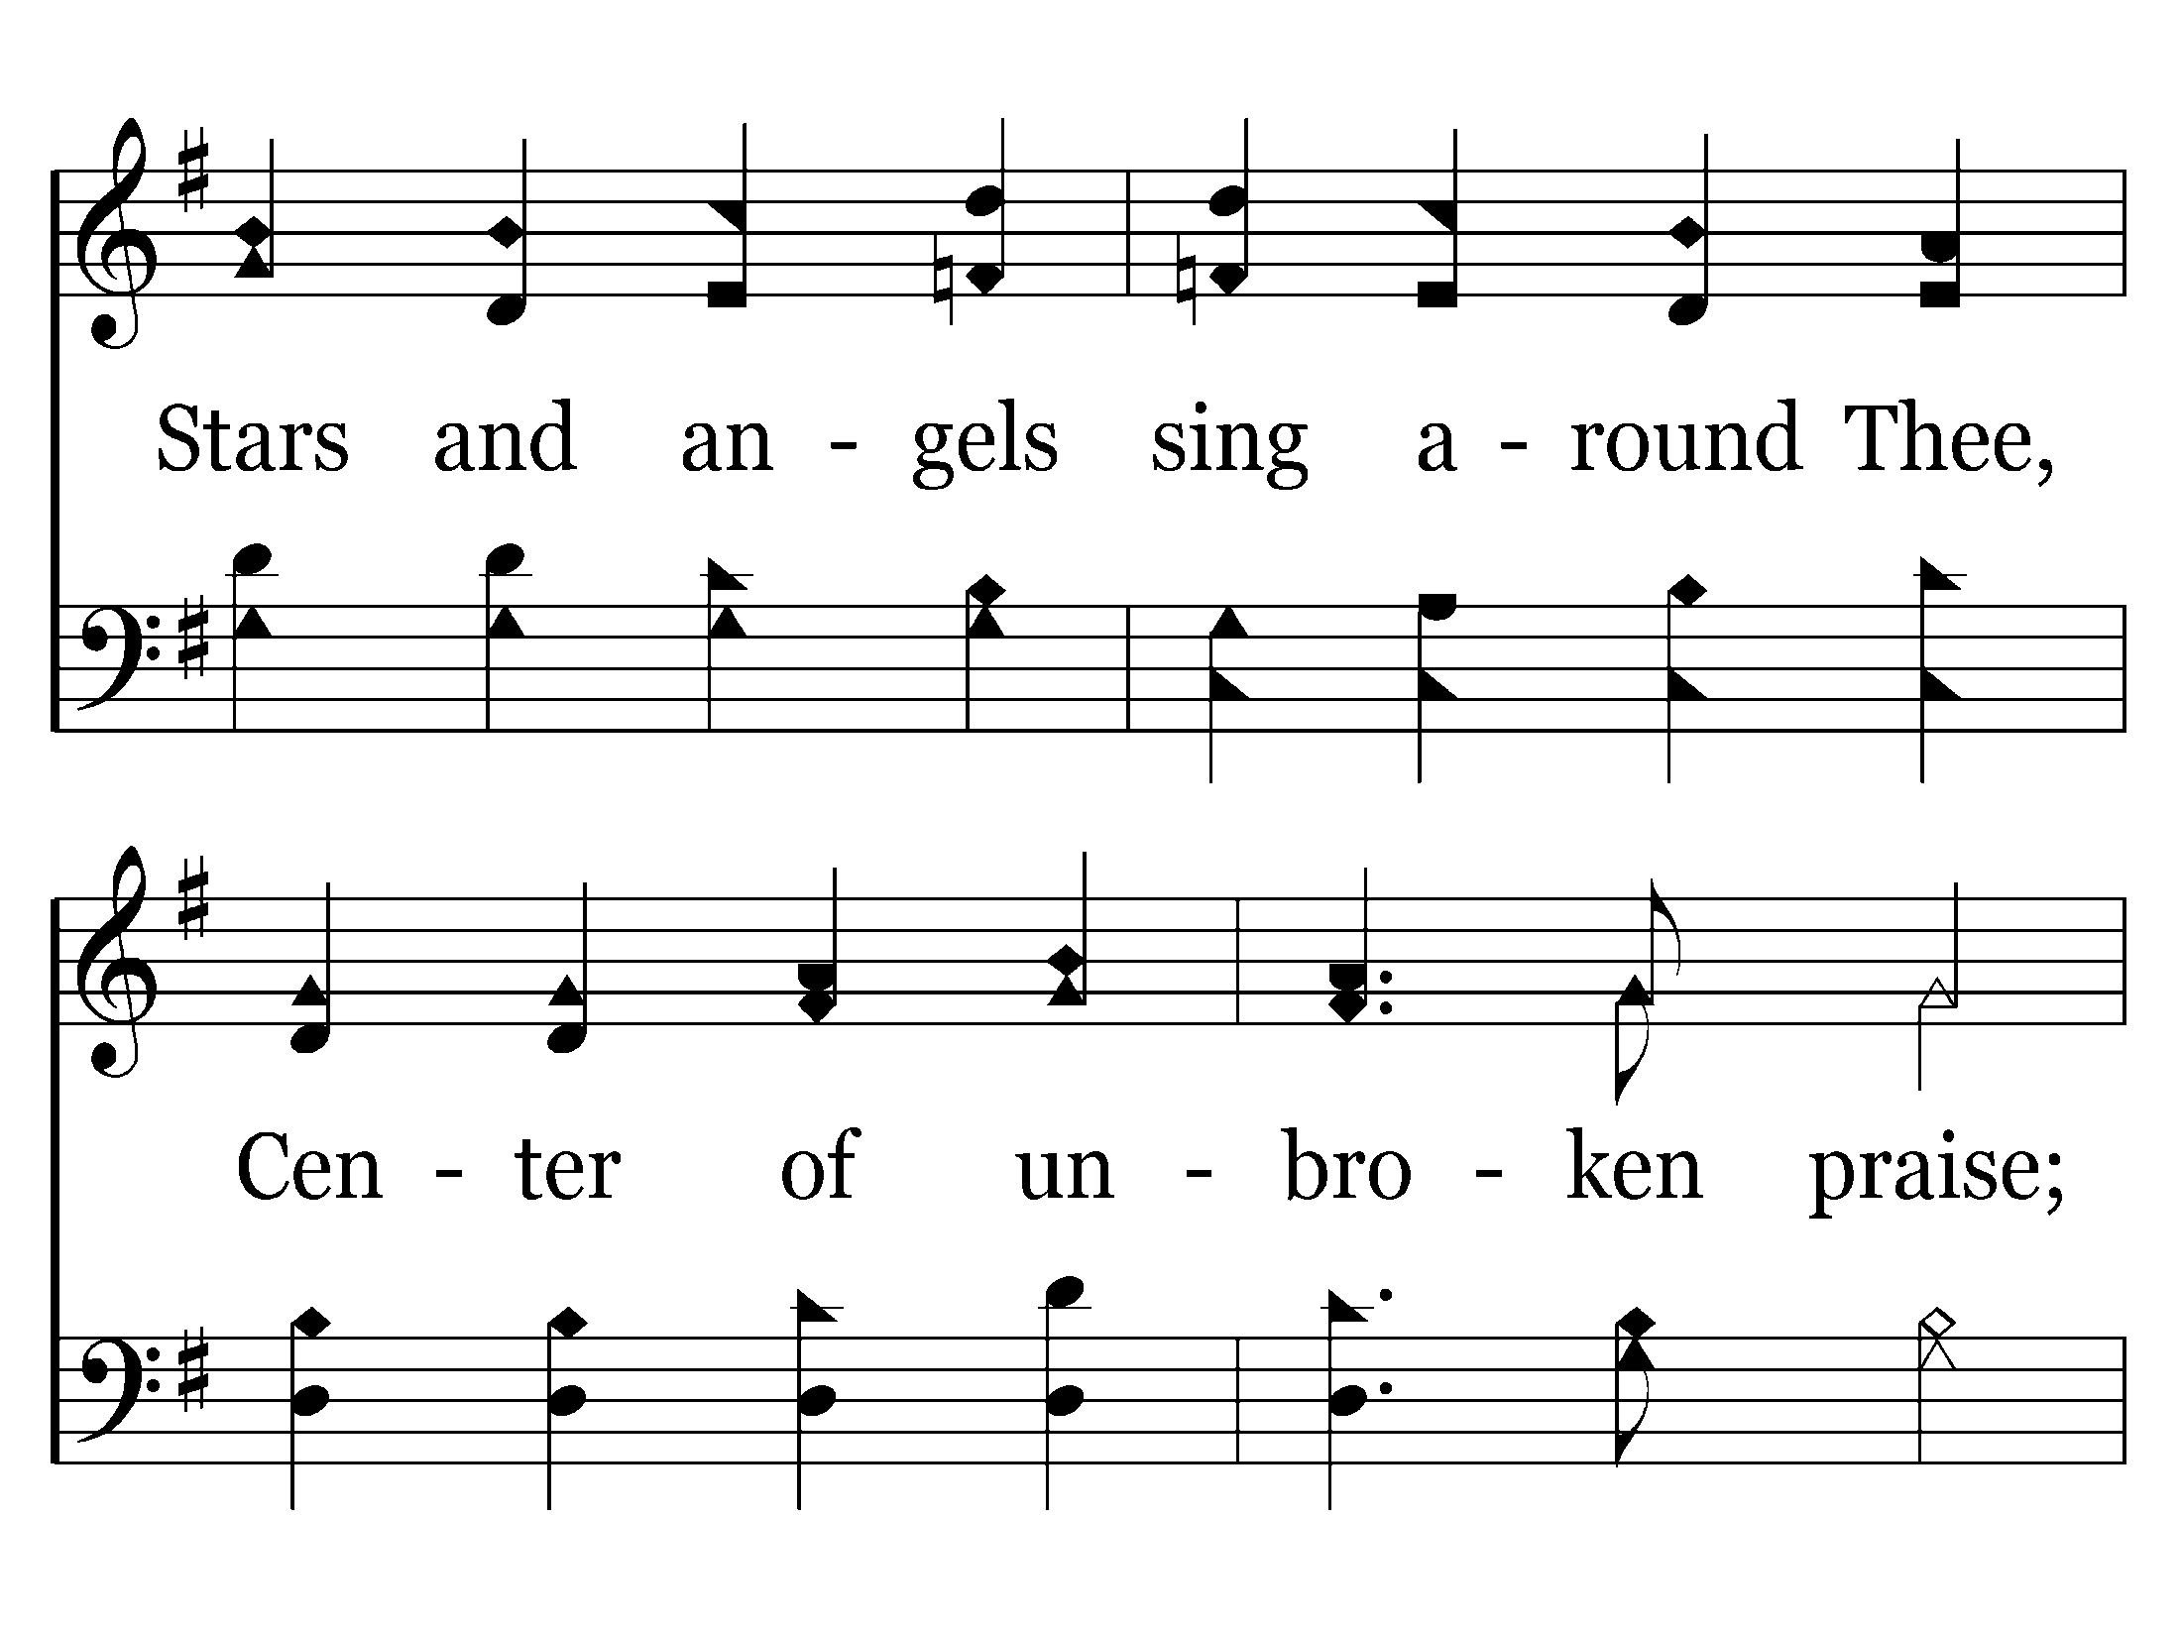
027 - Joyful, Joyful We Adore Thee - 2.2

Slide 8
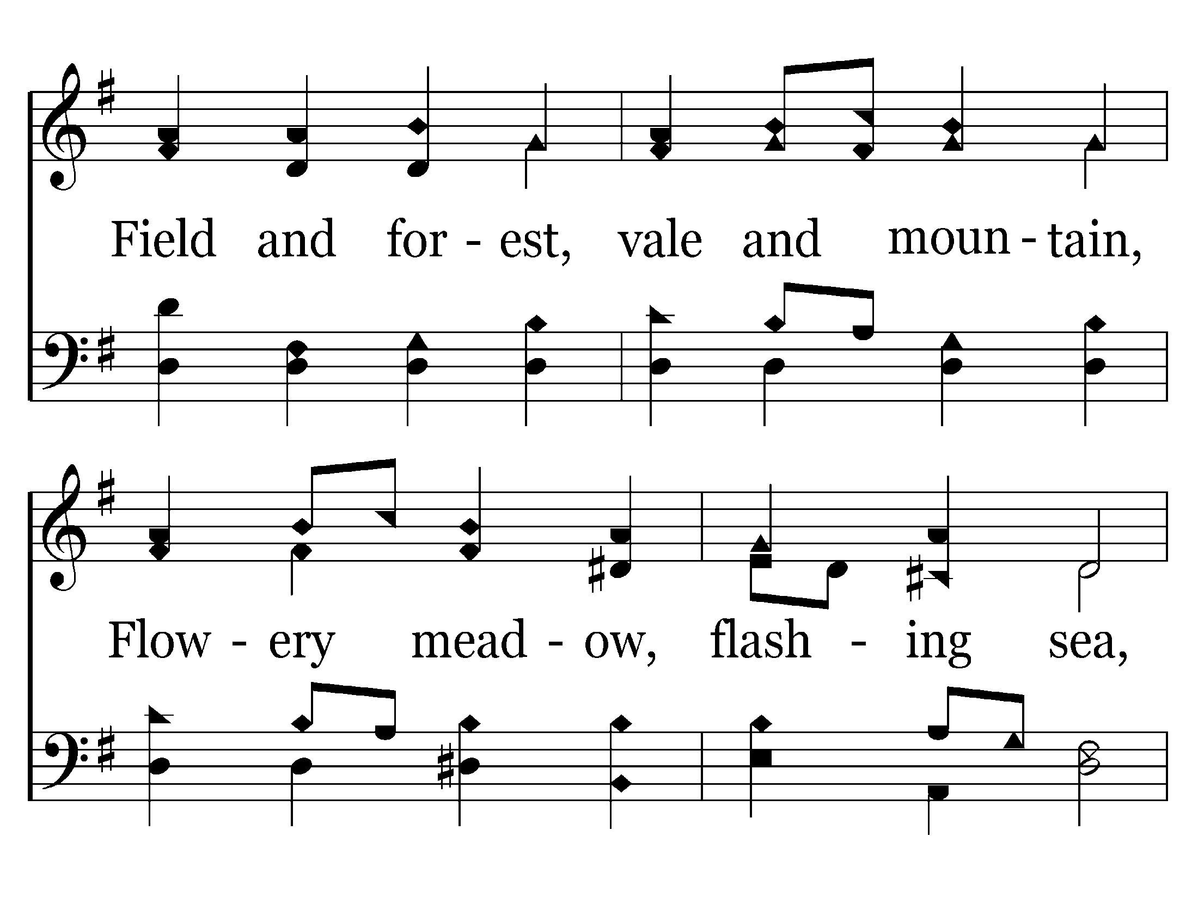
027 - Joyful, Joyful We Adore Thee - 2.3

Slide 9
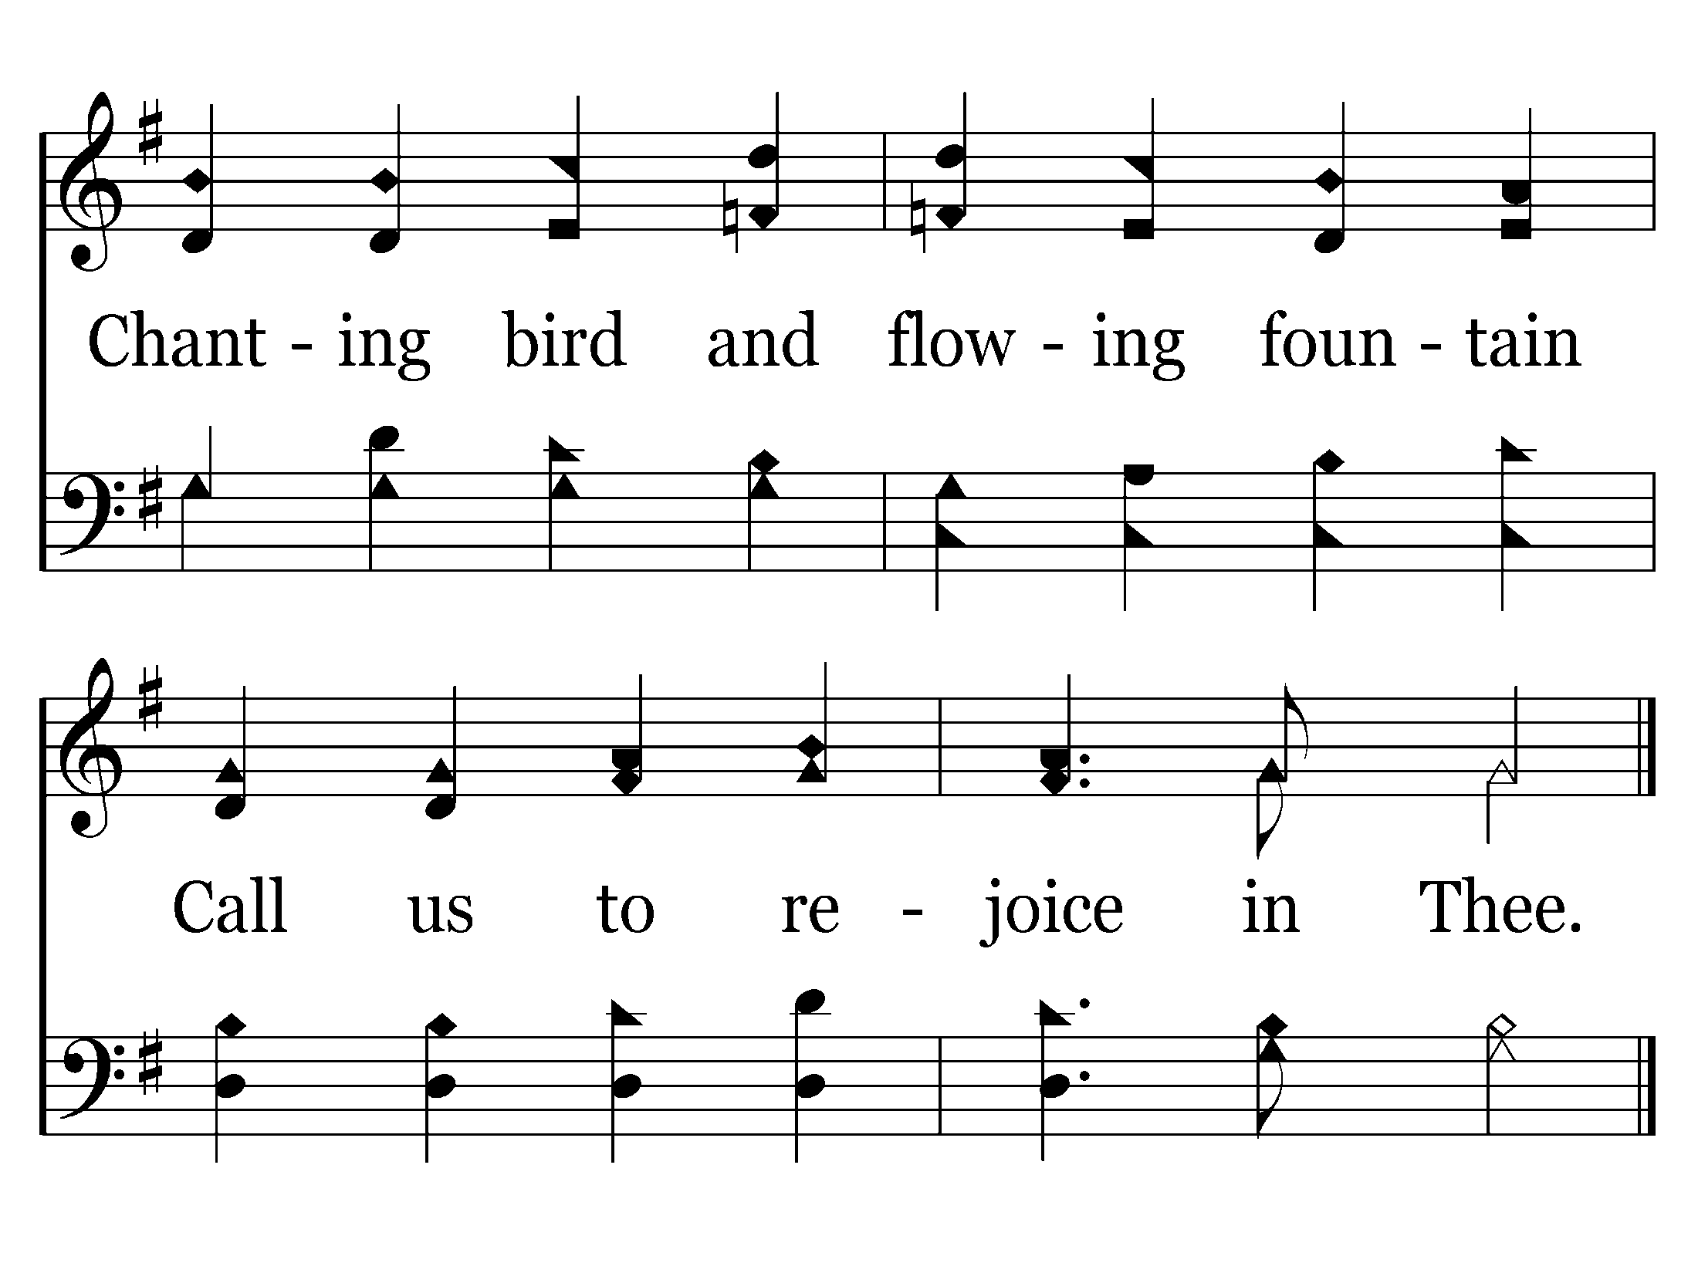
027 - Joyful, Joyful We Adore Thee - 2.4
End of Verse 2

Slide 10
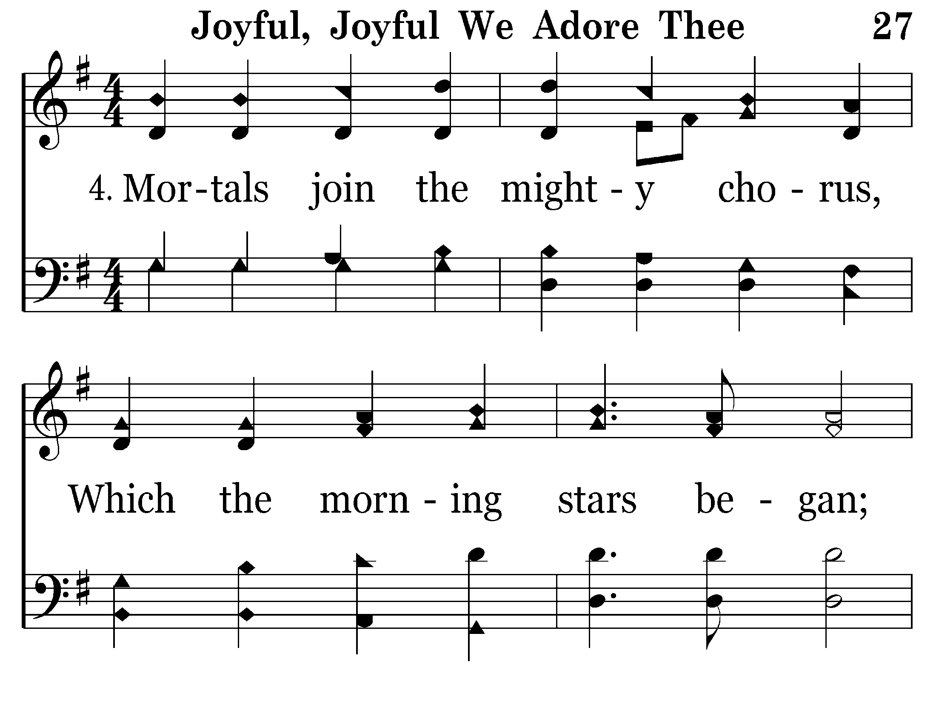
027 - Joyful, Joyful We Adore Thee - 4.1

Slide 11
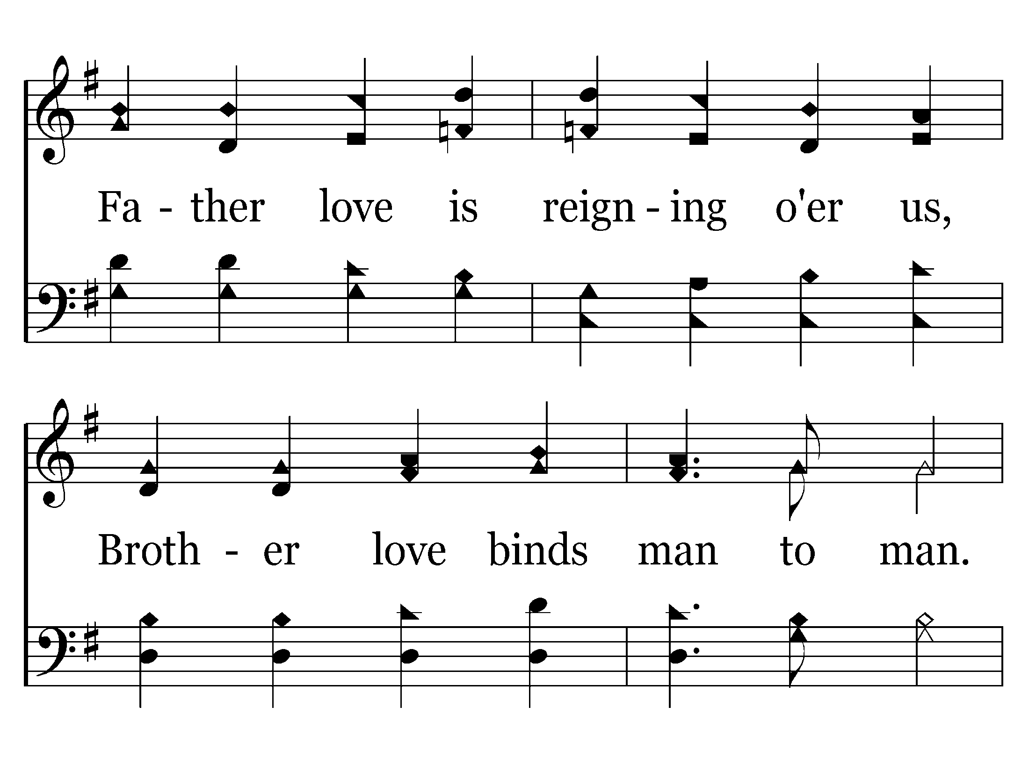
027 - Joyful, Joyful We Adore Thee - 4.2

Slide 12
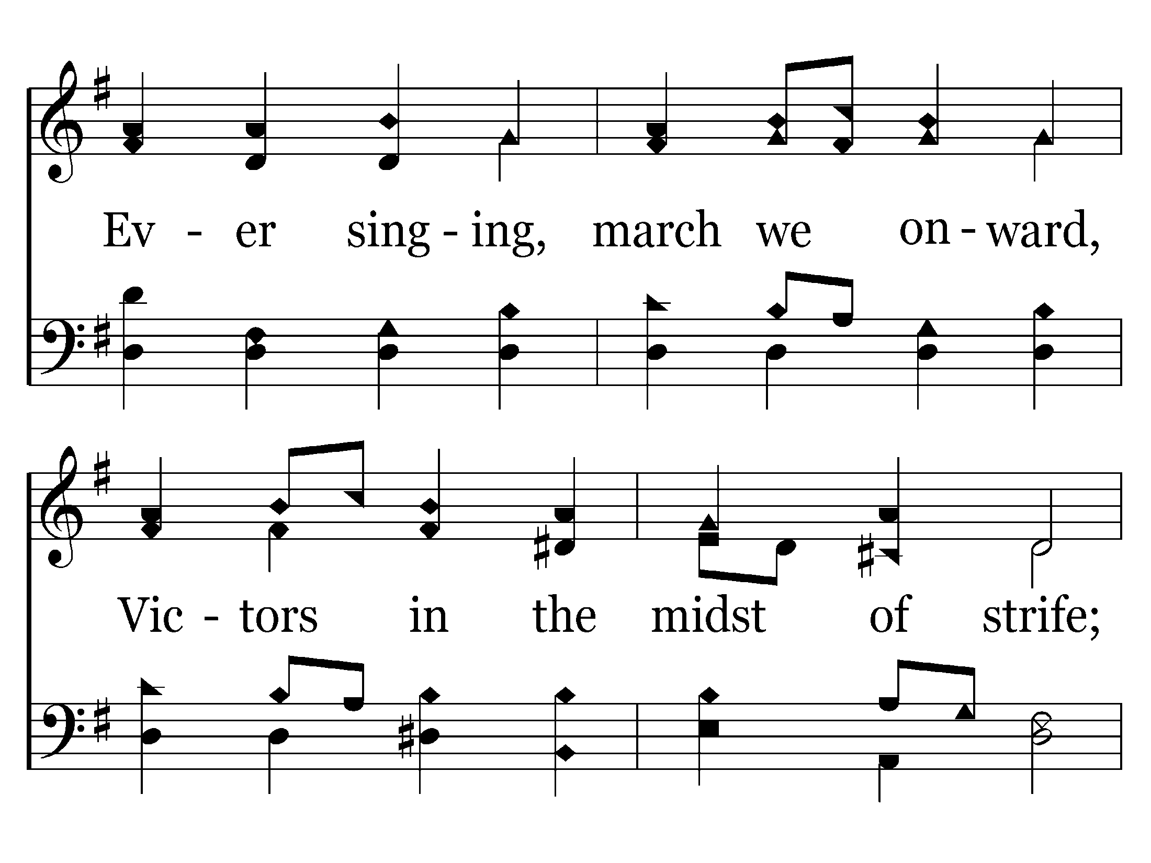
027 - Joyful, Joyful We Adore Thee - 4.3

Slide 13
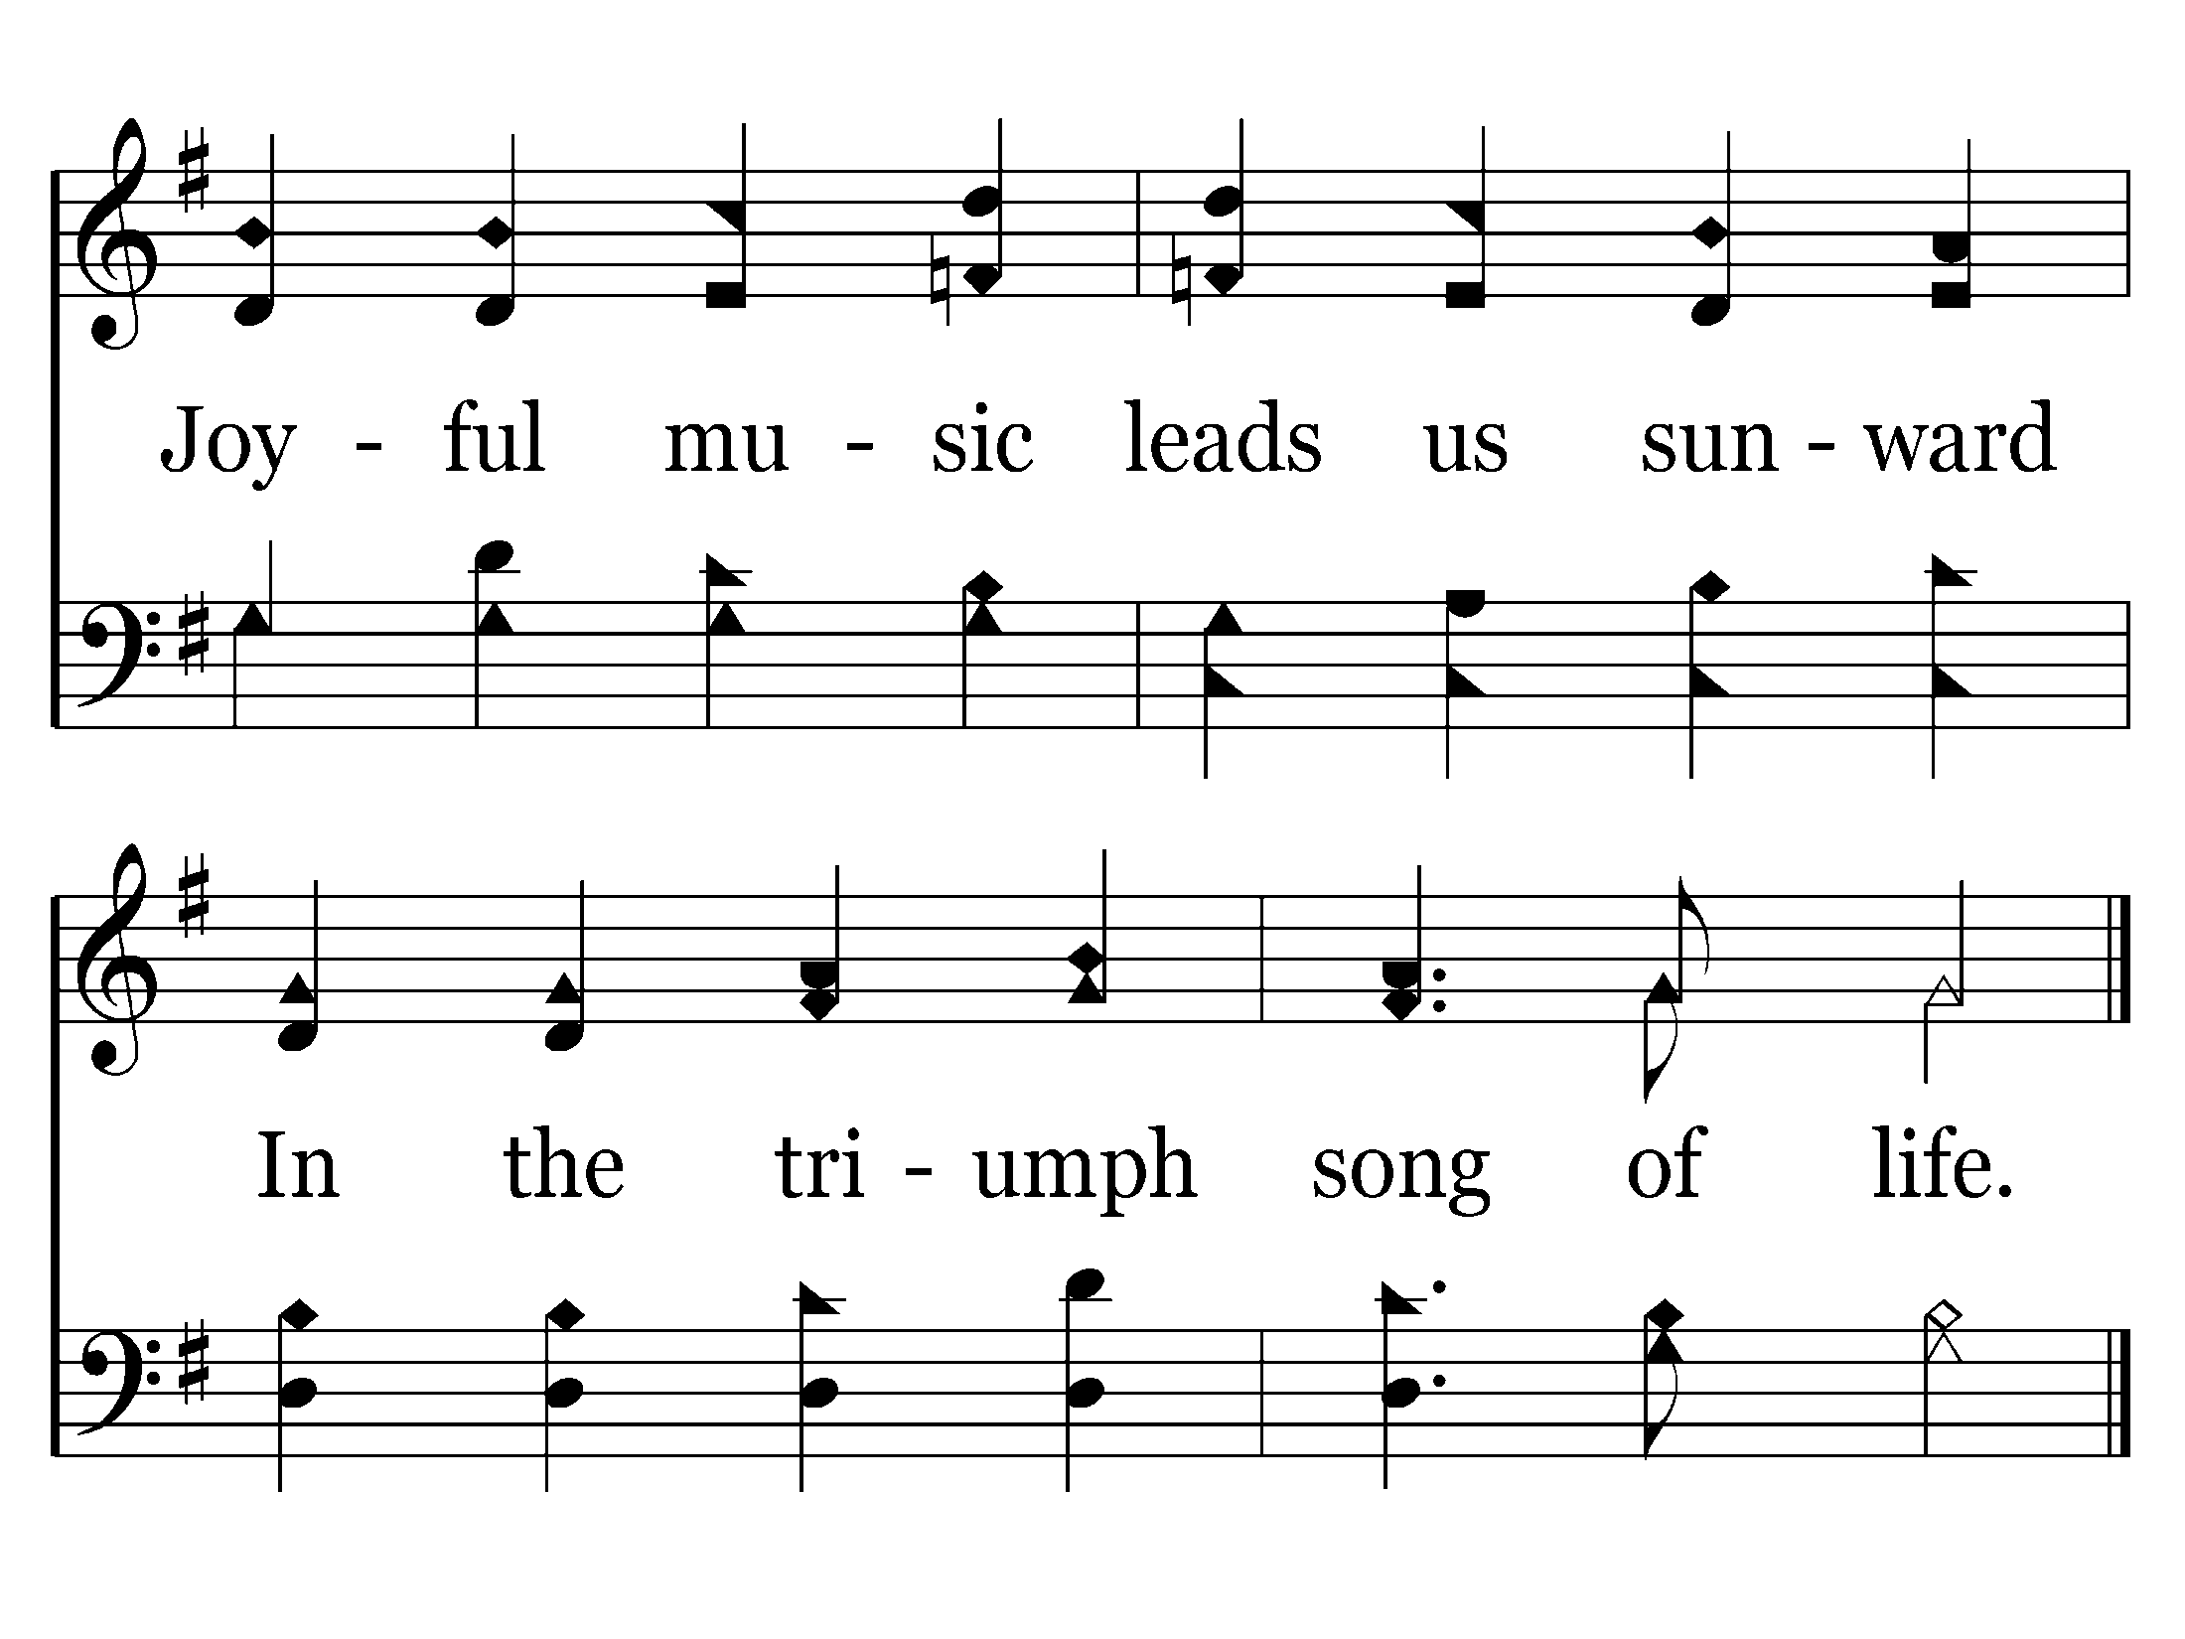
027 - Joyful, Joyful We Adore Thee - 4.4
End of Song

Slide 14
Opening Prayer

Slide 15
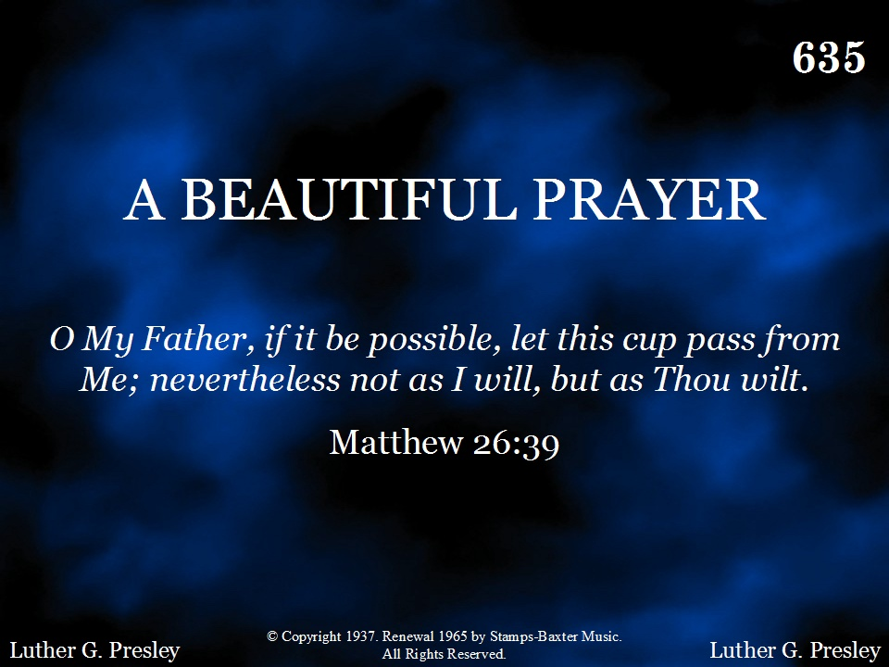
635 - A Beautiful Prayer - Title

Slide 16
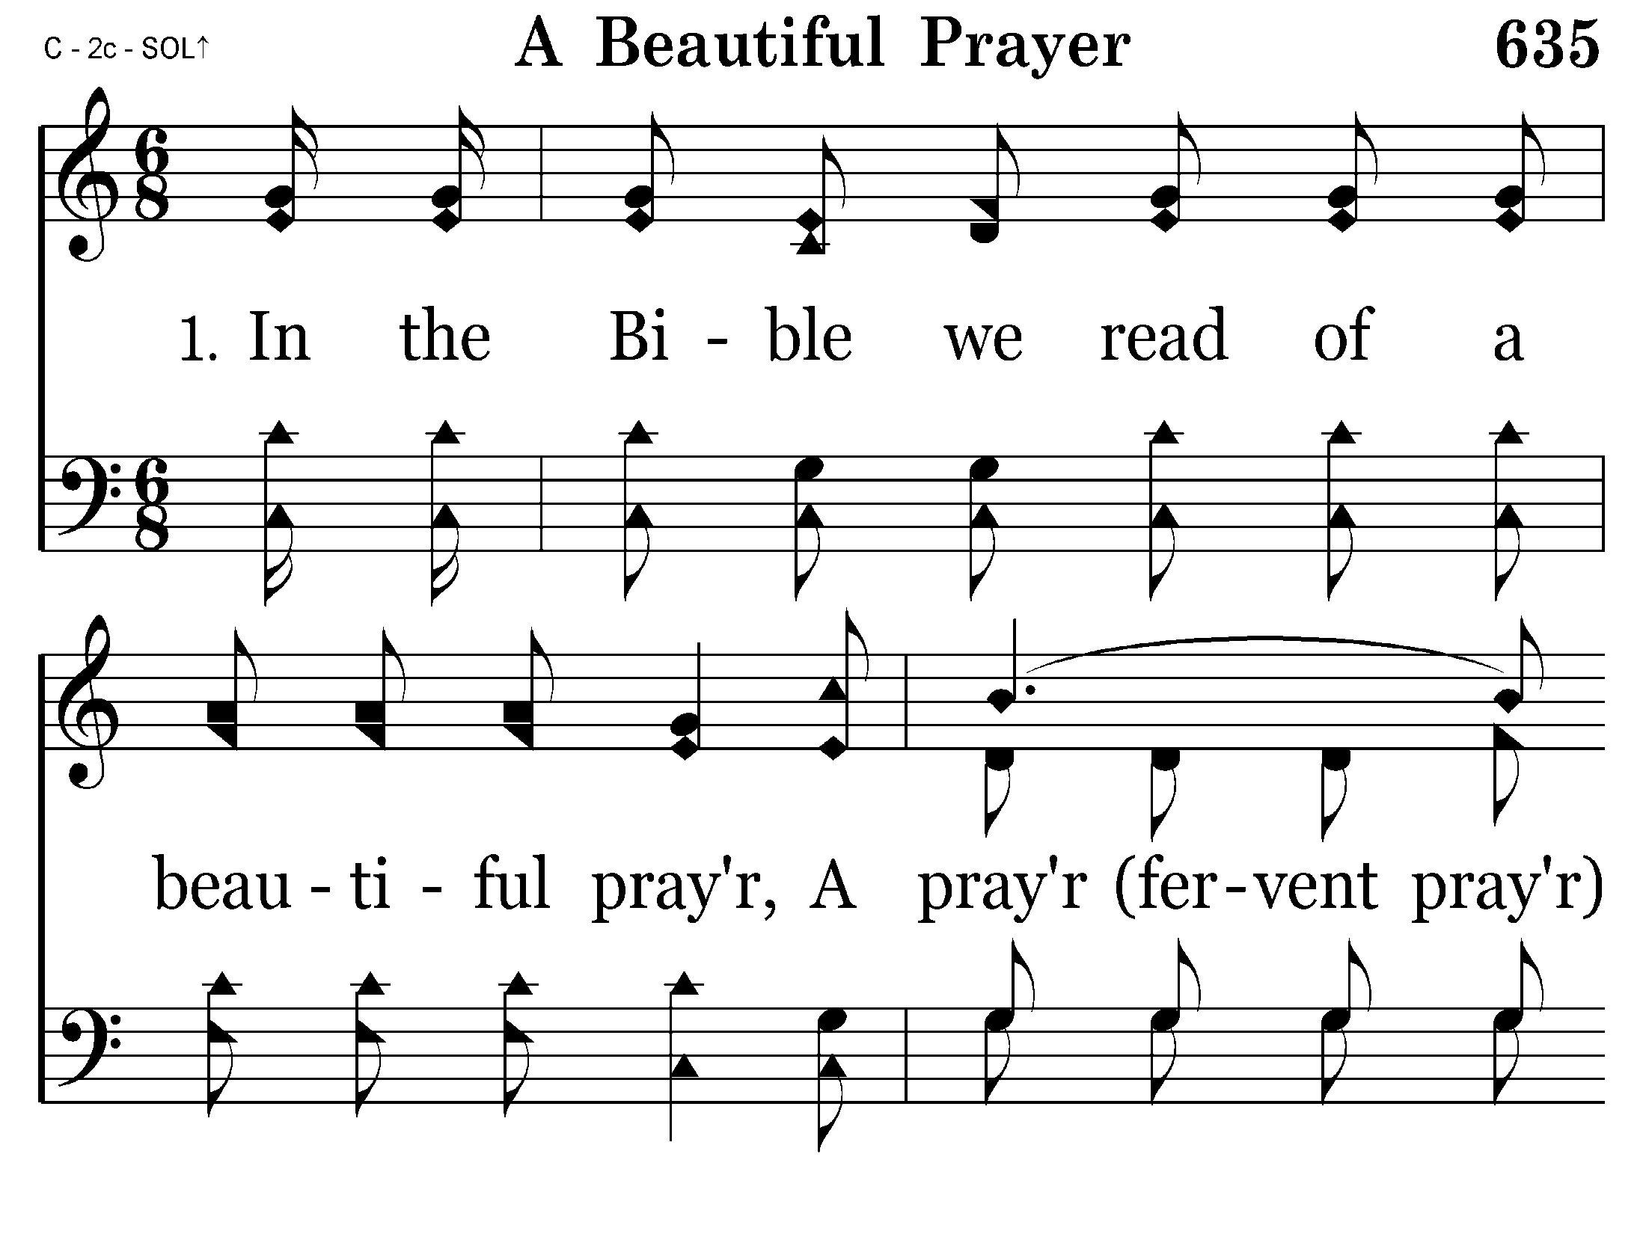
635 - A Beautiful Prayer - 1.1

Slide 17
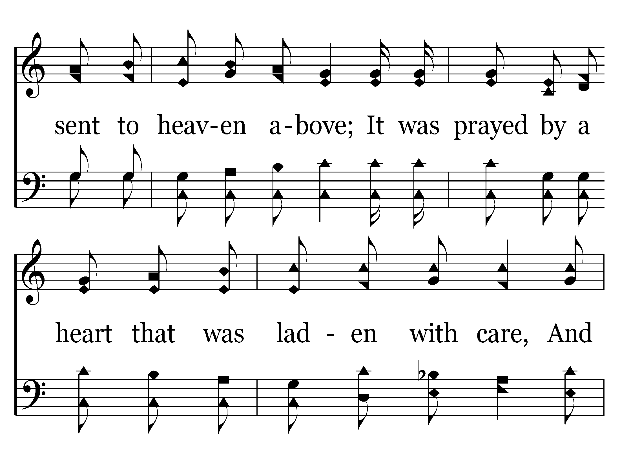
635 - A Beautiful Prayer - 1.2

Slide 18
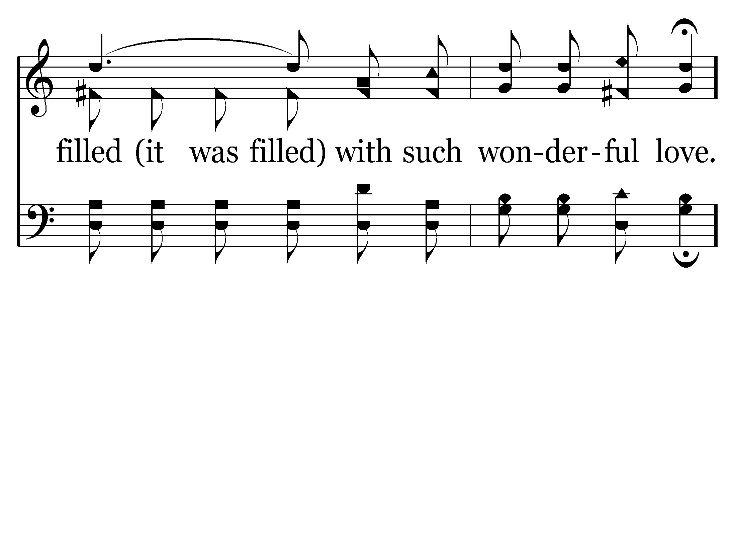
635 - A Beautiful Prayer - 1.3

Slide 19
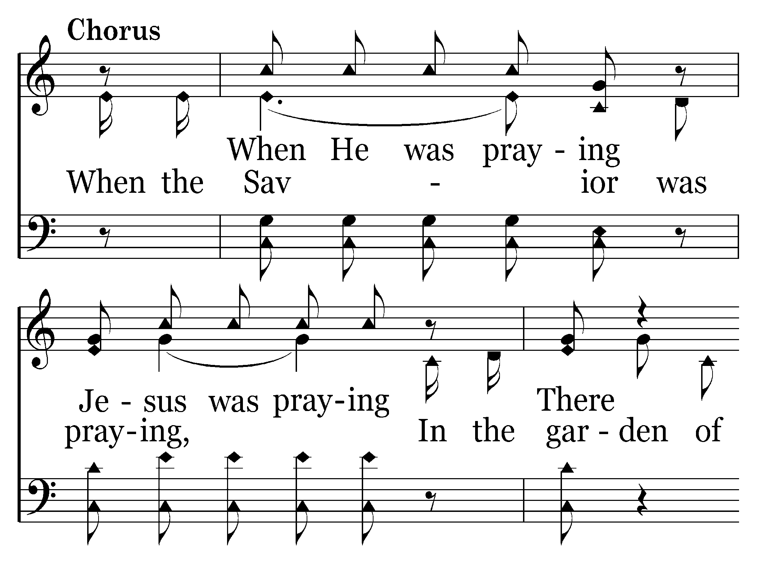
635 - A Beautiful Prayer - C.1

Slide 20
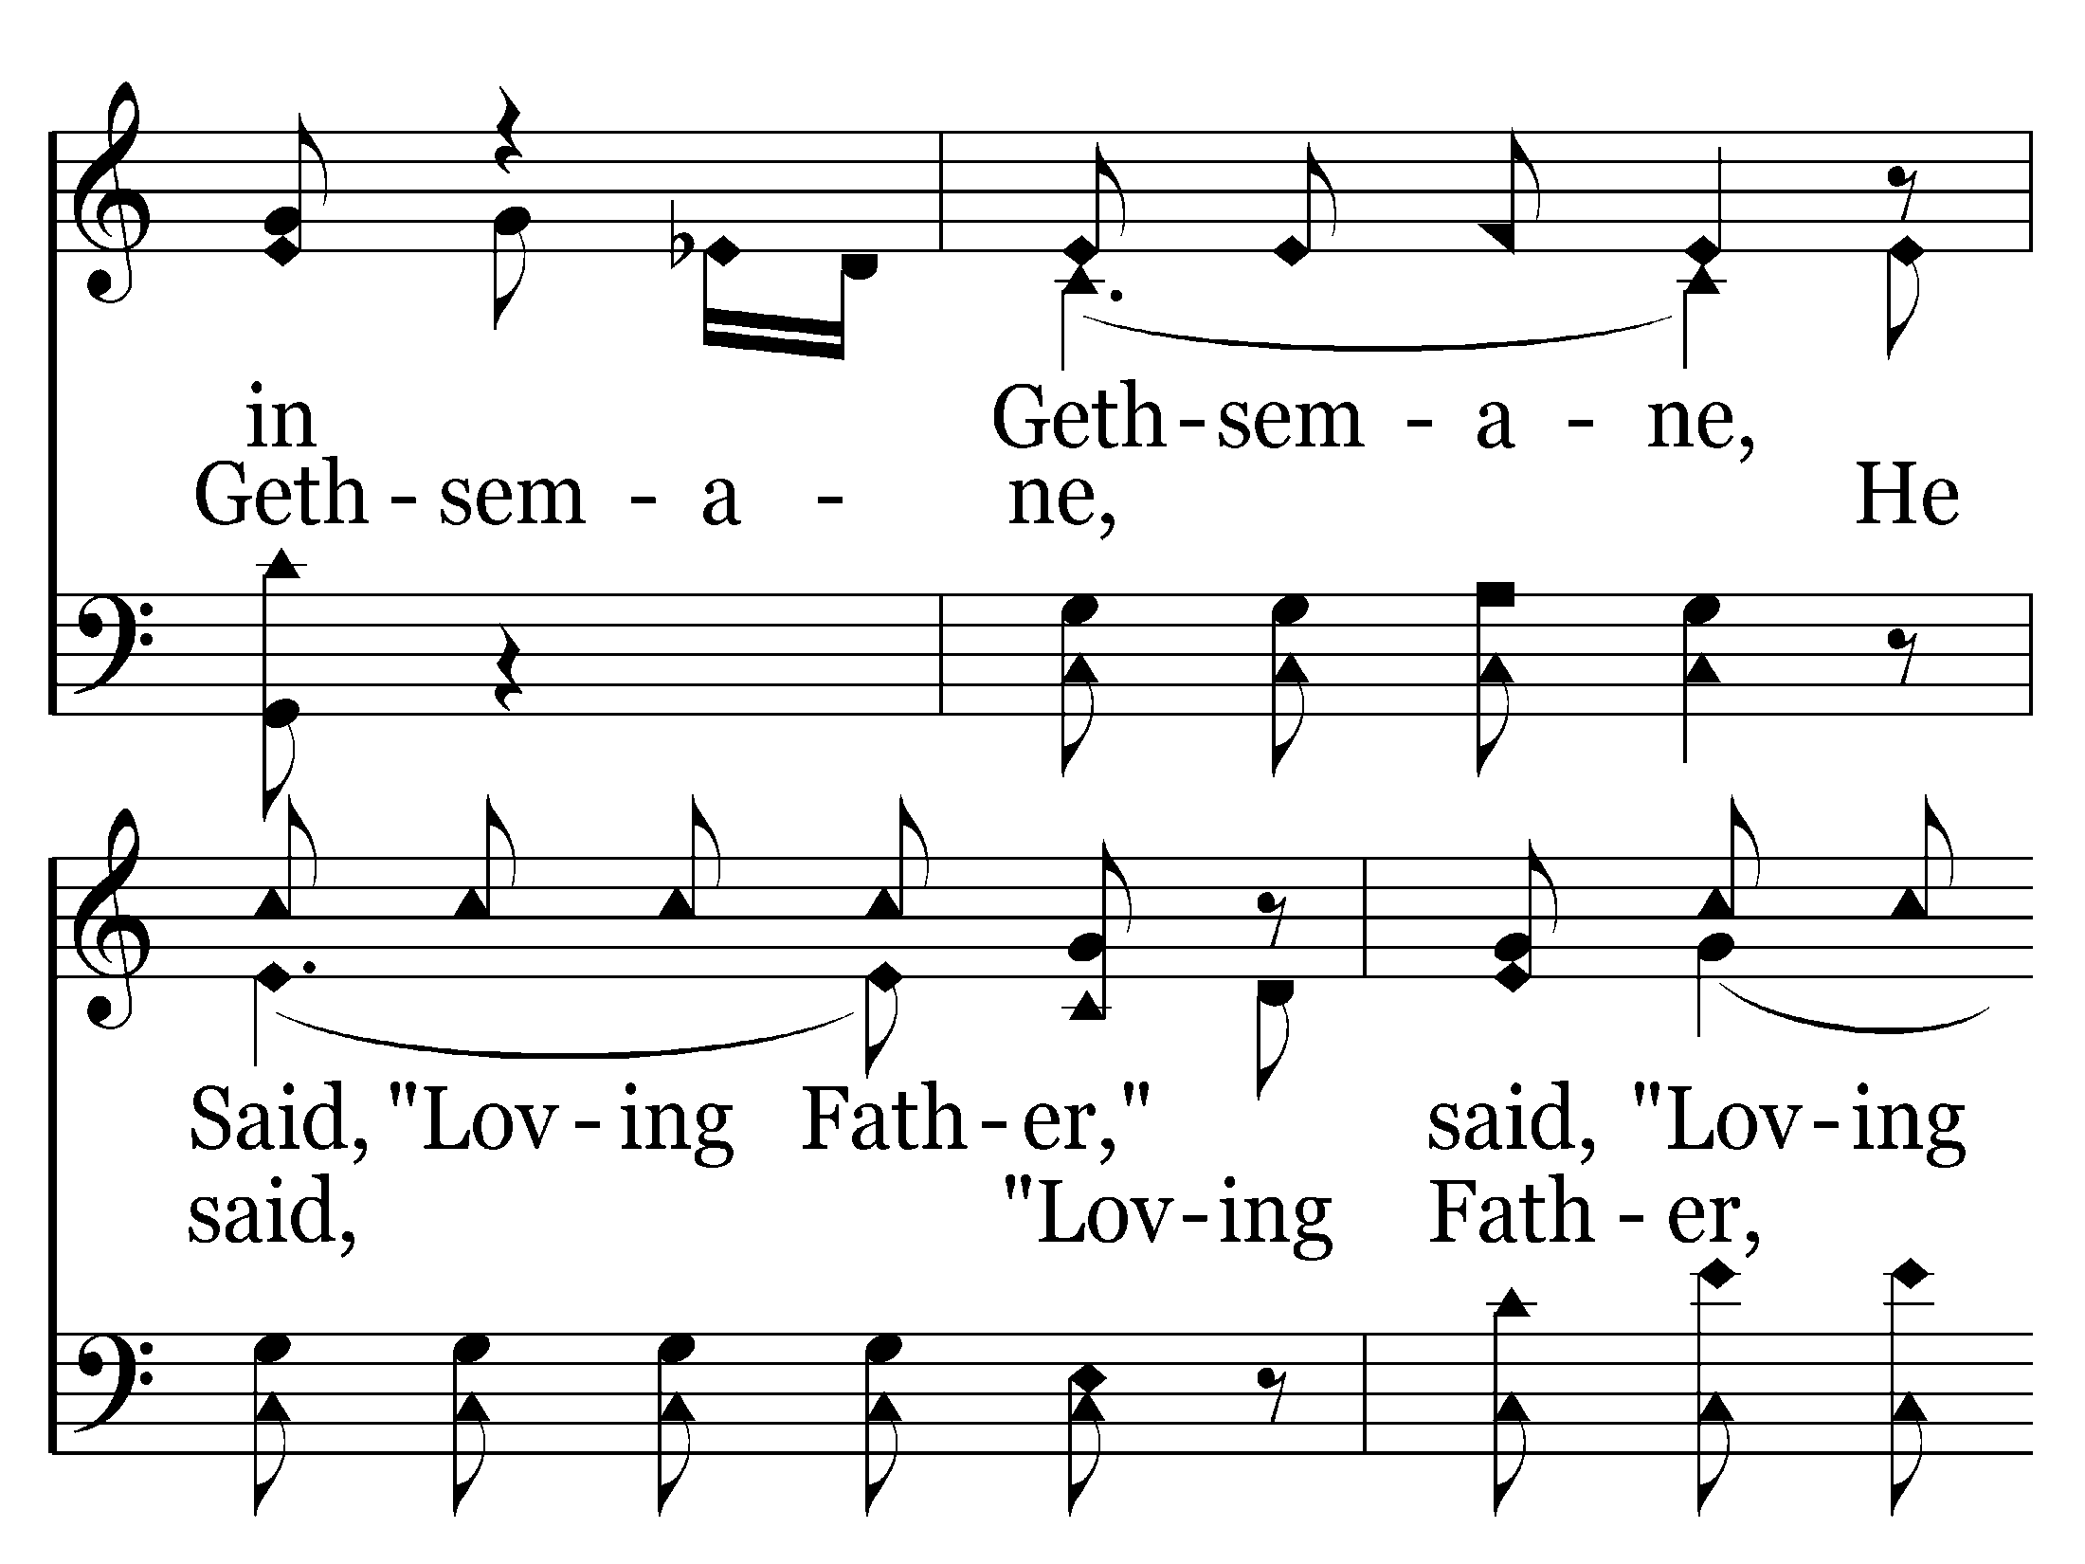
635 - A Beautiful Prayer - C.2

Slide 21
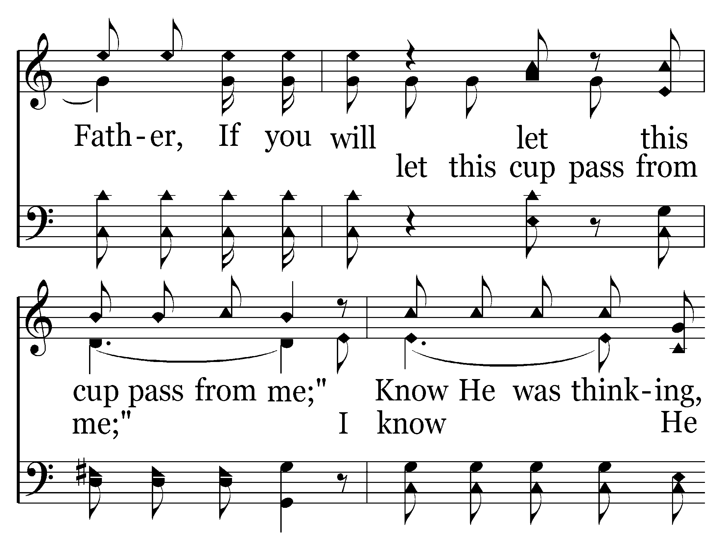
635 - A Beautiful Prayer - C.3

Slide 22
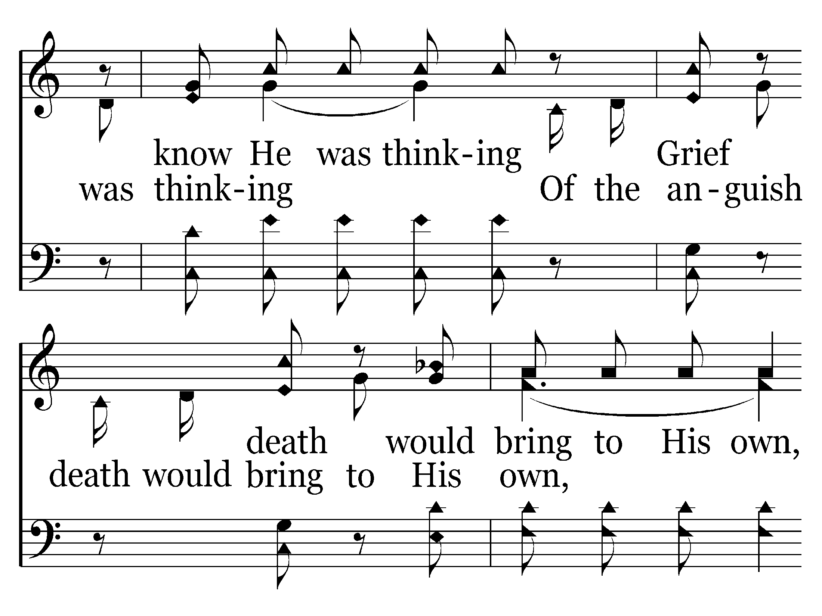
635 - A Beautiful Prayer - C.4

Slide 23
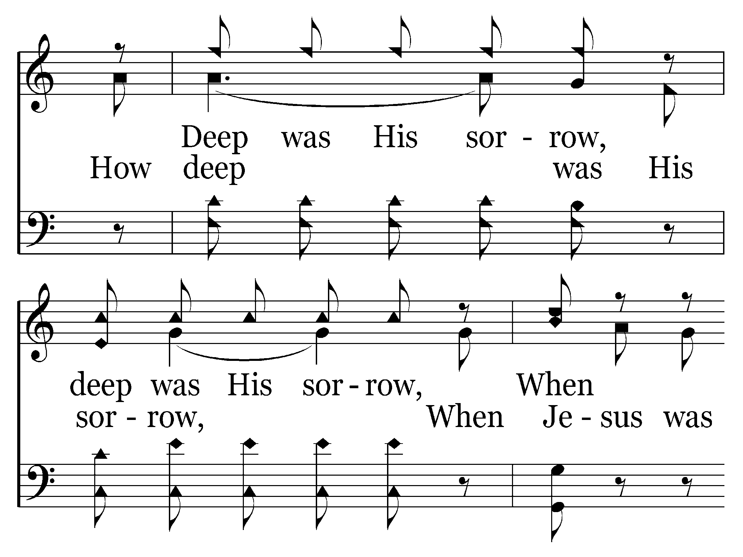
635 - A Beautiful Prayer - C.5

Slide 24
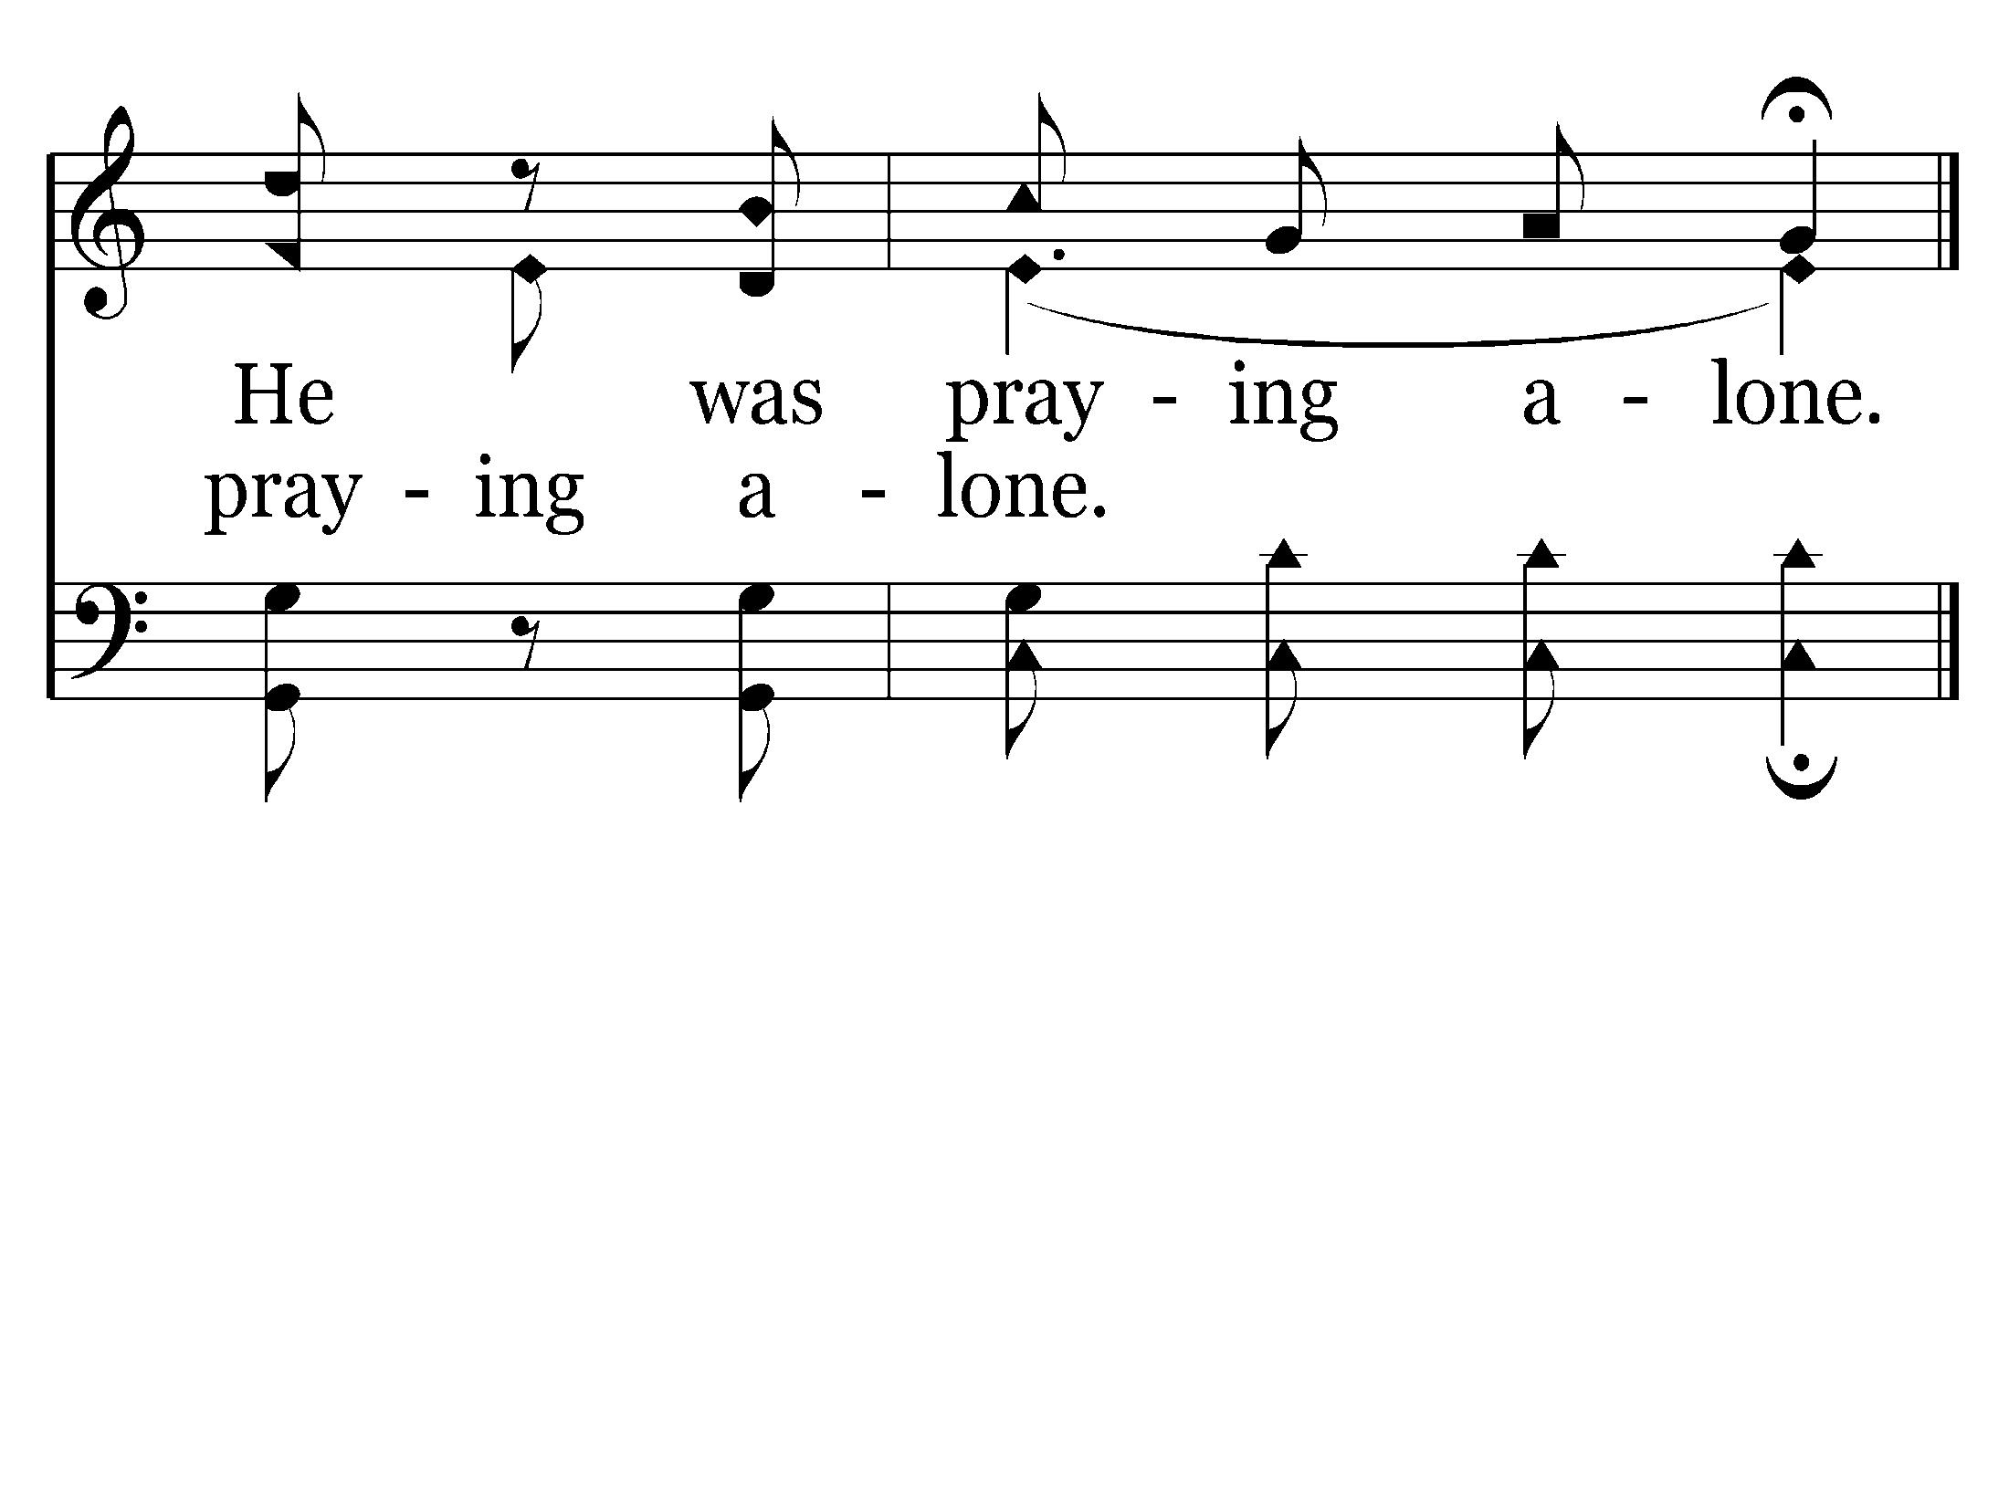
635 - A Beautiful Prayer - C.6
End of Verse 1

Slide 25
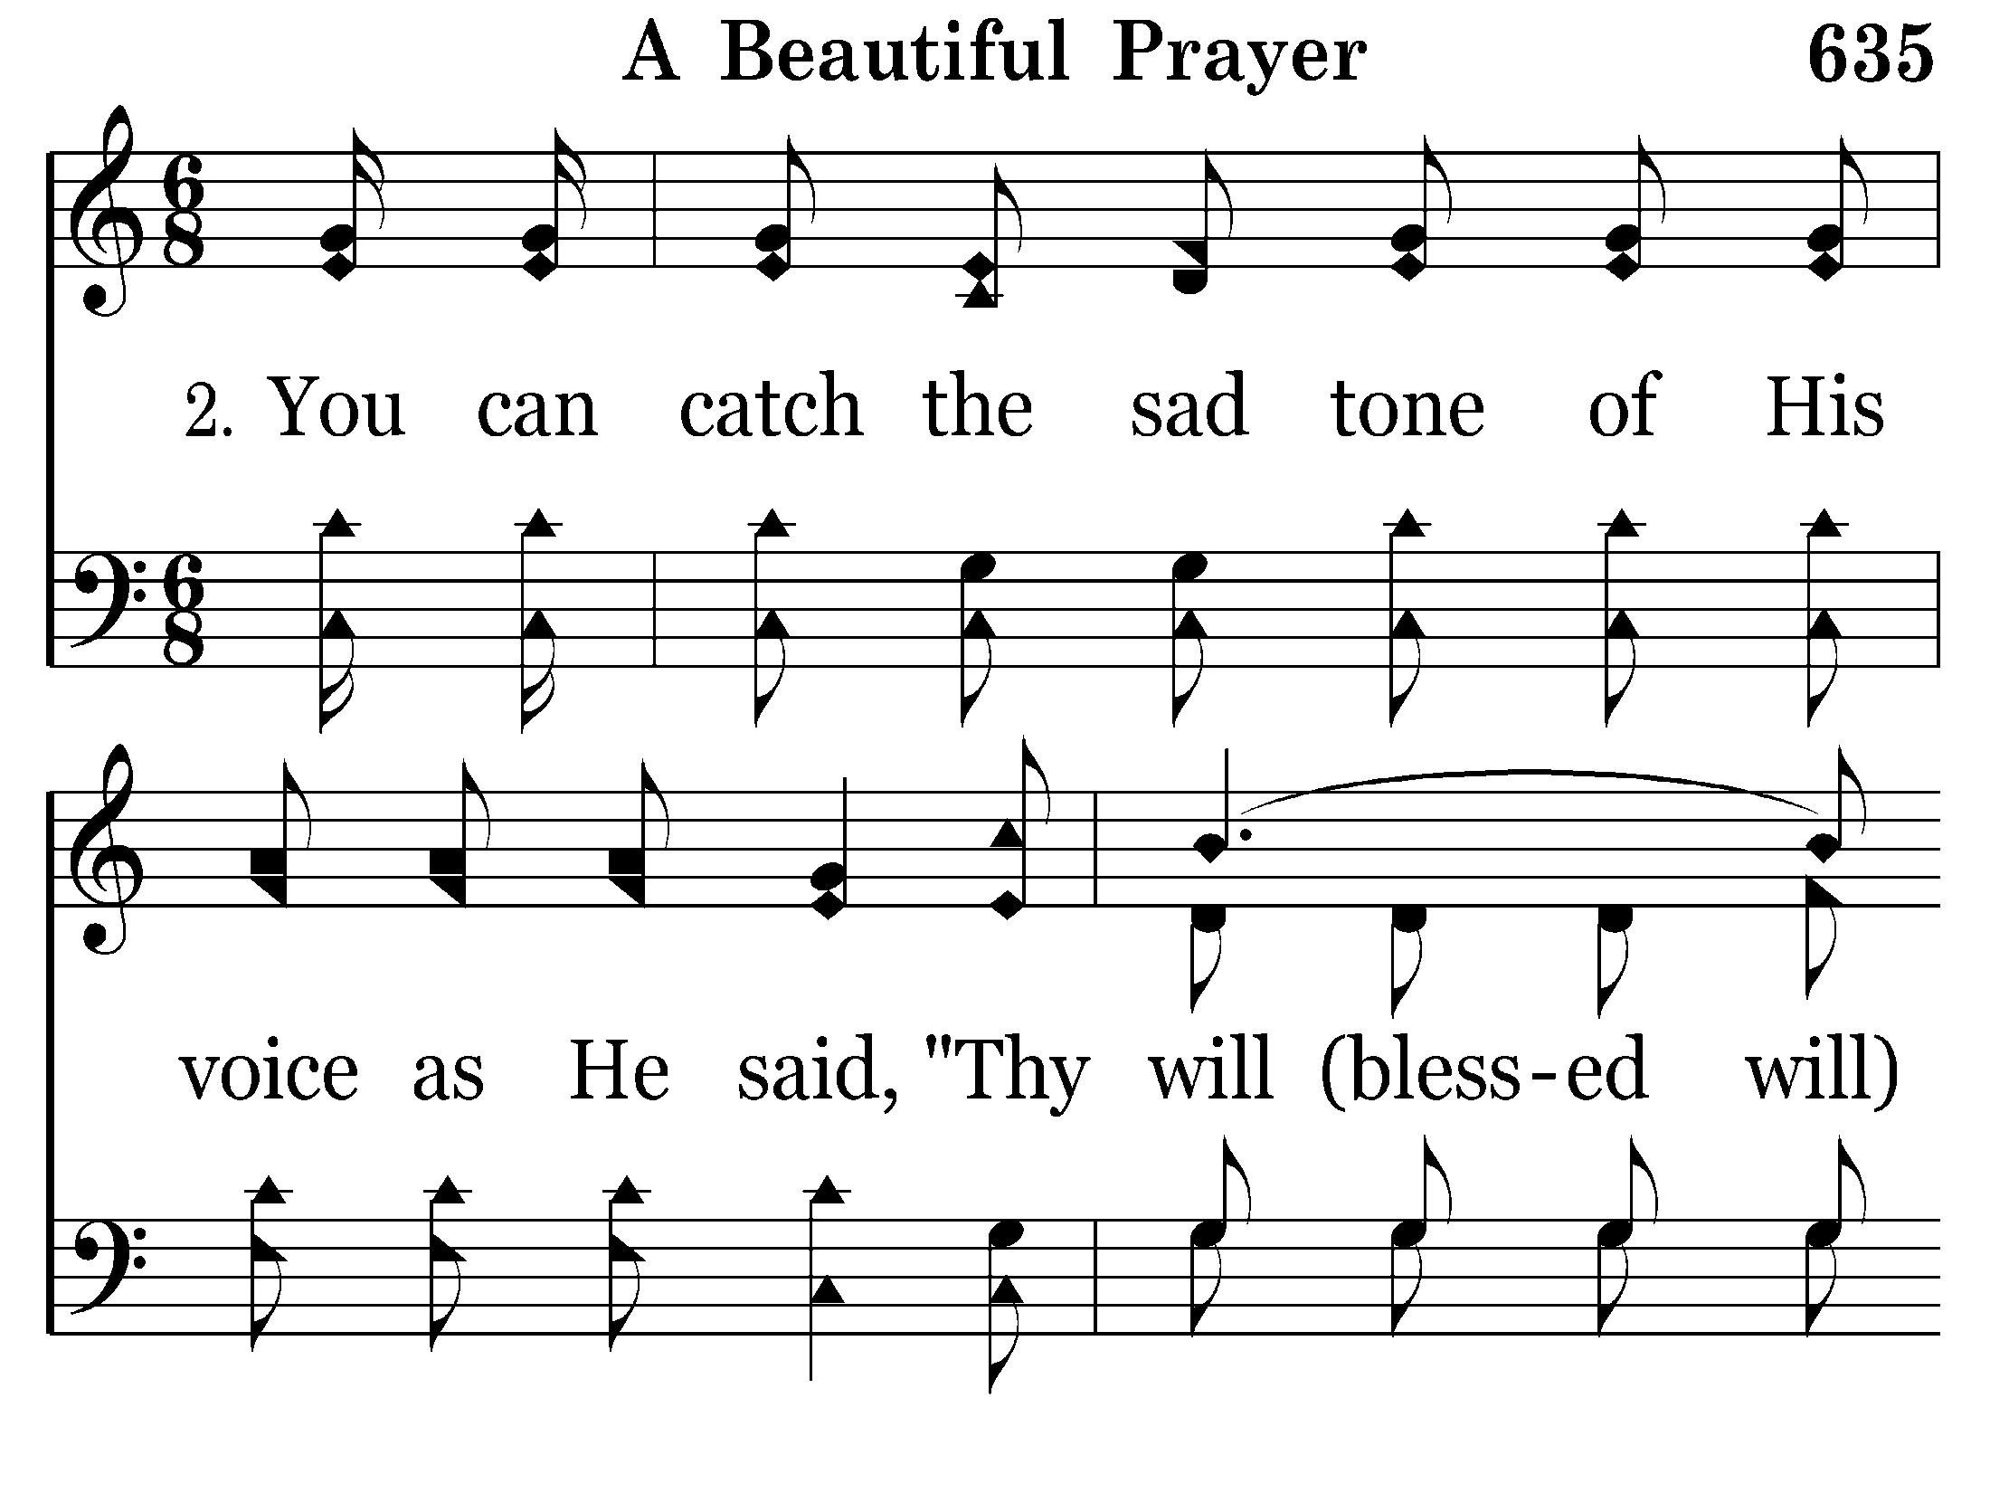
635 - A Beautiful Prayer - 2.1

Slide 26
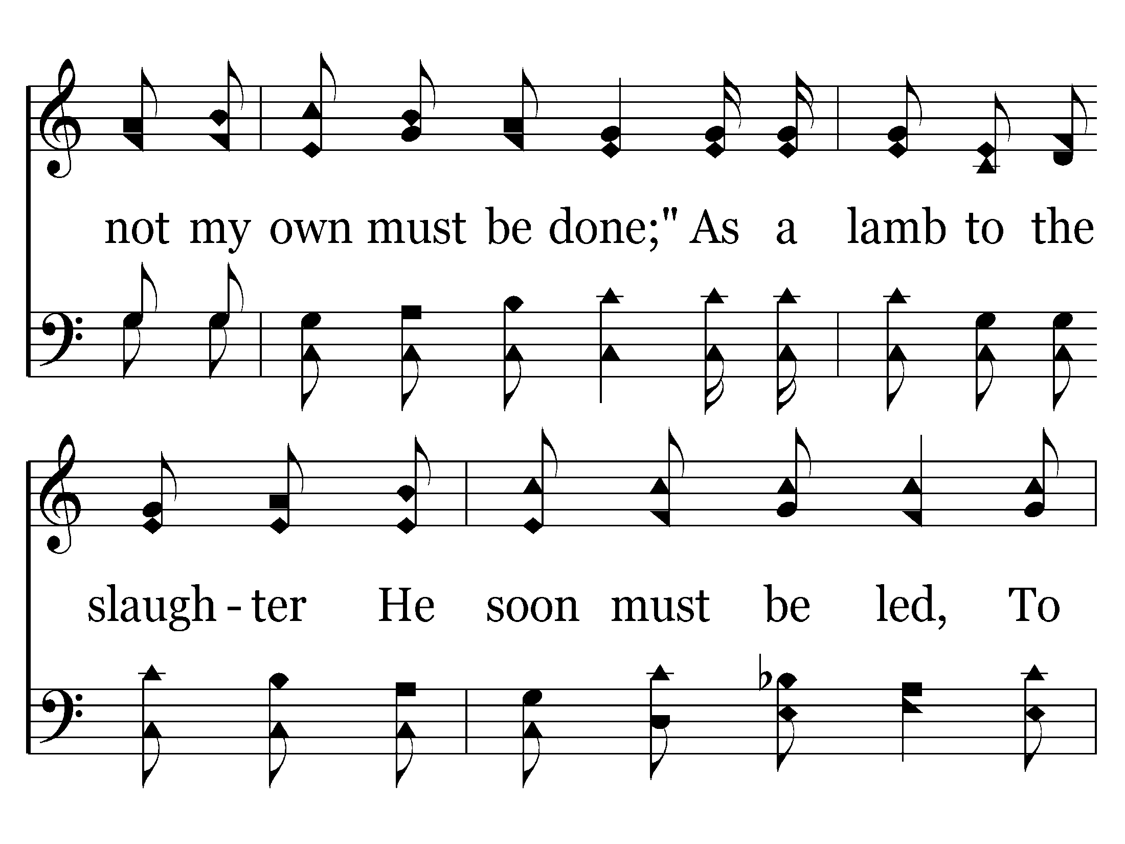
635 - A Beautiful Prayer - 2.2

Slide 27
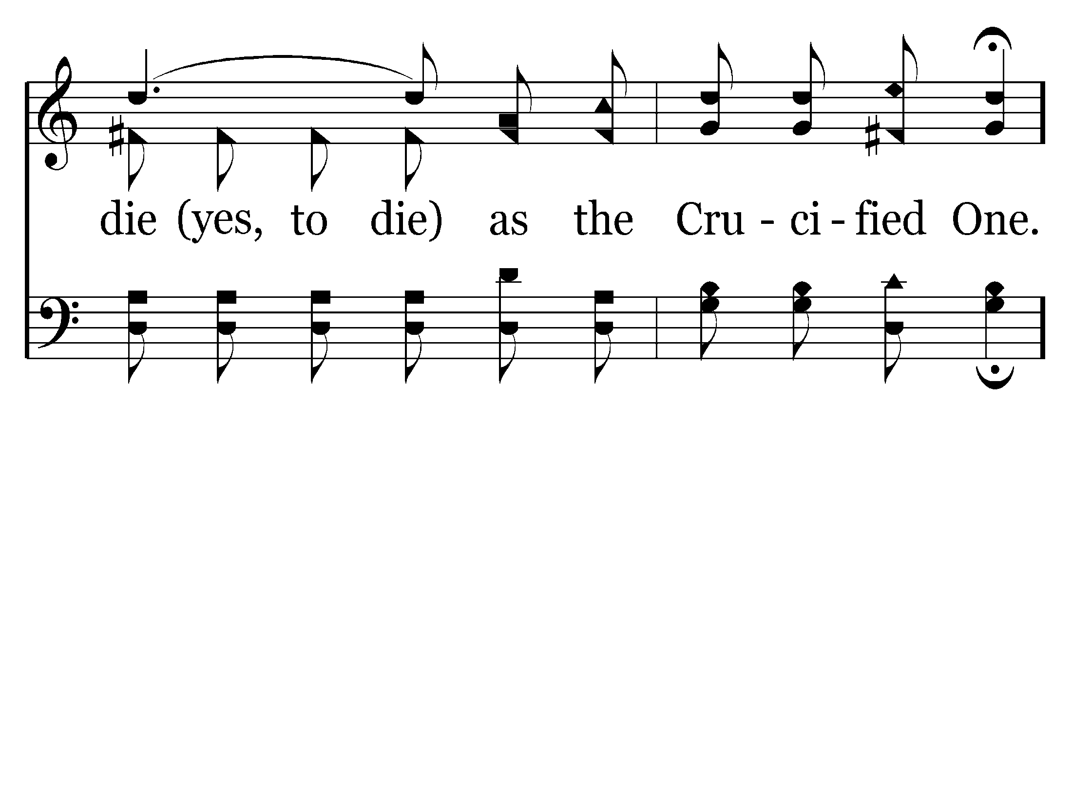
635 - A Beautiful Prayer - 2.3

Slide 28
635 - A Beautiful Prayer - C.1

Slide 29
635 - A Beautiful Prayer - C.2

Slide 30
635 - A Beautiful Prayer - C.3

Slide 31
635 - A Beautiful Prayer - C.4

Slide 32
635 - A Beautiful Prayer - C.5

Slide 33
635 - A Beautiful Prayer - C.6
End of Verse 2

Slide 34
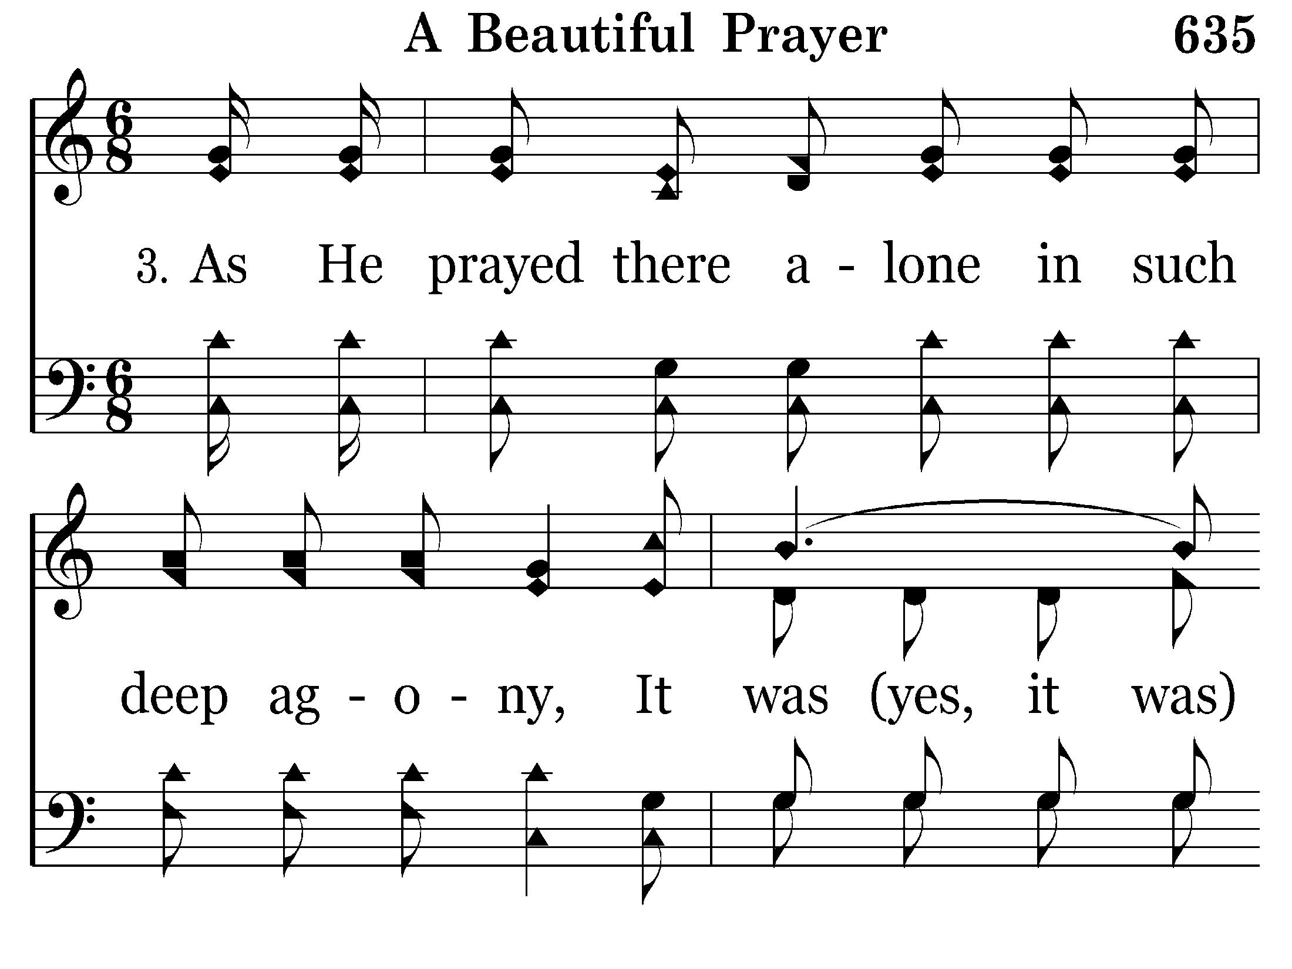
635 - A Beautiful Prayer - 3.1

Slide 35
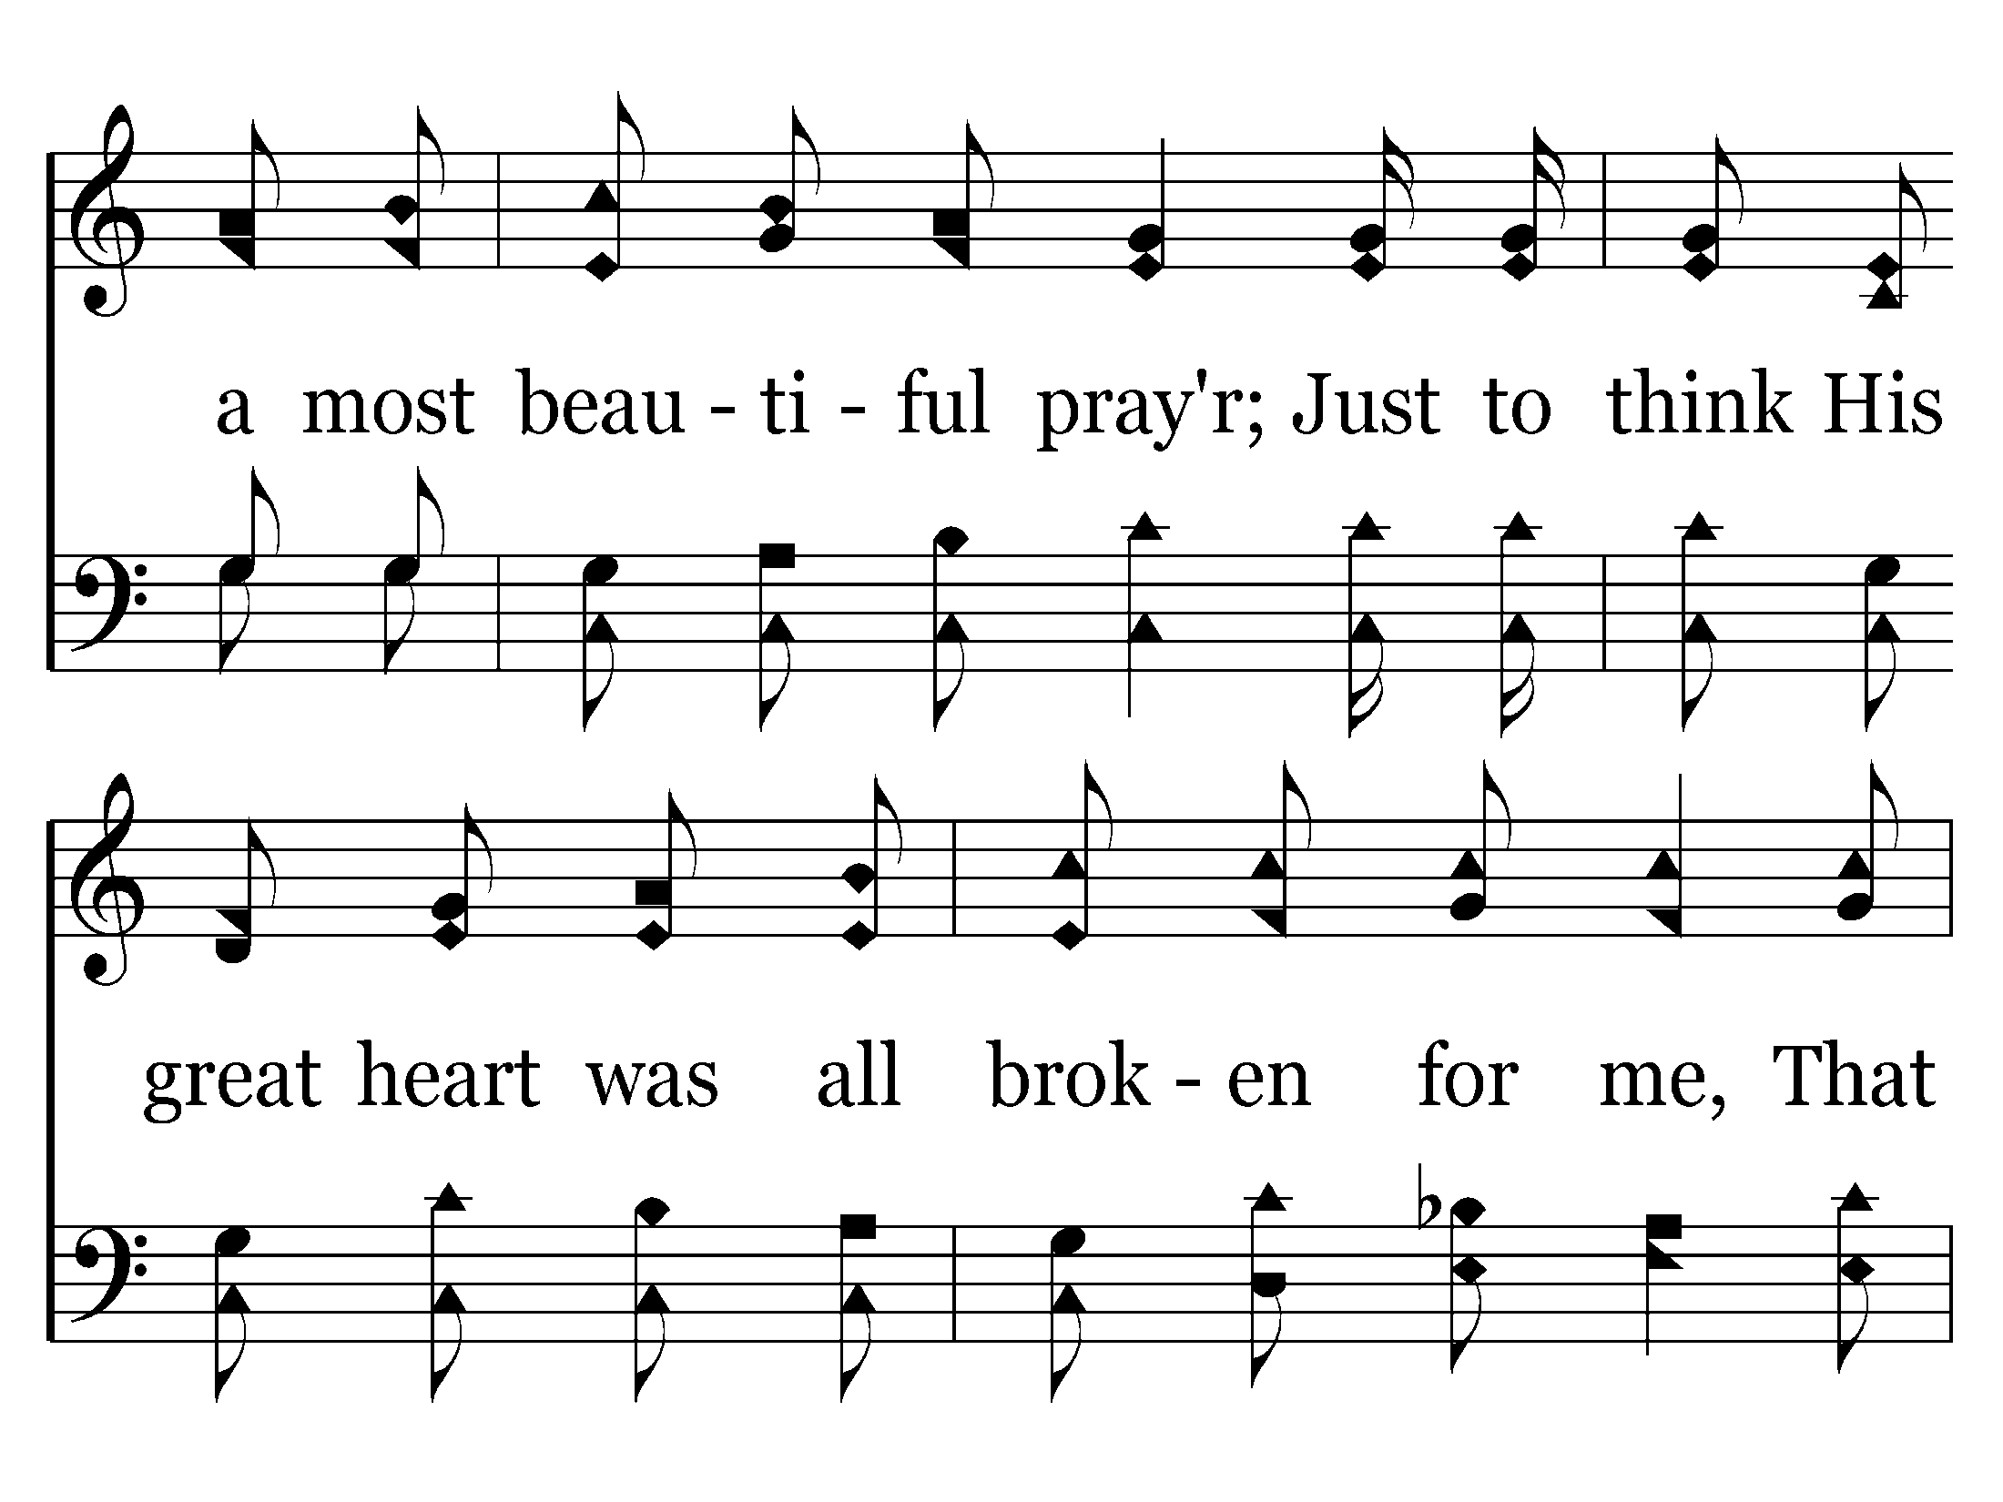
635 - A Beautiful Prayer - 3.2

Slide 36
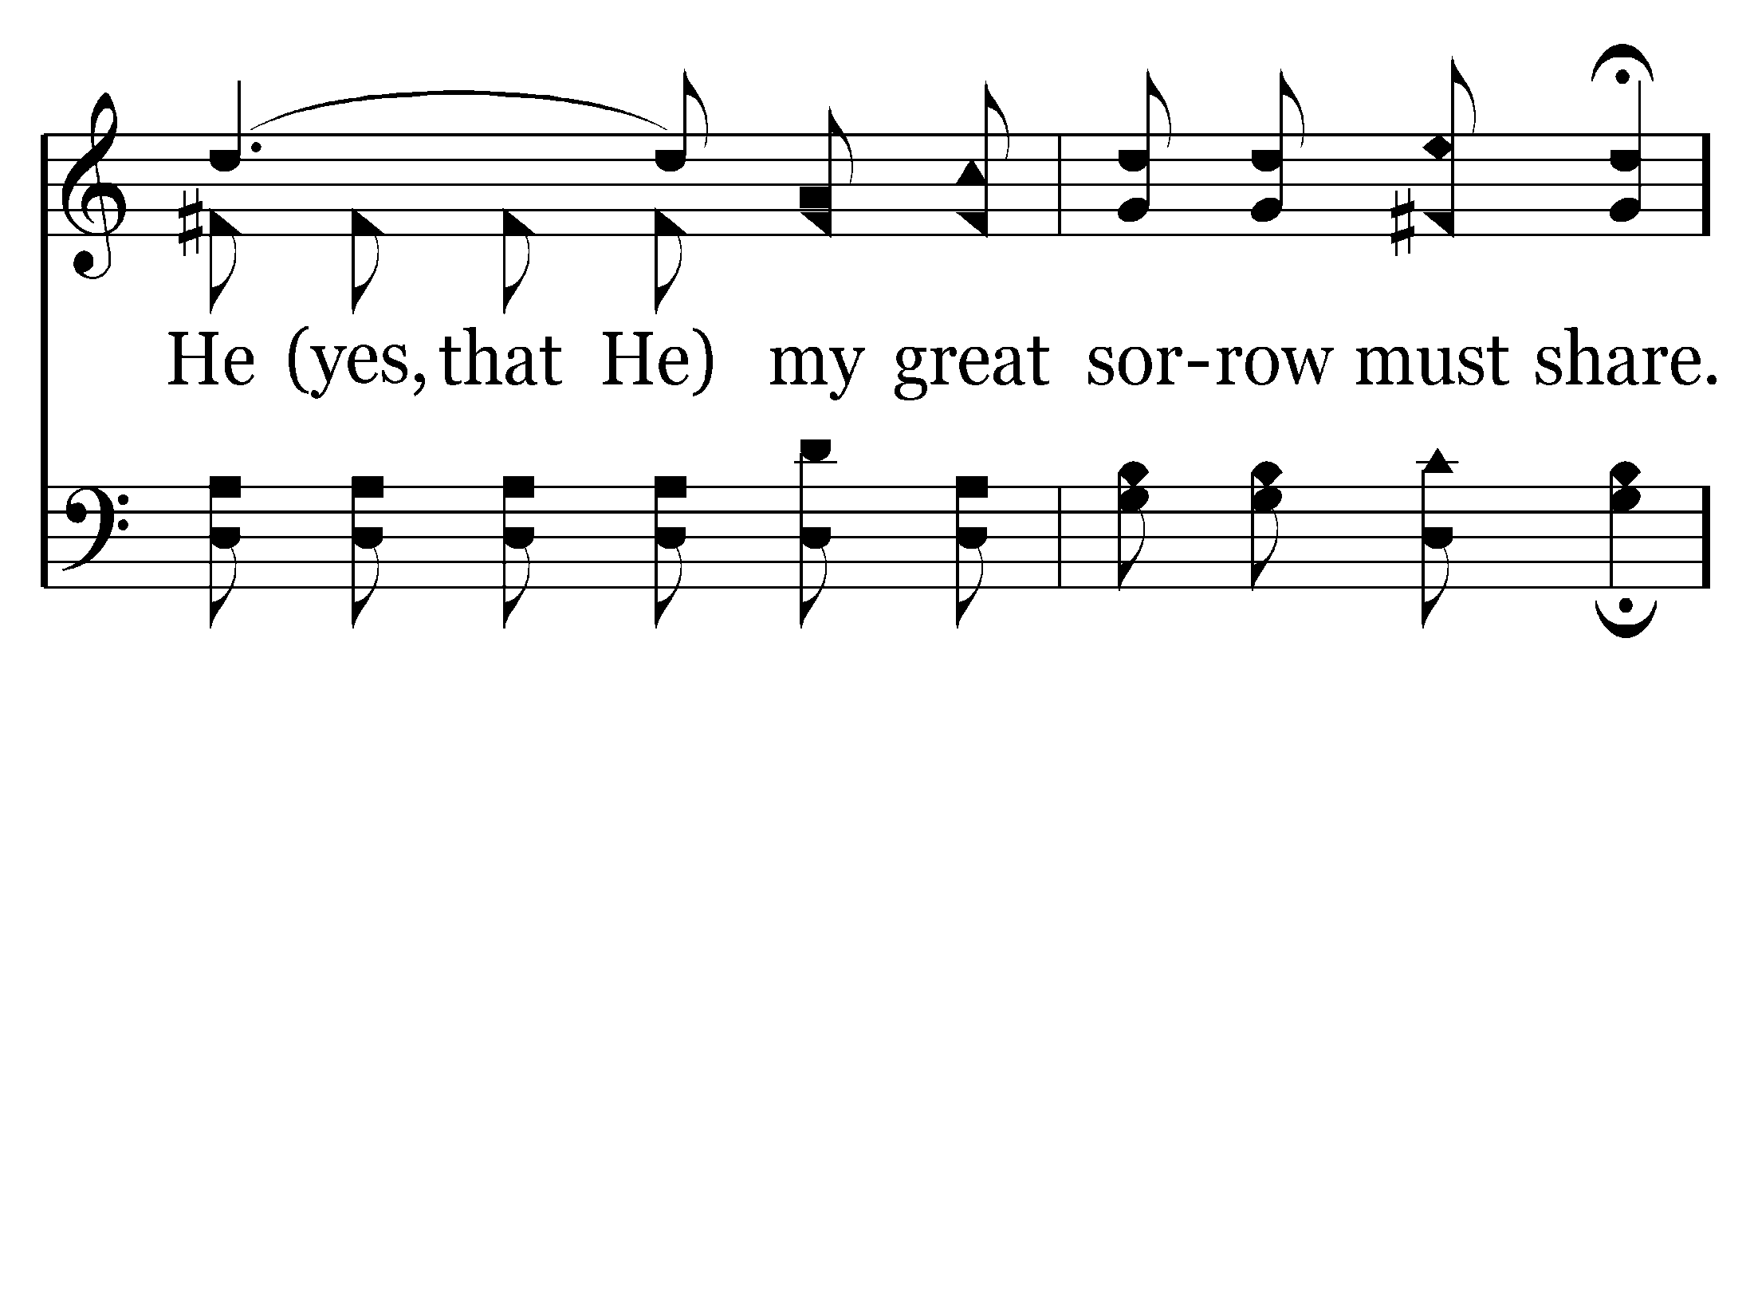
635 - A Beautiful Prayer - 3.3

Slide 37
635 - A Beautiful Prayer - C.1

Slide 38
635 - A Beautiful Prayer - C.2

Slide 39
635 - A Beautiful Prayer - C.3

Slide 40
635 - A Beautiful Prayer - C.4

Slide 41
635 - A Beautiful Prayer - C.5

Slide 42
635 - A Beautiful Prayer - C.6
End of Song

Slide 43
Lord’s Supper

Slide 44
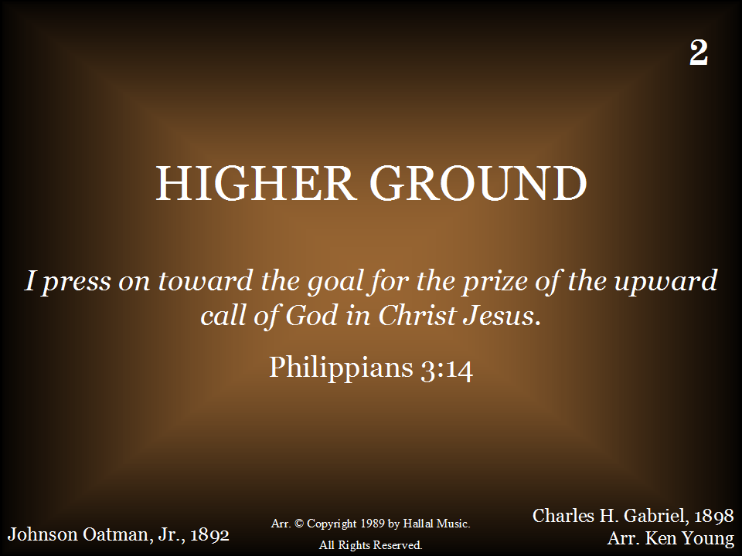

Slide 45
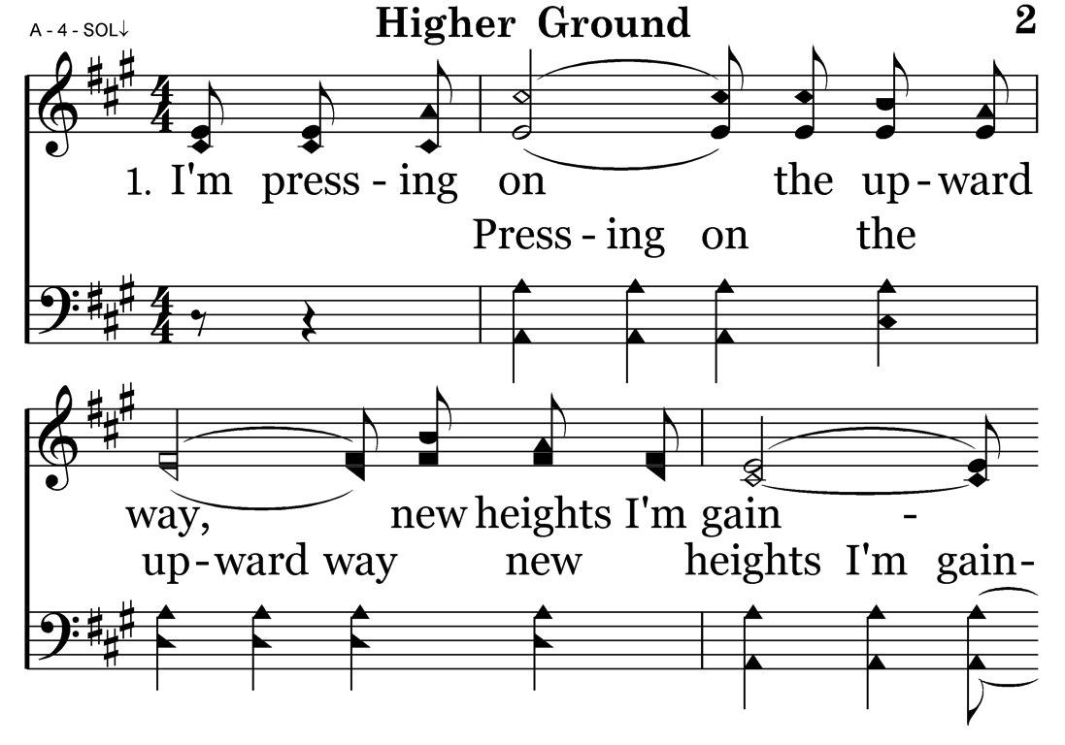

Slide 46
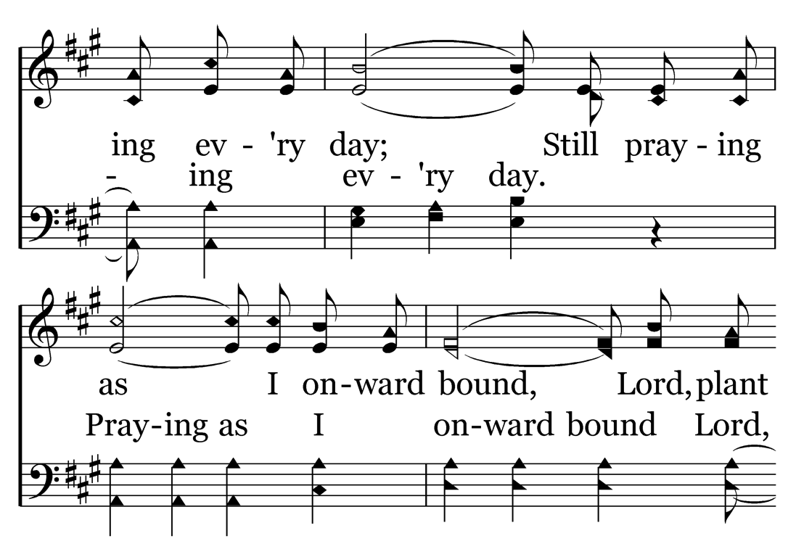

Slide 47
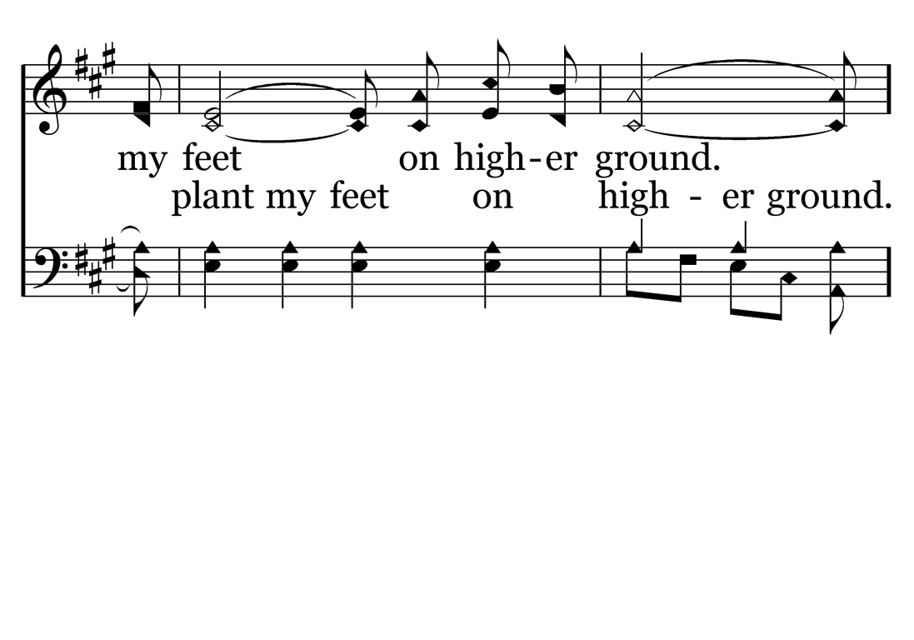

Slide 48
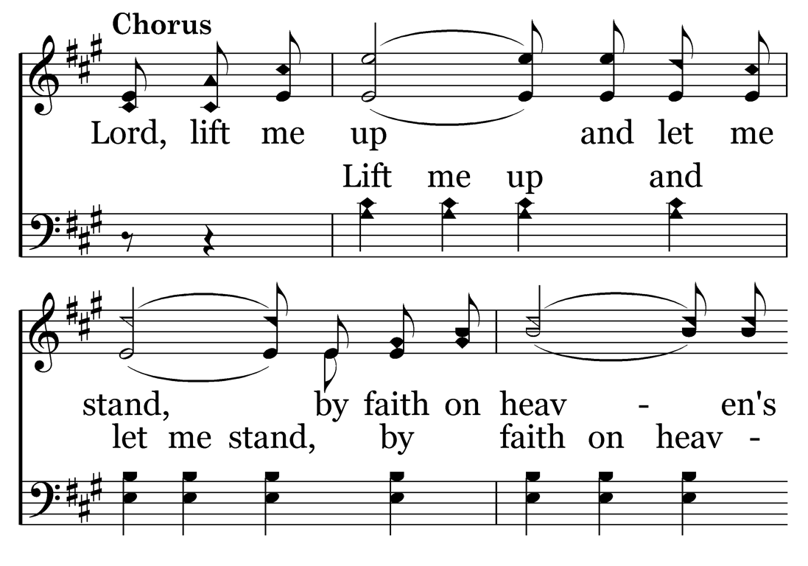

Slide 49
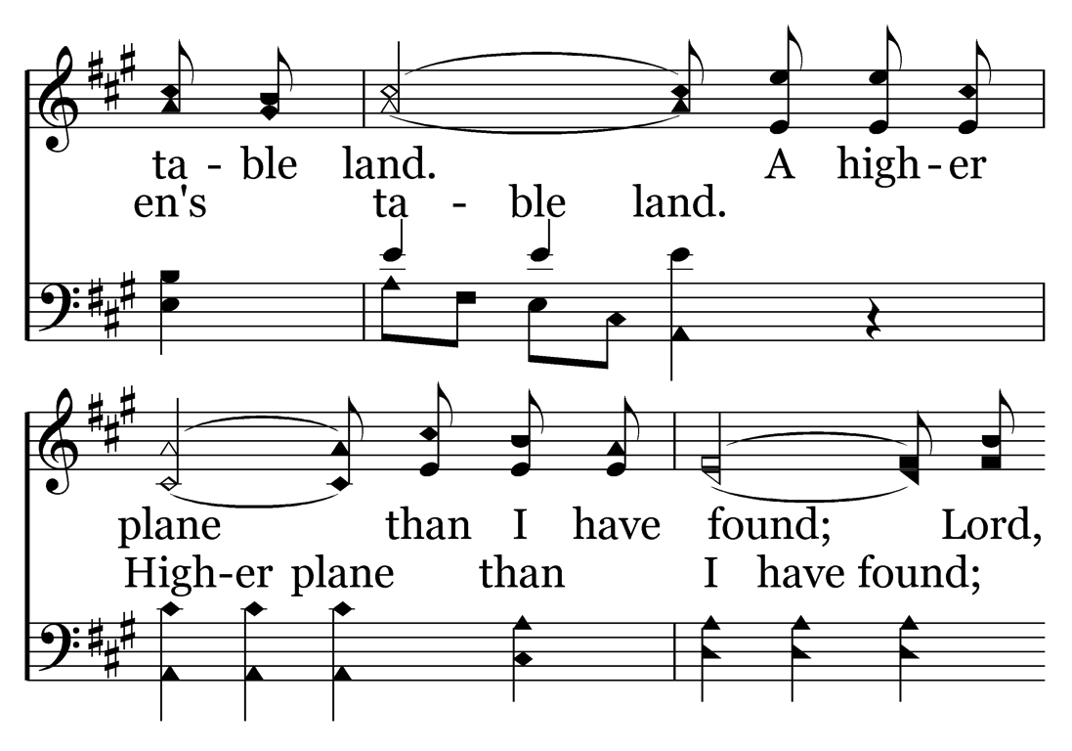

Slide 50
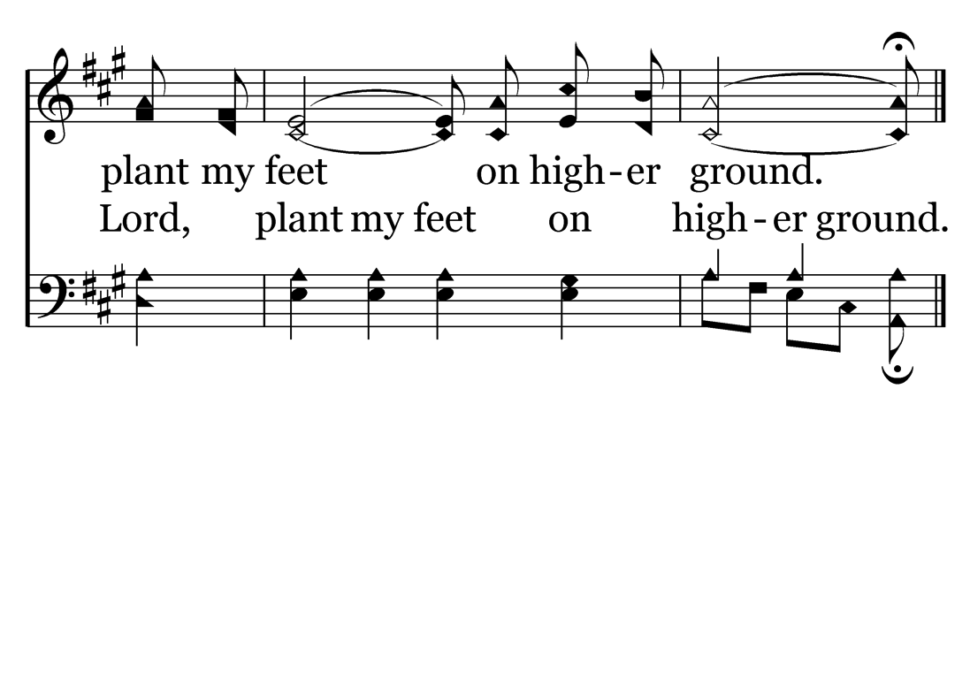

Slide 51
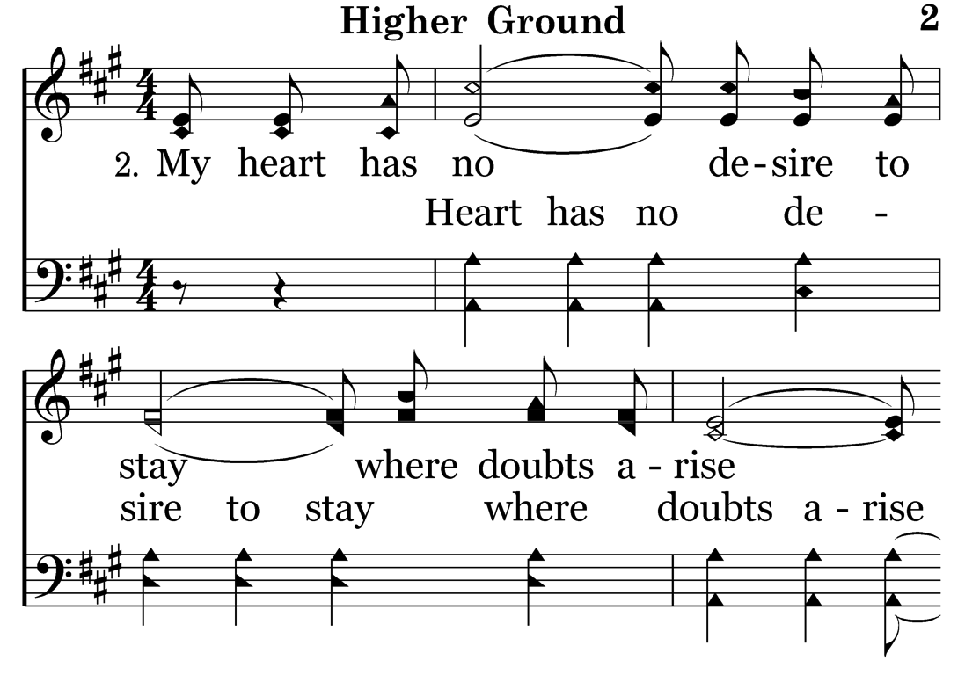

Slide 52
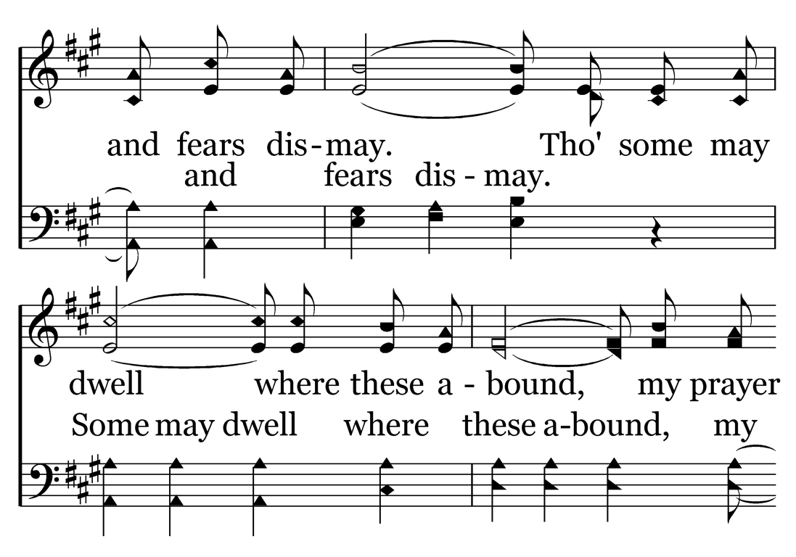

Slide 53
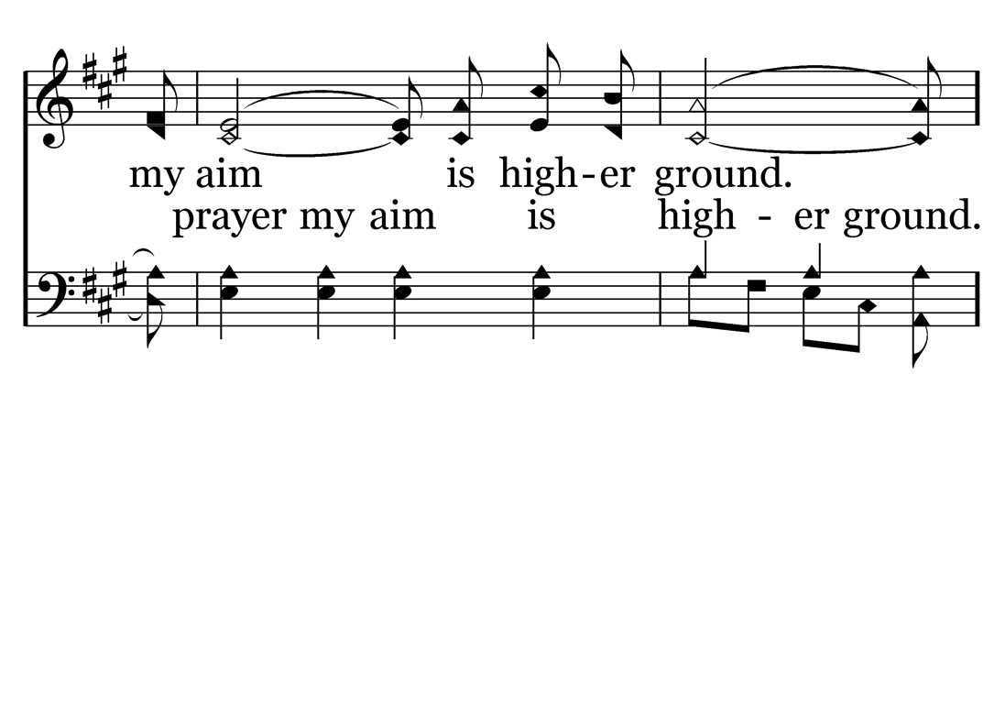

Slide 57
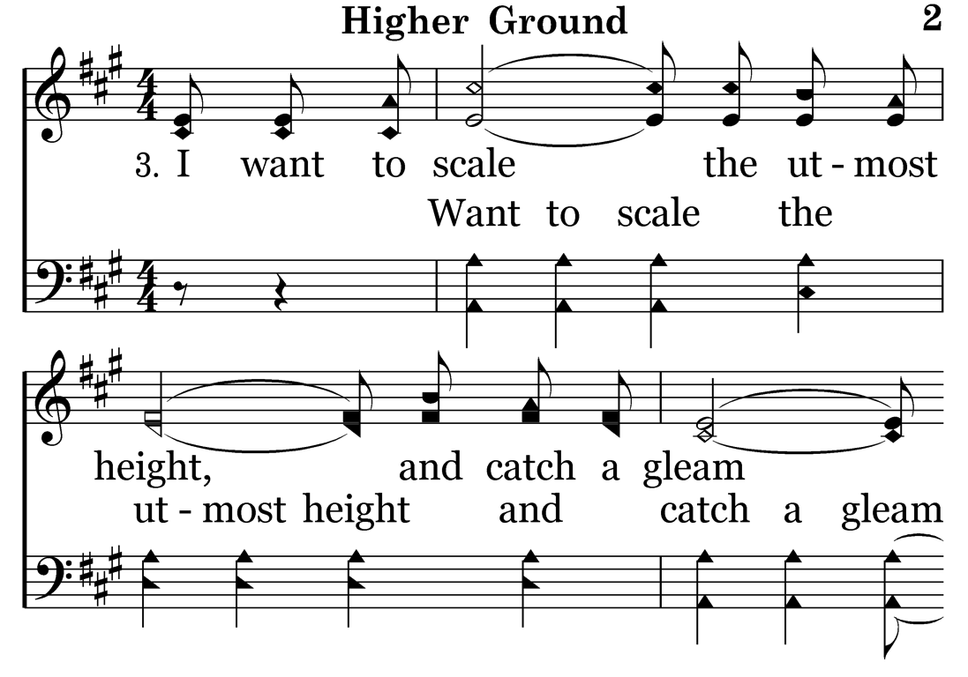

Slide 58
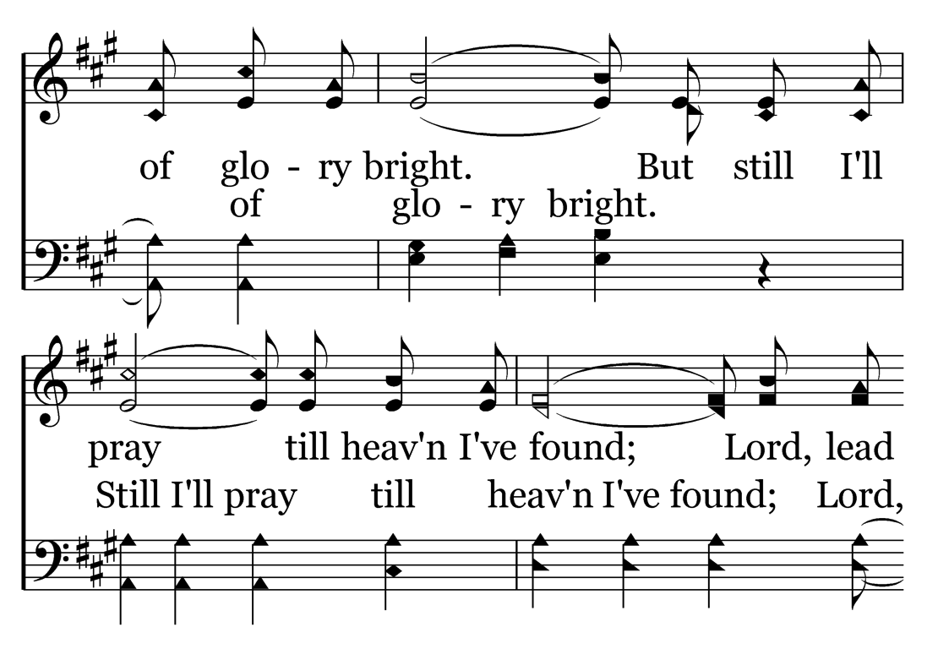

Slide 59
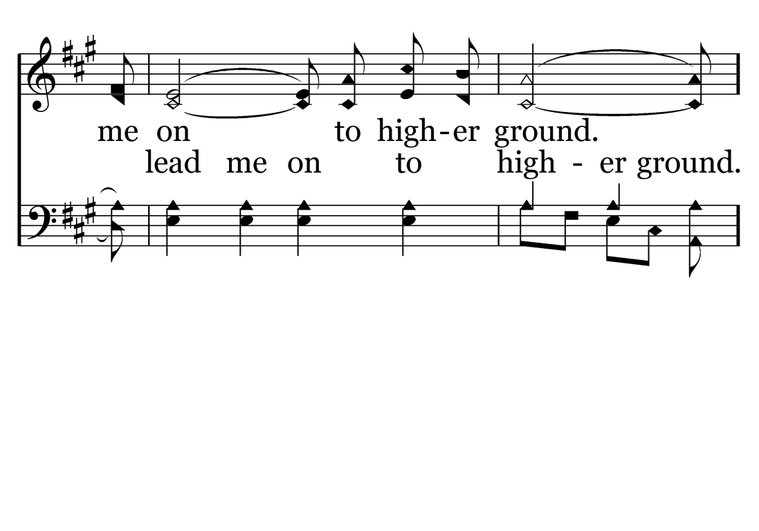

Slide 63
There’s a Stirring!

Slide 64
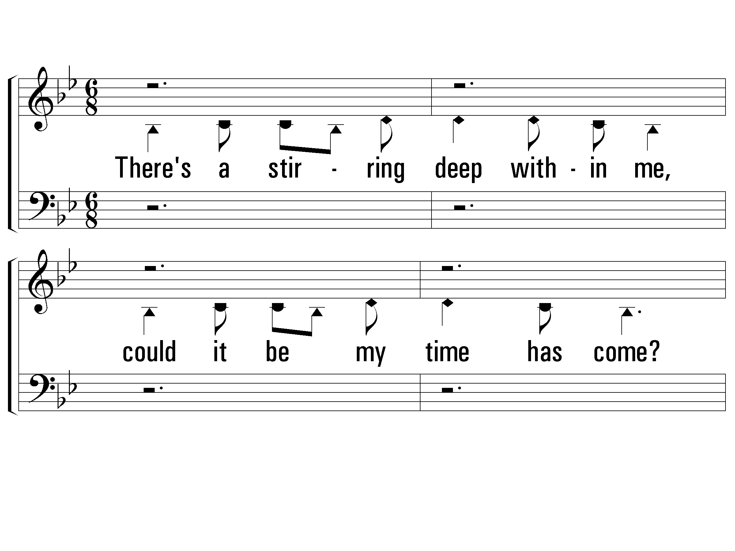
1 - There’s a Stirring
There's a stirring deep within me,
could it be my time has come?
When I see my Gracious Savior
face to face when all is done.
Is that His voice I am hearing,
come away my precious one.
Is He calling me?
Is He calling me?
I will rise up, rise up,
and bow down, and lay my crown
at His wounded feet.
There's a stir-ring deep within me.
Words & Music by: Annie Herring / Arr. by: Ken Young
Copyright © 1989 by Later Rain Music (ASCAP), Adm. by EMI
© 2002 The Paperless Hymnal™

Slide 65
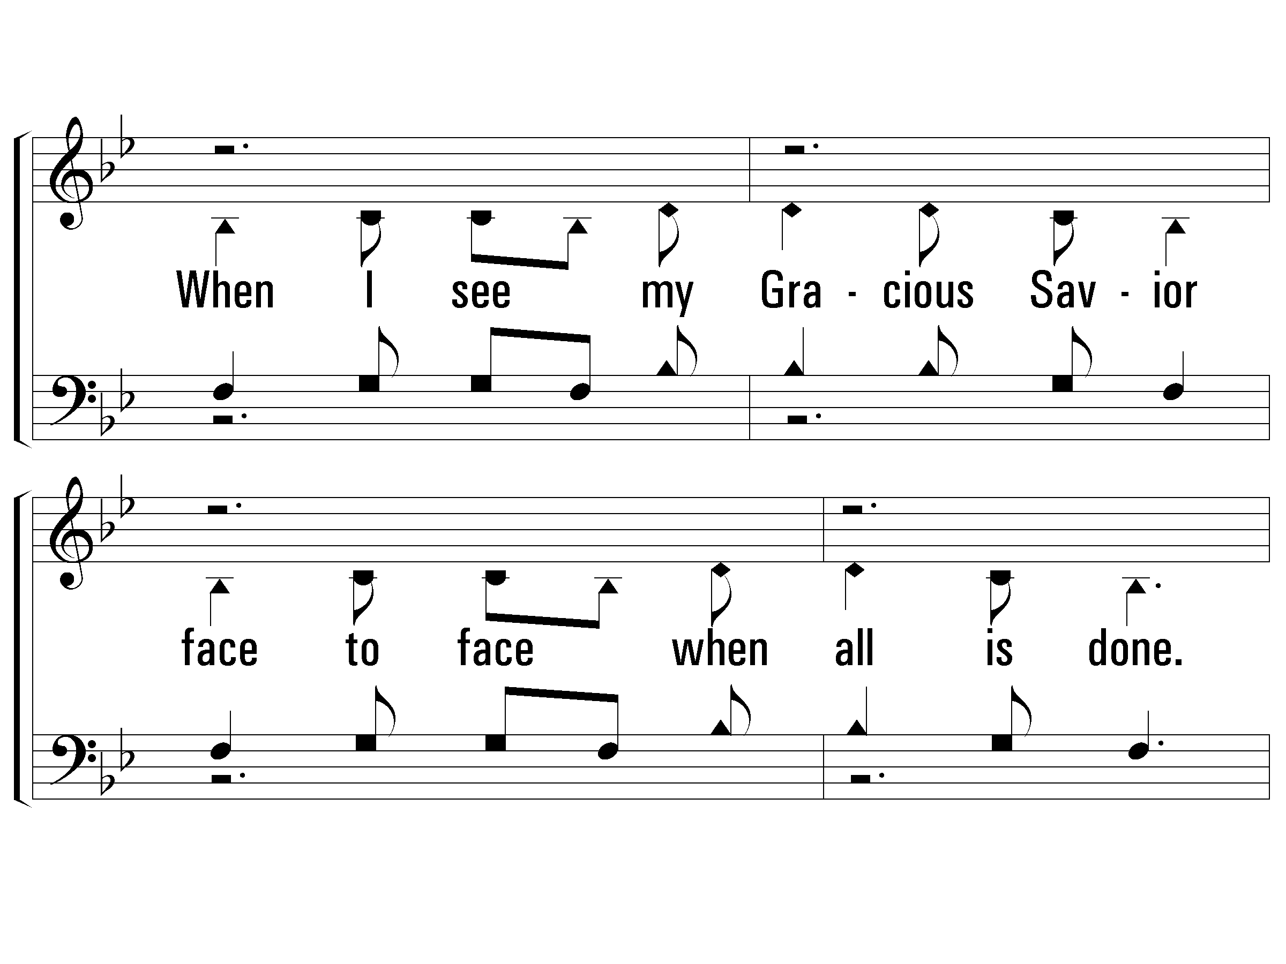
1 - There’s a Stirring
© 2002 The Paperless Hymnal™

Slide 66
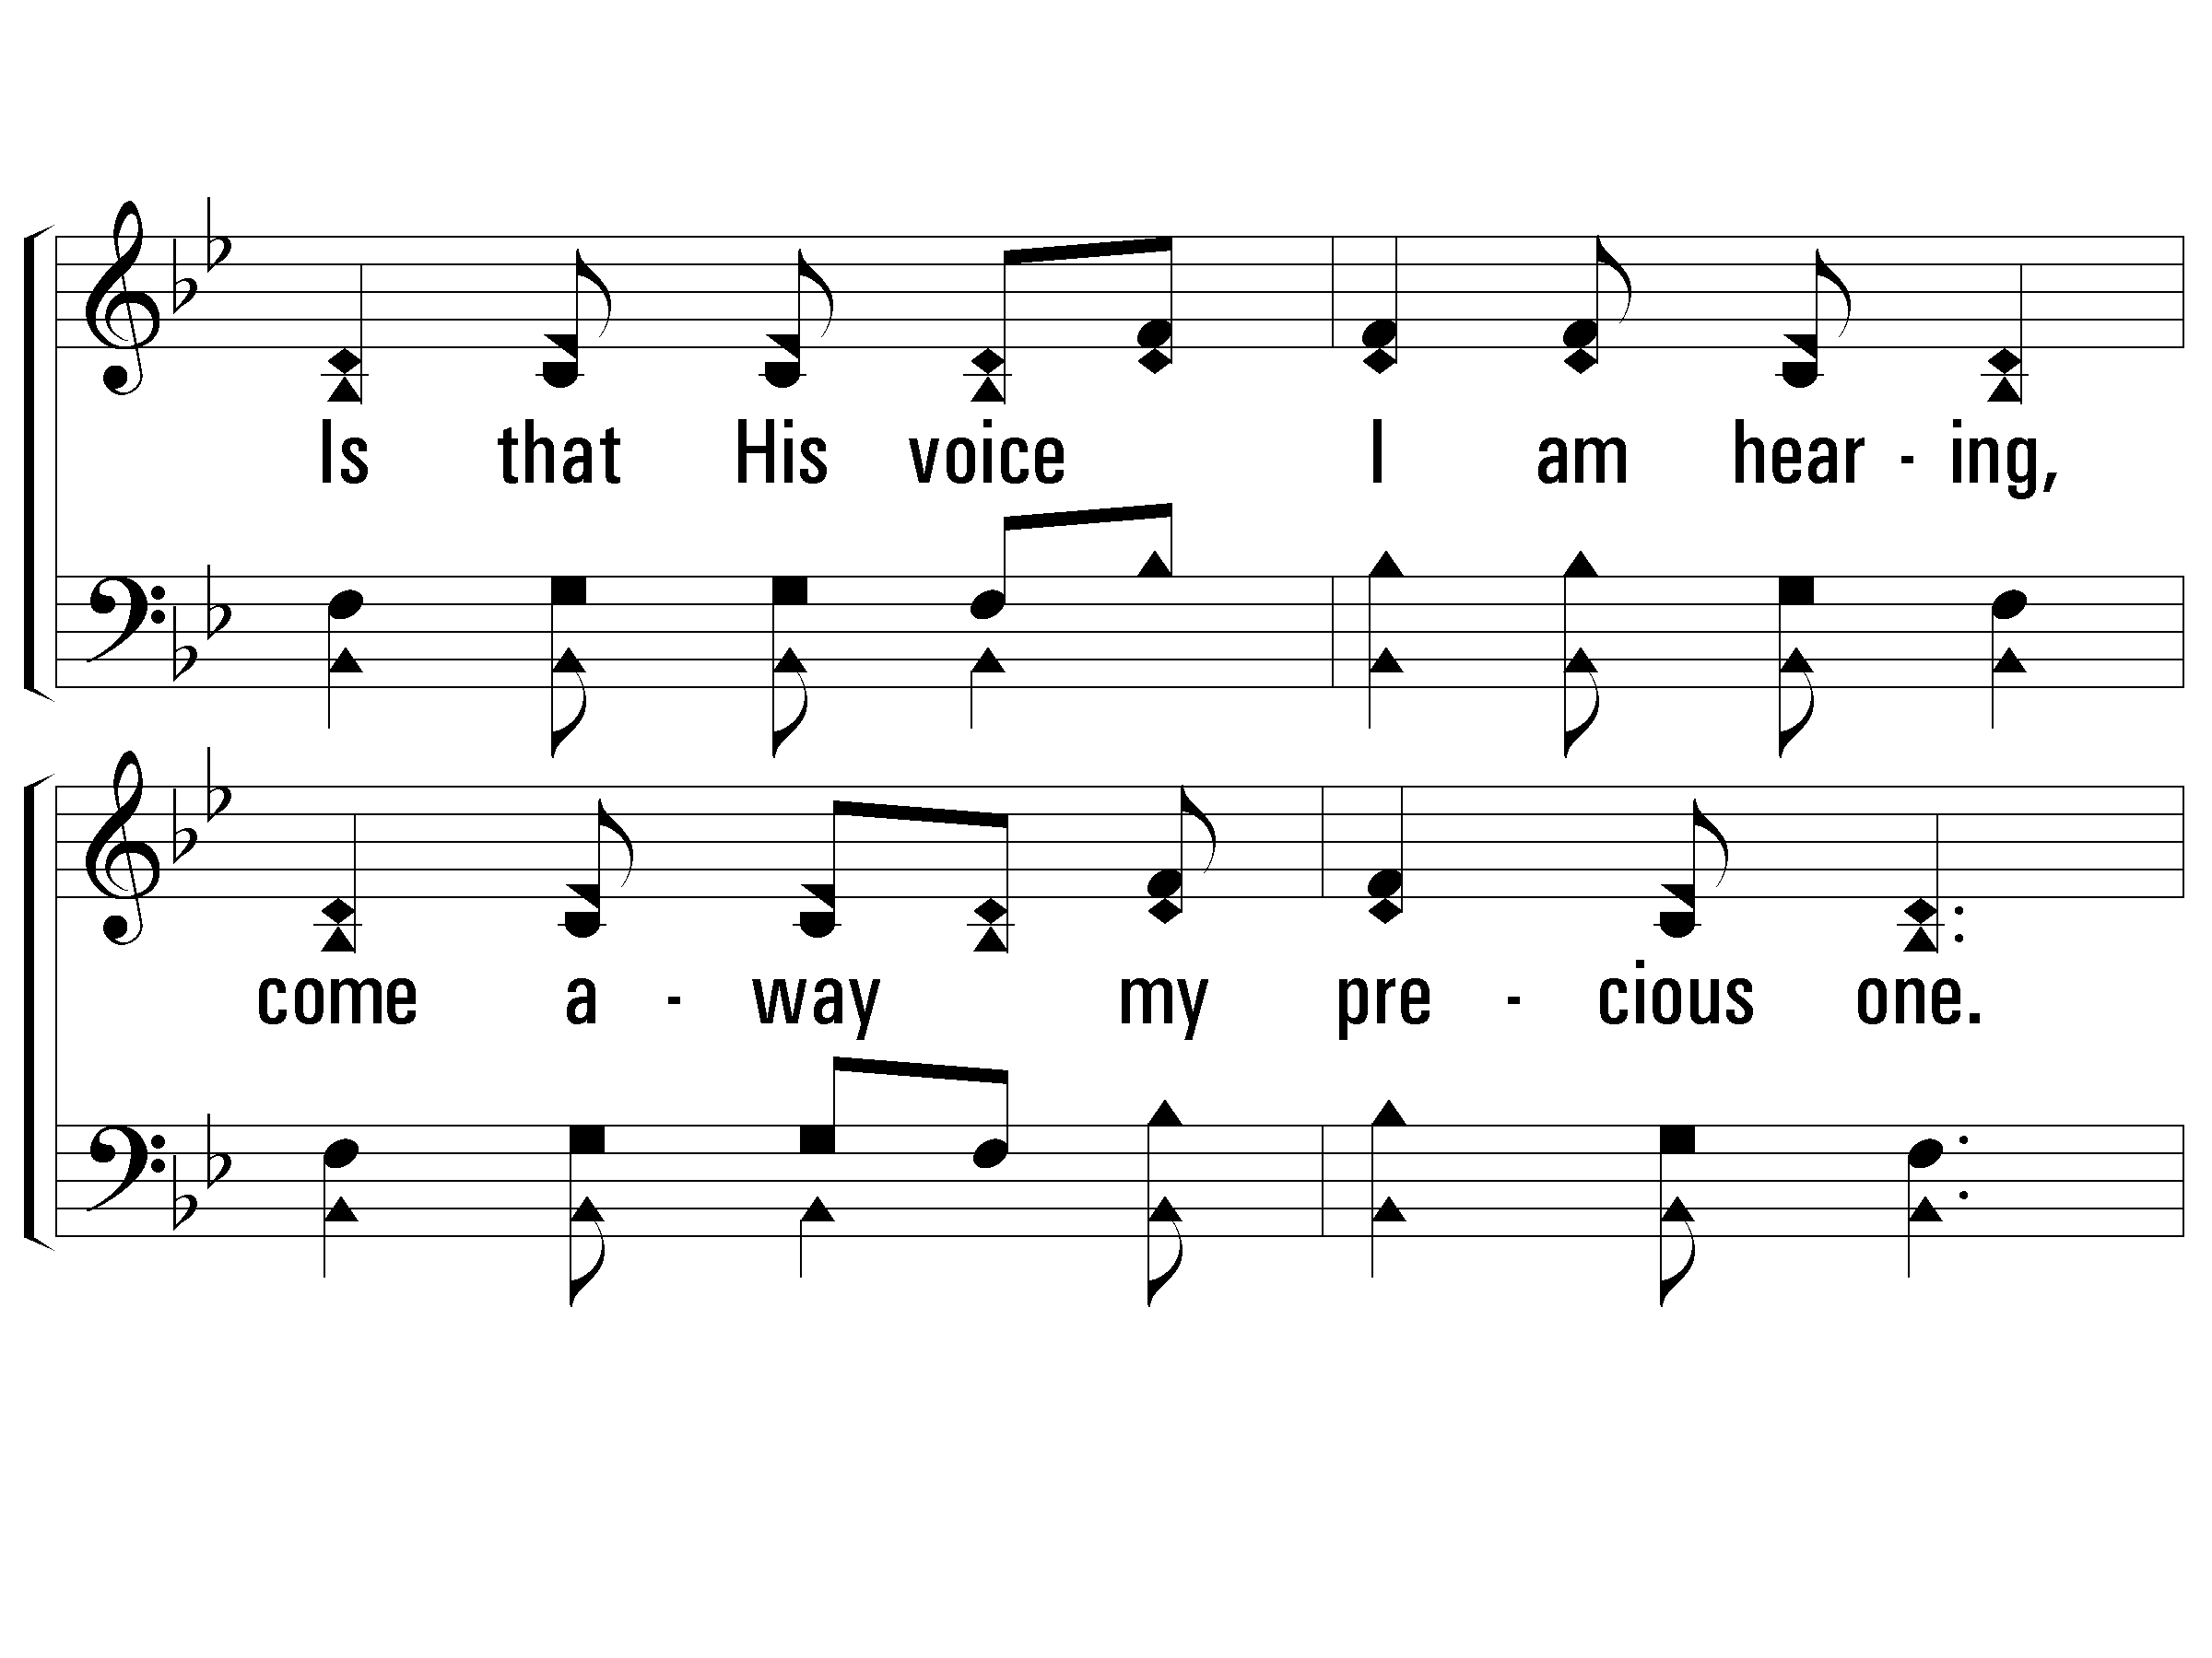
1 - There’s a Stirring
© 2002 The Paperless Hymnal™

Slide 67
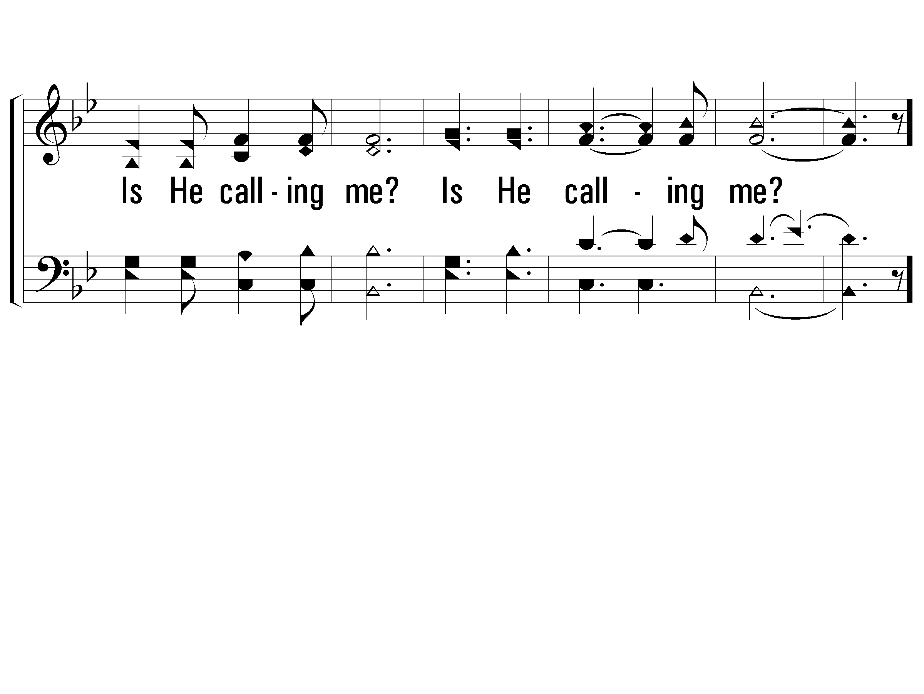
1 - There’s a Stirring
© 2002 The Paperless Hymnal™

Slide 68
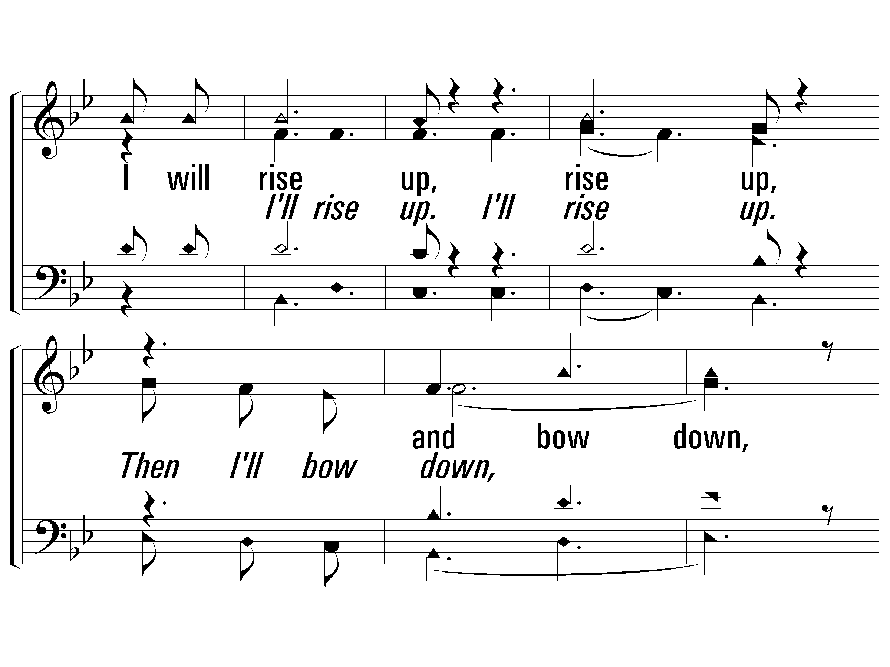
1 - There’s a Stirring
© 2002 The Paperless Hymnal™

Slide 69
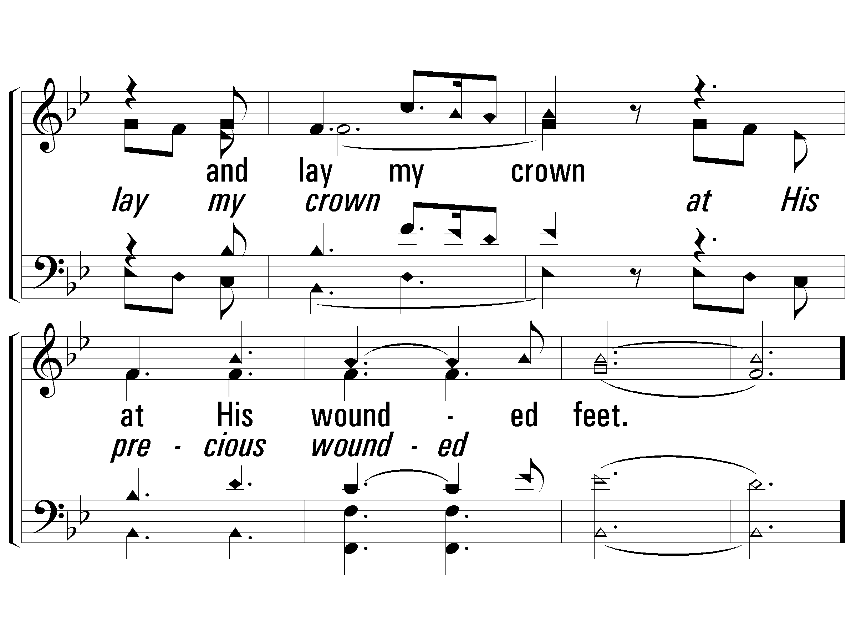
1 - There’s a Stirring
© 2002 The Paperless Hymnal™

Slide 70
2 - There’s a Stirring
Words & Music by: Annie Herring / Arr. by: Ken Young
Copyright © 1989 by Later Rain Music (ASCAP), Adm. by EMI
© 2002 The Paperless Hymnal™

Slide 71
2 - There’s a Stirring
© 2002 The Paperless Hymnal™

Slide 72
2 - There’s a Stirring
© 2002 The Paperless Hymnal™

Slide 73
2 - There’s a Stirring
© 2002 The Paperless Hymnal™

Slide 74
2 - There’s a Stirring
© 2002 The Paperless Hymnal™

Slide 75
2 - There’s a Stirring
© 2002 The Paperless Hymnal™

Slide 76
3 - There’s a Stirring
© 2002 The Paperless Hymnal™

Slide 77
3 - There’s a Stirring
© 2002 The Paperless Hymnal™

Slide 78
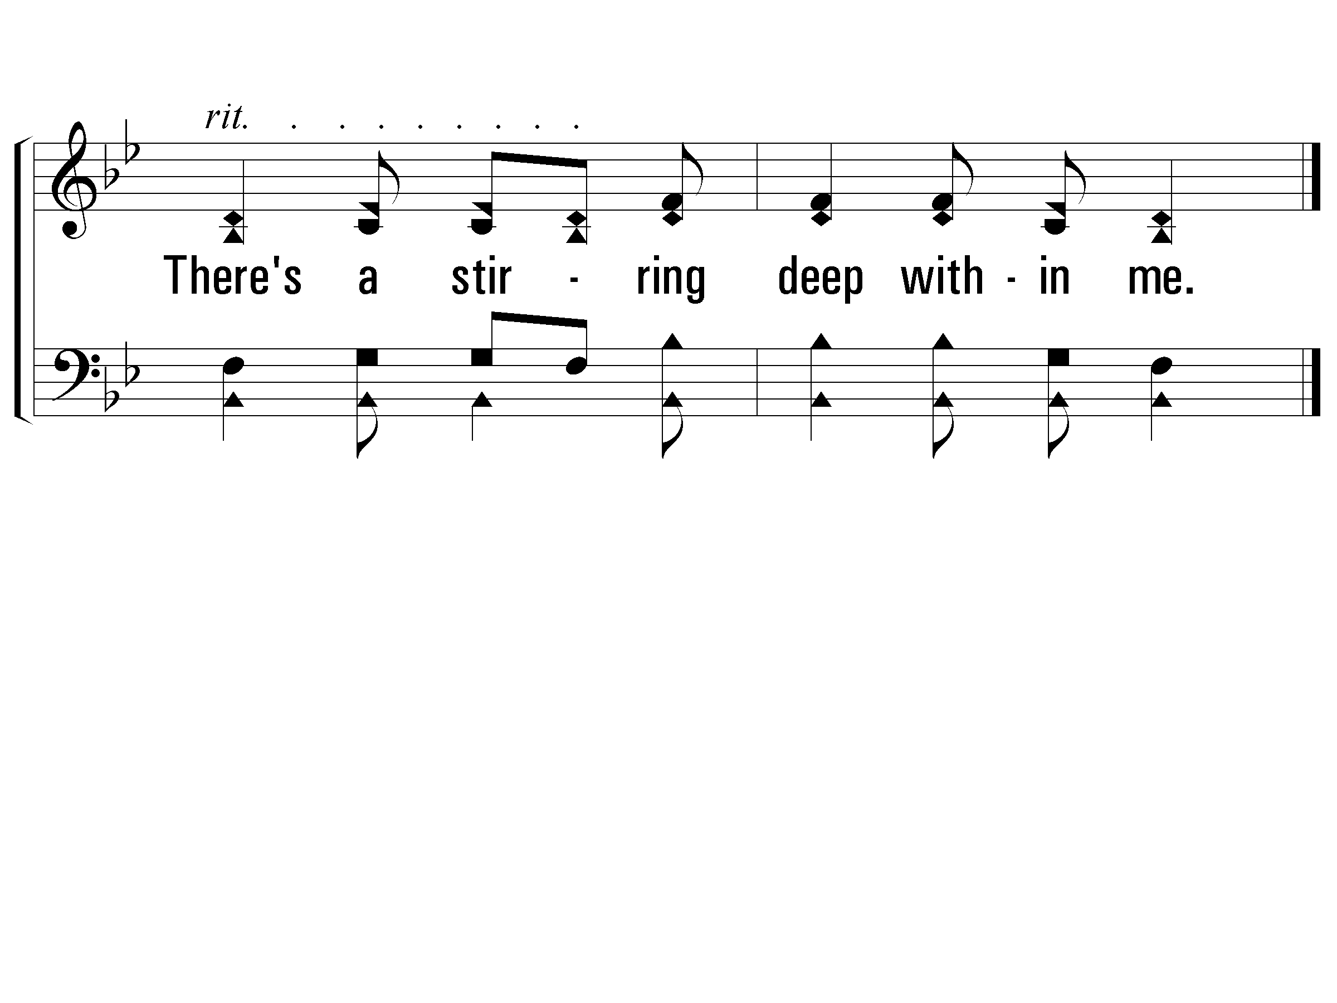
C - There’s a Stirring
© 2002 The Paperless Hymnal™

Slide 79
Sermon

Slide 80
WHY?
WHY?
Notes:
Lesson begins on next slide. Entire outline appears below for copying and printing purposes:
Why Do Bad Things Happen to Good People?
Job 1:1, 8, 13-18
Introduction:
A. Why do bad things happen to good people? A question pondered for ages.
B. Conversely, why do good things happen to bad people? (Cf. Jer. 12:1)
C. Likely, no man can fully answer either question. Can understand much about it.
D. Several things to consider while groping with the problem:
Discussion:
I. We Live in a World Cursed by Sin.
A. In the beginning everything was good - including man (Gen. 1:31; Ecc. 7:29).
B. Sin brought a curse upon man and the world. (Gen. 3:16-24)
1. Pain, suffering, and sorrow a part of dying process of man.
2. God removed man from the “tree of life” — immunity to death.
a. Without this immunity the body deteriorates — disease and pain.
b. Without this protection “nature” can be agent of death and destruction— accidents, etc.
C. No one is immune to this curse (Eccl. 9:2,3; 1 Cor. 15:22; Heb. 9:27).
II. We Must Give the Devil His Dues.
A. Saying “it is the Lord’s will” does not fully explain a tragedy.
1. Everything — even sin— is the “Lord’s will” in that He permits it to happen.
2. Not everything is Lord’s will in that he desires or causes it to happen.
B. We must recognize Satan’s role in both moral and physical evil in world.
1. Satan is source of sin and its consequences. (Gen. 3:5, 22; cf. John 8:44; 1 John 3:8).
2. Satan was the source of Job’s troubles.
3. Satan was source of Paul’s thorn. (2 Cor. 12:7).
4. Satan hindered Paul from going to Thessalonica (2 Thess.2:18).
5. Satan was source of woman’s infirmity (Luke 13:16).
III. We Are Limited in Our Vision.
A. Only God can see from beginning to end. (Ecc. 3:11).
B. Today’s trouble may be tomorrow’s blessing — but cannot see it today.
1. Joseph’s troubles (Gen. 45:8).
2. Paul’s troubles (Phil. 1:12-14).
3. Stephen’s death and persecution at Jerusalem (Acts 8:1-4).
C. “Worst thing that can happen” sometimes “best thing that could happen.”
IV. God Has the Final Word.
A. Ill: A child listens to father read story and laughs at villain’s behavior. Had already heard last page..
B. Would not be best for man to live in sinful world, immune from the effects of sin (cf. Jas. 1:2-4, 12).
C. God will remove the redeemed from such a world in due time.
1. Will be no more pain, sorrow and death. (Rev. 21:4)
2. No more bad things for good people, no good things for bad people.
Conclusion:
1. God will not allow us to be tempted (or tried) beyond limits. (1 Cor. 10:13).
2. One day we can live in a place with be no bad things or bad people.
Another Sermon by Edward O. Bragwell, Sr.

Slide 81
…Do Bad Things Happen to Good People
WHY?
Notes:
Why Do Bad Things Happen to Good People?
Job 1:1, 8, 13-18
Introduction:
Why do bad things happen to good people? A question pondered for ages.
B. Conversely, why do good things happen to bad people? (Cf. Jer. 12:1)
(Jer 12:1-2 NKJV) Righteous are You, O LORD, when I plead with You; Yet let me talk with You about Your judgments. Why does the way of the wicked prosper? Why are those happy who deal so treacherously? {2} You have planted them, yes, they have taken root; They grow, yes, they bear fruit. You are near in their mouth But far from their mind.
C. Likely, no man can fully answer either question. Can understand much about it.
D. Several things to consider while groping with the problem:

Slide 82
We Live in a World Cursed by Sin
WHY?
God made all things good – Gen. 1.31; Ecc. 7.29
Sin brought curse on man and world – Gen. 3.16-24
Notes:
We Live in a World Cursed by Sin.
[adv]
A. In the beginning everything was good - including man
(Gen 1:31 NKJV) Then God saw everything that He had made, and indeed it was very good. So the evening and the morning were the sixth day.
(Eccl 7:29 NKJV) Truly, this only I have found: That God made man upright, But they have sought out many schemes."
[adv]
B. Sin brought a curse upon man and the world. (Gen. 3:16-24)
1. Pain, suffering, and sorrow a part of dying process of man.
2. God removed man from the “tree of life” — immunity to death.
a. Without this immunity the body deteriorates — disease and pain.
b. Without this protection “nature” can be agent of death and destruction— accidents, etc.
[next slide]

Slide 83
We Live in a World Cursed by Sin
WHY?
God made all things good – Gen. 1.31; Ecc. 7.29
Sin brought curse on man and world – Gen. 3.16-24
None immune to this curse – Ecc. 9.2-3; 1 Cor. 15.22; Heb. 9.27
Notes:
C. No one is immune to this curse:
(Eccl 9:2-3 NKJV) All things come alike to all: One event happens to the righteous and the wicked; To the good, the clean, and the unclean; To him who sacrifices and him who does not sacrifice. As is the good, so is the sinner; He who takes an oath as he who fears an oath. {3} This is an evil in all that is done under the sun: that one thing happens to all. Truly the hearts of the sons of men are full of evil; madness is in their hearts while they live, and after that they go to the dead.
1 Cor. 15:22 For as in Adam all die…
Heb. 9:27 “It is appointed for man to die once…”
[next slide]

Slide 84
Give the Devil His Due
WHY?
³¹ “Simon, Simon, behold, * Satan has ⁴ demanded permission to * sift you like wheat; ³² but I * have prayed for you, that your faith may not fail; and you, when once you have turned again, * strengthen your brothers.” ^{LUKE 22}
So when He had dipped the morsel, He *took and *gave it to Judas, * the son of Simon Iscariot. ²⁷ After the morsel, * Satan then * entered into him. Therefore Jesus *said to him, “What you do, do quickly.” ^{John 13:26}
Notes:
II. We Must Give the Devil His Dues.
[adv]
Saying “it is the Lord’s will” does not fully explain a tragedy.
1.Everything — yes even sin— is under the LORD’s eye, in that He permits sin for now to happen.
2. Not everything is the Lord’s will in that he desires or causes it to happen.
B. We must recognize Satan’s role in both a moral and physical evil in world.
¹³ Let no one say when he is tempted, “ * I am being tempted ¹⁴ by God”; for God cannot be tempted ¹⁵ by evil, and He Himself does not tempt anyone. ¹⁴ But each one is tempted when he is carried away and enticed by his own lust. ¹⁵ Then * when lust has conceived, it gives birth to sin; and when * sin ¹⁶ is accomplished, it brings forth death. ^{16 *} Do not be ¹⁷ deceived, * my beloved brethren. ¹⁷ Every good thing given and every perfect gift is * from above, coming down from * the Father of lights, * with whom there is no variation or ¹⁸ shifting shadow.
[adv]

Slide 85
Give the Devil His Due
WHY?
Saying “it is the Lord’s will” doesn’t fully explain tragedy
Satan is the source of:
  Sin and its consequences
  ^{2Cor.12: 7} Because of the surpassing greatness of the * revelations, for this reason, to keep me from exalting myself, there was given me a * thorn in the flesh, a * messenger of Satan to ² torment me–to keep me from exalting myself
Notes:
Satan is source of sin and its consequences.
Gen 3:4-5
Then the serpent said to the woman, "You will not surely die. For God knows that in the day you eat of it your eyes will be opened, and you will be like God, knowing good and evil.“
In verses 7-12, we are granted a glance behind the scenes of this world. Satan, though a fallen creature, still is permitted access to the presence of God. His casting down to earth, mentioned in Revelation 12, is still future. He is spoken of in that chapter as, "the accuser of our brethren," and that is just what we see him doing here: he does not change. He accused Job of self-seeking in his apparent piety: in other words, that he was in large measure a hypocrite — just what presently we shall find the three friends insinuating. He virtually challenged God to test him by some catastrophe, when Job's skin-deep piety would be broken through, and he would curse the God whom he professed to regard.
The Lord accepted Satan's challenge and permitted the adversary to act against all that he had, but not against himself. Satan promptly acted and the disasters fell with devastating effect.
Joh 8:44 You are of your father the devil, and the desires of your father you want to do. He was a murderer from the beginning, and does not stand in the truth, because there is no truth in him. When he speaks a lie, he speaks from his own resources, for he is a liar and the father of it.
1Jn 3:8 He who sins is of the devil, for the devil has sinned from the beginning. For this purpose the Son of God was manifested, that He might destroy the works of the devil.
[adv]

Slide 86
Give the Devil His Due
WHY?
Saying “it is the Lord’s
will” doesn’t fully explain tragedy
Satan is the source of:
  Sin and its consequences
  Job’s trouble
  Paul’s thorn and hindrance
  Woman’s infirmity
Notes:
2. Satan was the source of Job’s troubles.
3. Satan was source of Paul’s thorn.
(2 Cor. 12:7) And lest I should be exalted above measure by the abundance of the revelations, a thorn in the flesh was given to me, a messenger of Satan to buffet me, lest I be exalted above measure.
4. Satan hindered Paul from going to Thessalonica
(1 Thess.2:18) Therefore we wanted to come to you — even I , Paul , time and again — but Satan hindered us
5. Satan was source of woman’s infirmity
(Luke 13:16) So ought not this woman, being a daughter of Abraham , whom Satan has bound — think of it—for eighteen years , be loosed from this bond on the Sabbath ?”
[next slide]

Slide 87
We Are Limited In Vision
WHY?
Only God can see from beginning to end – Ec. 3.11
Today’s trouble may be tomorrow’s blessing – cannot see it today:
  Joseph’s troubles – Gen. 45.7
Notes:
III. We Are Limited in Our Vision.
[adv] A. Only God can see from beginning to end.
(Ecc. 3:11 “…no one can find out the work that God does from beginning to end”).
[adv]
B. Today’s trouble may be tomorrow’s blessing — but cannot see it today.
[adv] 1. Joseph’s troubles
Gen 45:7 And God sent me before you to preserve a posterity for you in the earth, and to save your lives by a great deliverance.
[adv]

Slide 88
We Are Limited In Vision
WHY?
Only God can see from beginning to end – Ec. 3.11
Today’s trouble may be tomorrow’s blessing – cannot see it today:
  Joseph’s troubles – Gen. 45.7
  Paul’s troubles – Phil. 1.12-14
  Stephen’s death and persecution at Jerusalem – Acts 8.1-4
Notes:
2. Paul ’s troubles
Phil. 1:12-14 But I want you to know, brethren, that the things which happened to me have actually turned out for the furtherance of the gospel, (13) so that it has become evident to the whole palace guard, and to all the rest, that my chains are in Christ; (14) and most of the brethren in the Lord, having become confident by my chains, are much more bold to speak the word without fear.
[adv] 3. Stephen’s death and persecution at Jerusalem (Acts 8:1-4).
Act 8:1-4 Now Saul was consenting to his death. At that time a great persecution arose against the church which was at Jerusalem; and they were all scattered throughout the regions of Judea and Samaria, except the apostles. (2) And devout men carried Stephen to his burial, and made great lamentation over him. (3) As for Saul, he made havoc of the church, entering every house, and dragging off men and women, committing them to prison. (4) Therefore those who were scattered went everywhere preaching the word.
**** C. “Worst thing that can happen” sometimes “best thing that could happen.”

Slide 89
God Has Final Word
WHY?
We have already read the last page of the book.
Would not be best for man to live in a sinful world immune from its effects – Jas. 1.2-4, 12
God will remove the redeemed in due time
Notes:
IV. God Has the Final Word.
Ill: A child listens to father read story and laughs at villain’s behavior. Had already heard last page..
[adv] A. We have already read the last page of the book.
[adv] B. Would not be best for man to live in sinful world, immune from the effects of sin (cf. Jas. 1:2-4, 12).
Jas 1:2-4 My brethren, count it all joy when you fall into various trials, (3) knowing that the testing of your faith produces patience. (4) But let patience have its perfect work, that you may be perfect and complete, lacking nothing.
Jas. 1.12 Blessed is the man who endures temptation; for when he has been approved, he will receive the crown of life which the Lord has promised to those who love Him.
[adv] C. God will remove the redeemed from such a world in due time.
1. Will be no more pain, sorrow and death.
(Rev. 21:4) And God will wipe away every tear from their eyes; there shall be no more death, nor sorrow, nor crying. There shall be no more pain, for the former things have passed away."
2. No more bad things for good people, no good things for bad people.

Slide 90
…Do Bad Things Happen to Good People
WHY?
Notes:
Conclusion:
God will not allow us to be tempted (or tried) beyond limits. (1 Cor. 10:13).
2. One day we can live in a place with be no bad things or bad people.

Slide 91
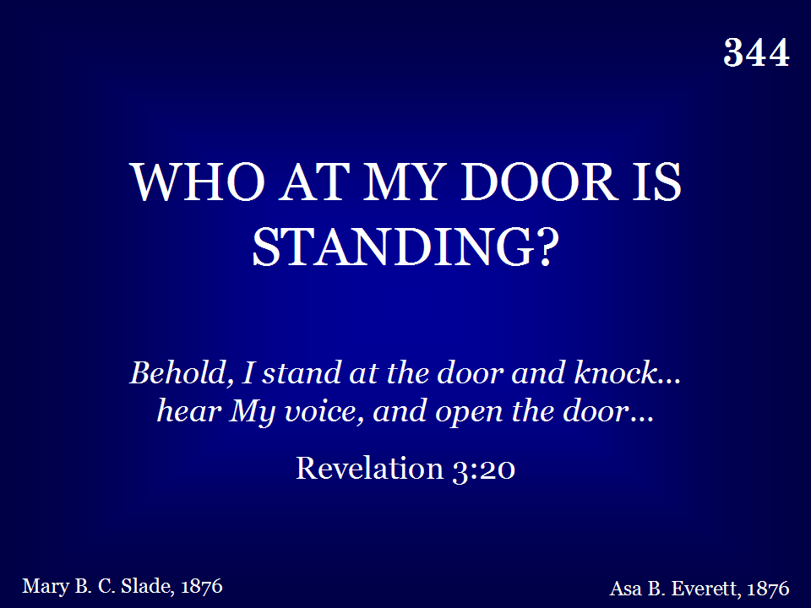
344 - Who At My Door Is Standing - Title

Slide 92

344 - Who At My Door Is Standing - 1.1

Slide 93

344 - Who At My Door Is Standing - 1.2

Slide 94

344 - Who At My Door Is Standing - C.1

Slide 95

344 - Who At My Door Is Standing - C.2
End of Verse 1

Slide 96

344 - Who At My Door Is Standing - 2.1

Slide 97

344 - Who At My Door Is Standing - 2.2

Slide 98
344 - Who At My Door Is Standing - C.1

Slide 99
344 - Who At My Door Is Standing - C.2
End of Verse 2

Slide 100

344 - Who At My Door Is Standing - 3.1

Slide 101

344 - Who At My Door Is Standing - 3.2

Slide 102
344 - Who At My Door Is Standing - C.1

Slide 103
344 - Who At My Door Is Standing - C.2
End of Song

Slide 104
Collection

