Slide 1
“But are you willing to recognize, you foolish fellow, that faith without works is useless? Was not Abraham our father justified by works when he offered up Isaac his son on the altar? You see that faith was working with his works, and as a result of the works, faith was perfected; and the Scripture was fulfilled which says, “And Abraham believed God, and it was reckoned to him as righteousness,” and he was called the friend of God. You see that a man is justified by works and not by faith alone.”
- James 2:20-24 (NASB)

Slide 2
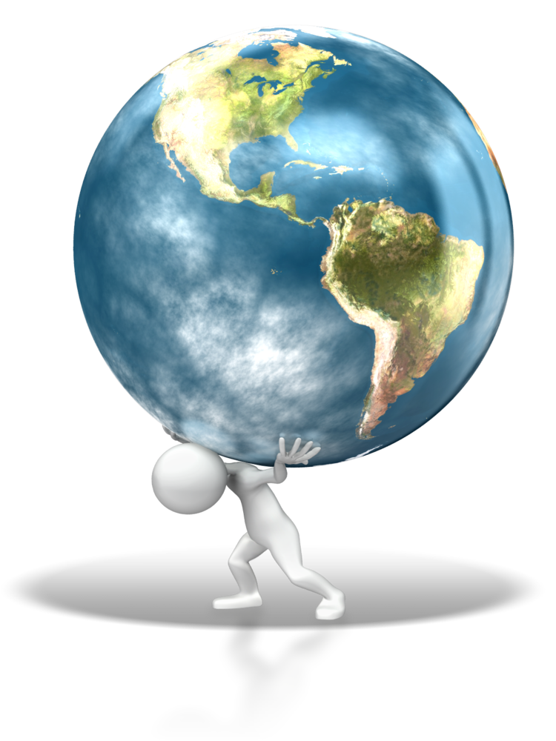
Does what I do in my Christian life impact where I spend eternity?
Do I have to do everything perfectly to be saved?
What if I die and I haven’t done everything right?

Slide 3
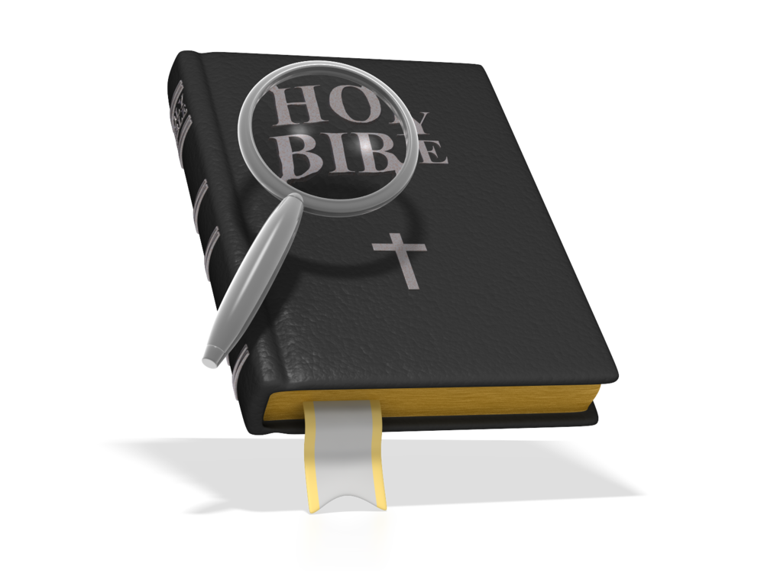
For by grace you have been saved through faith; and that not of yourselves, it is the gift of God;
- Ephesians 2:8 (NASB)

Slide 4
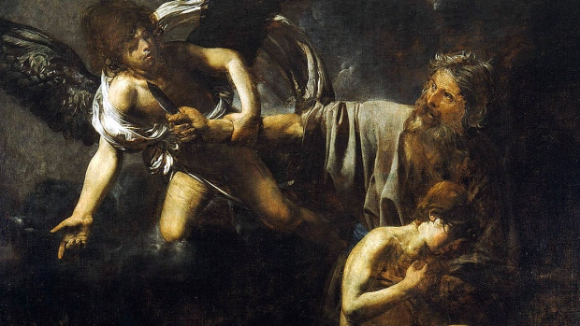
“But are you willing to recognize, you foolish fellow, that faith without works is useless? Was not Abraham our father justified by works when he offered up Isaac his son on the altar? You see that faith was working with his works, and as a result of the works, faith was perfected; and the Scripture was fulfilled which says, “And Abraham believed God, and it was reckoned to him as righteousness,” and he was called the friend of God. You see that a man is justified by works and not by faith alone.”
- James 2:20-24 (NASB)
Valentine de Boulogne - 1631

Slide 5
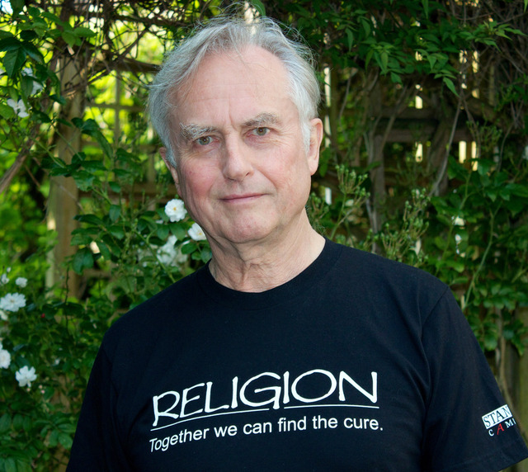
What is Faith?
“Faith is merely belief without evidence; a process of non-active thinking. It is a practice that only degrades our understanding of the natural world by allowing anyone to make a claim about nature that is based solely on their personal thoughts, and possibly distorted perceptions, that does not require testing against nature, has no ability to make reliable and consistent predictions, and is not subject to peer review.” Richard Dawkins, 2006
Hebrews 11:1 “Faith is the assurance of things hoped for, the conviction of things not seen.”
Belief/acceptance, leading to trust, leading to commitment (obedience)

Slide 6
What About Grace?
“And Abraham believed God, and it was reckoned to him as righteousness.”
Debit
Credit
Balance
Debit
Credit
Result
$1,000.00
$1,000.00
Sin
Dead
$1,000.00
$2,000.00
Sin
Dead
$1,000.00
$3,000.00
Sin
Dead
Rubber Duck
$ 00.00
Faith
Righteous

