Slide 1
Ephesians 4:14-16 (NASB)
¹⁴ As a result, we are no longer to be children, tossed here and there by waves and carried about by every wind of doctrine, by the trickery of men, by craftiness in deceitful scheming; ¹⁵ but speaking the truth in love, we are to grow up in all aspects into Him who is the head, even Christ, ¹⁶ from whom the whole body, being fitted and held together by what every joint supplies, according to the proper working of each individual part, causes the growth of the body for the building up of itself in love.

Slide 2
The Church – Why Am I Here?
What does “church” mean for me as an individual Christian?
Why am I here?
What am I supposed to be doing?
What is my role in the church?

Slide 3
The Church – The Definition Problem
Society/culture has redefined what the church is, and in doing so, has redefined its purpose.
As individual Christians, we are becoming more and more separated from the “church.”
The problem is in the definition!
We have forgotten what the church is and what its purpose is.

Slide 4
The Church – The Personal Problem – “Me”
I take care of myself
I work for myself
I answer to myself, and only myself
I attend “church” for what I get out of it
“Church” is personal
“Church” is private
“Church” is devotional – but just for me

Slide 5
The Church – Dedicated to “We”
Different backgrounds
Different personalities
Different cultures
Otherwise disconnected people, connected by the love of God and the blood of Christ!

Slide 6
The Church – Ephesians 4:11-16
Point of the chapter – Unity of the Church
Verses 1-3 – Attitudes required for unity – Humility, Gentleness, Patience, Love
Verses 4-6 – Underlying facts of unity – One Body, one Spirit, one hope, one Lord, one faith, one baptism, one God
Verses 7-8 – Christ gave gifts which generate and encourage unity

Slide 7
The Church – Ephesians 4:11-16
¹¹ And He gave some as apostles, and some as prophets, and some as evangelists, and some as pastors and teachers, ¹² for the equipping of the saints for the work of service, to the building up of the body of Christ; ¹³ until we all attain to the unity of the faith, and of the knowledge of the Son of God, to a mature man, to the measure of the stature which belongs to the fullness of Christ.

Slide 8
The Church – Ephesians 4:11-16
¹⁴ As a result, we are no longer to be children, tossed here and there by waves and carried about by every wind of doctrine, by the trickery of men, by craftiness in deceitful scheming; ¹⁵ but speaking the truth in love, we are to grow up in all aspects into Him who is the head, even Christ, ¹⁶ from whom the whole body, being fitted and held together by what every joint supplies, according to the proper working of each individual part, causes the growth of the body for the building up of itself in love.

Slide 9
The Church – What Are the Gifts?
Apostles and Prophets – Revealers of the Word
And He gave some apostles, and some prophets, and some evangelists, and some pastors and teachers…
Evangelists – Proclaimers of the Word
Pastors – Shepherds to feed the flock and help the church function in accordance with the Word
Teachers – Explainers of the Word

Slide 10
The Church – What Are the Gifts?
How we sometimes view this:
…for the equipping of the saints for the work of service, to the building up of the body of Christ
Christ gave evangelists, pastors and teachers
For equipping the saints
For the work of service
To the building up of the body of Christ

Slide 11
The Church – What Are the Gifts?
How the Holy Spirit meant it:
…for the equipping of the saints for the work of service, to the building up of the body of Christ
Christ gave evangelists, pastors and teachers for the equipping of the saints for the work of service
to (for the purpose of) the building up (edifying) of the body of Christ!

Slide 12
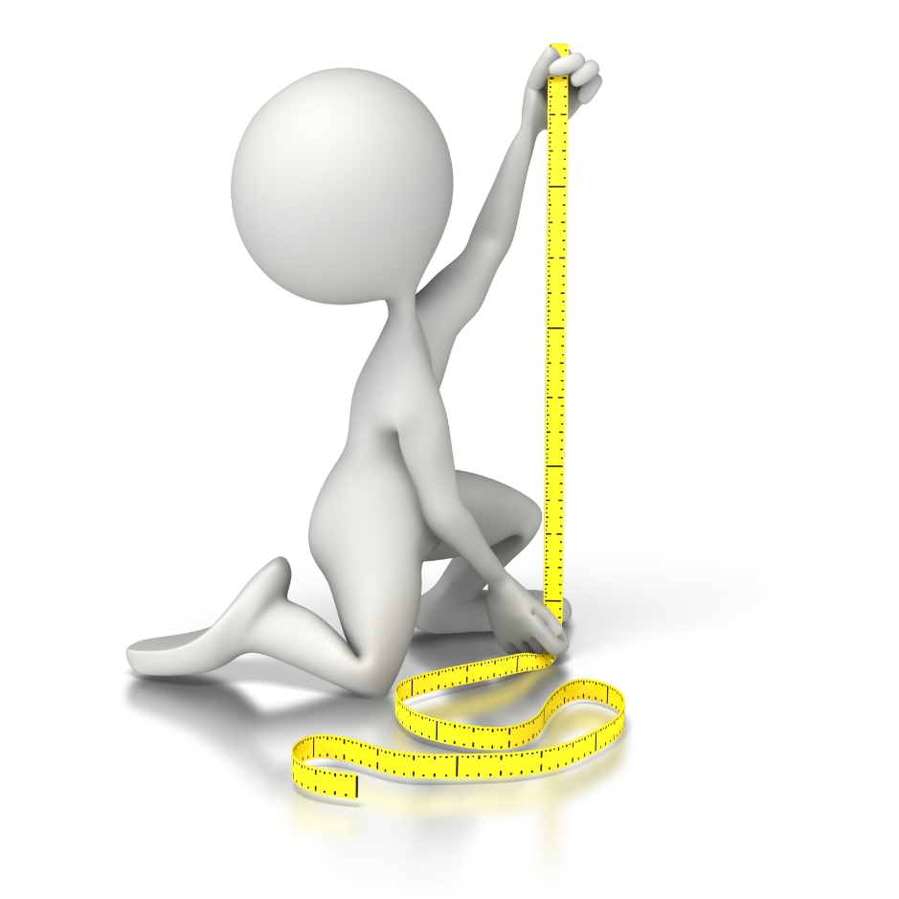
The Church – The End Result
ALL attain the unity of the faith
…until we all attain to the unity of the faith, and of the knowledge of the Son of God, to a mature man, to the measure of the stature which belongs to the fullness of Christ.
ALL attain the unity of the knowledge of the Son of God
ALL attain maturity

Slide 13
The Church – The End Result
ALL attain the measure of the stature which belongs to the fullness of Christ
…until we all attain to the unity of the faith, and of the knowledge of the Son of God, to a mature man, to the measure of the stature which belongs to the fullness of Christ.
Something which can be measured
Measuring against the stature of Christ
Measuring against the fullness (completeness) of the stature of Christ
We are to grow until we are ALL completely like Christ!

Slide 14
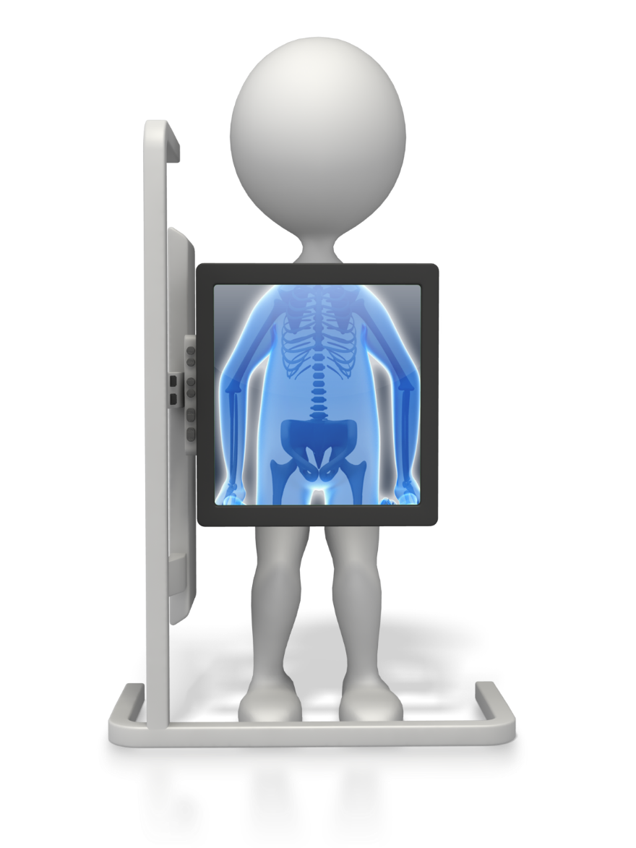
The Church – What Every Joint Supplies
The entire body is fit together and held together by the joints
Each individual part doing its job
The joints are not the individual parts, but connect them!
The result is growth and the building up of the church
This is something that only happens from the inside!

Slide 15
The Church – Bound together in love
We are in a group of people that we may not, under normal circumstances befriend, much less join with in a family
We are joined together by the love of God and the blood of Christ
We are learning to love one another as the ekklesia of God, in a world that rejects the church as unnecessary and full of extremists and hypocrites
We are not “holy” and “pure” as the world defines it
We are a group of unholy and impure people made holy and pure by the blood of Christ.
We are working together to grow up together to become like Christ.

